Slide 1
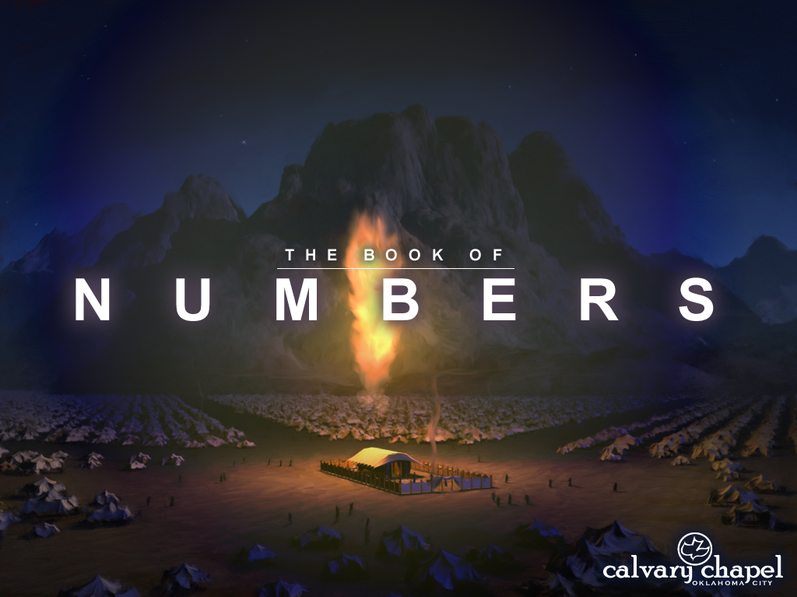


A CD of this message will available immediately following the service …
… or you may download a podcast later in this week
1 8 – 2 0

Slide 2
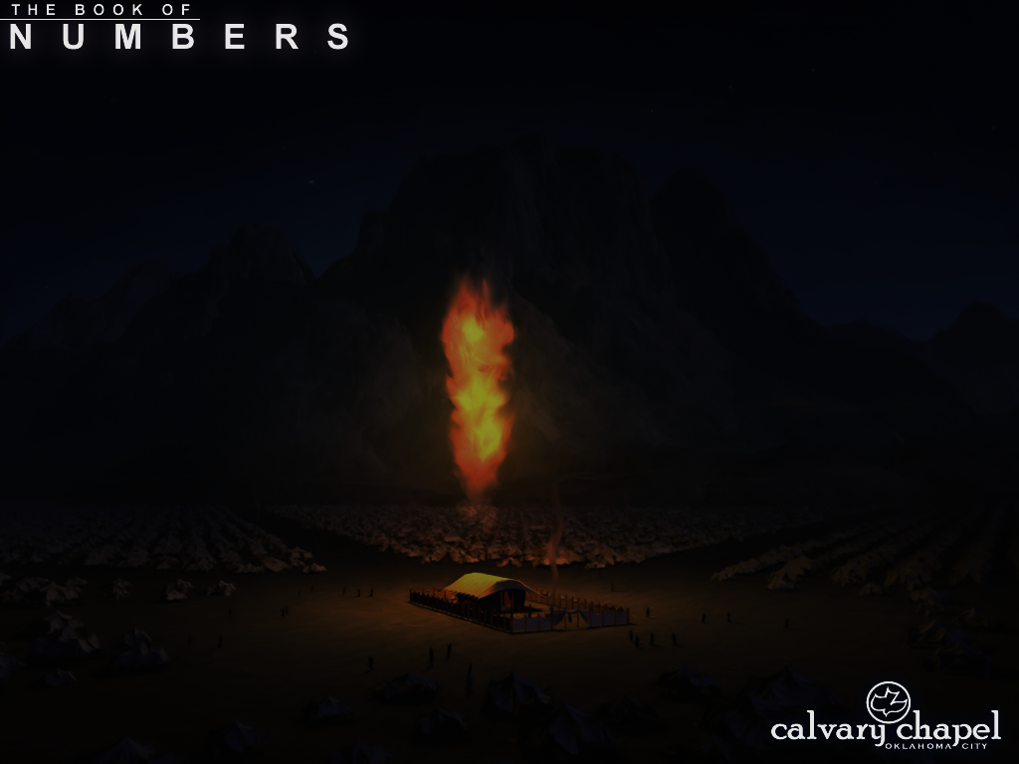
1 8 – 2 0
2x the Lord spoke directly to Aaron
Here (in chapter 18) and Lev. 10:8 (after the death of Nadab and Abihu)
Bear ~ endure and remove

Slide 3
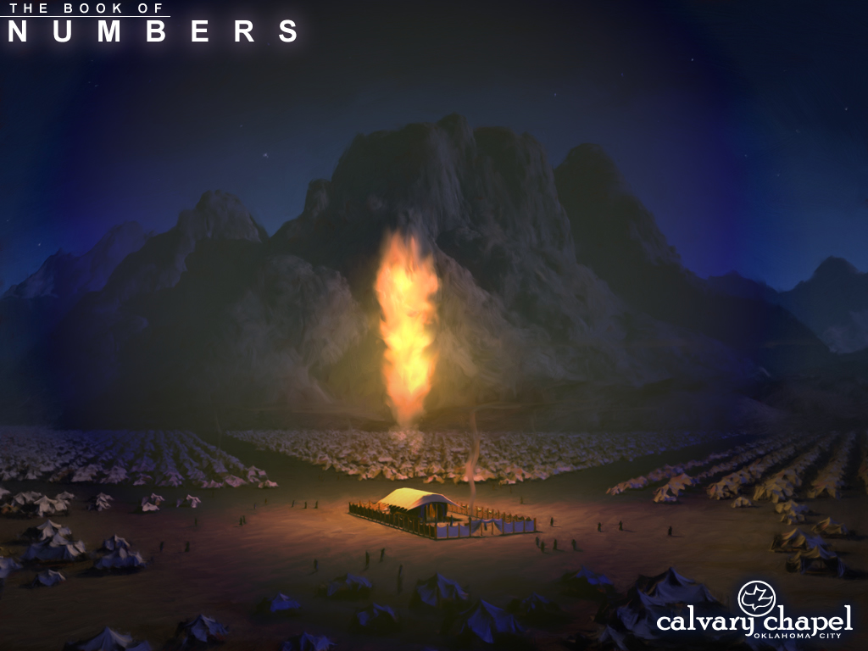
1 8 – 2 0

Slide 4
1 8 – 2 0
Salary, from Latin word salarium – salt money

Slide 5
1 8 – 2 0

Slide 6
1 8 – 2 0
Matthew Henry ~ “They had no grounds to occupy, no land to till, no vineyards to dress, no cattle to tend, no visible estate to take care of.”

Slide 7
1 8 – 2 0

Slide 8
1 8 – 2 0
Red (adom)
Without blemish
Never yoked
Performed by non-Aaronite
Outside camp
Wholly consumed

Slide 9
1 8 – 2 0
Three animals taken “outside the camp”
1. Scapegoat (Lev. 16) ~ personal guilt of sin
Heb. 10:17 ~ Their sins and their lawless deeds I will remember no more.
2. Living bird (Lev. 14) ~ resurrection through death
Rom. 6:5 ~ For if we have been united together in the likeness of His death, certainly we also shall be in the likeness of His resurrection,

Slide 10
1 8 – 2 0
Three animals taken “outside the camp”
3. Red heifer (Num. 19) ~ defilement of sin
John 13:10 ~ He who is bathed needs only to wash his feet, but is completely clean;

Slide 11
1 8 – 2 0

Slide 12
1 8 – 2 0
Ps. 32: 3-4 ~ ³ When I kept silent, my bones grew old
Through my groaning all the day long.
⁴ For day and night Your hand was heavy upon me;
My vitality was turned into the drought of summer.
Selah

Slide 13
1 8 – 2 0

Slide 14
1 8 – 2 0
2 Cor. 7:1 ~ Having therefore these promises, dearly beloved, let us cleanse ourselves from all filthiness of the flesh and spirit, perfecting holiness in the fear of God.

Slide 15
1 8 – 2 0

Slide 16
1 8 – 2 0
Prov. 14:12 ~ There is a way that seems right to a man,
But its end is the way of death.

Slide 17
1 8 – 2 0

Slide 18
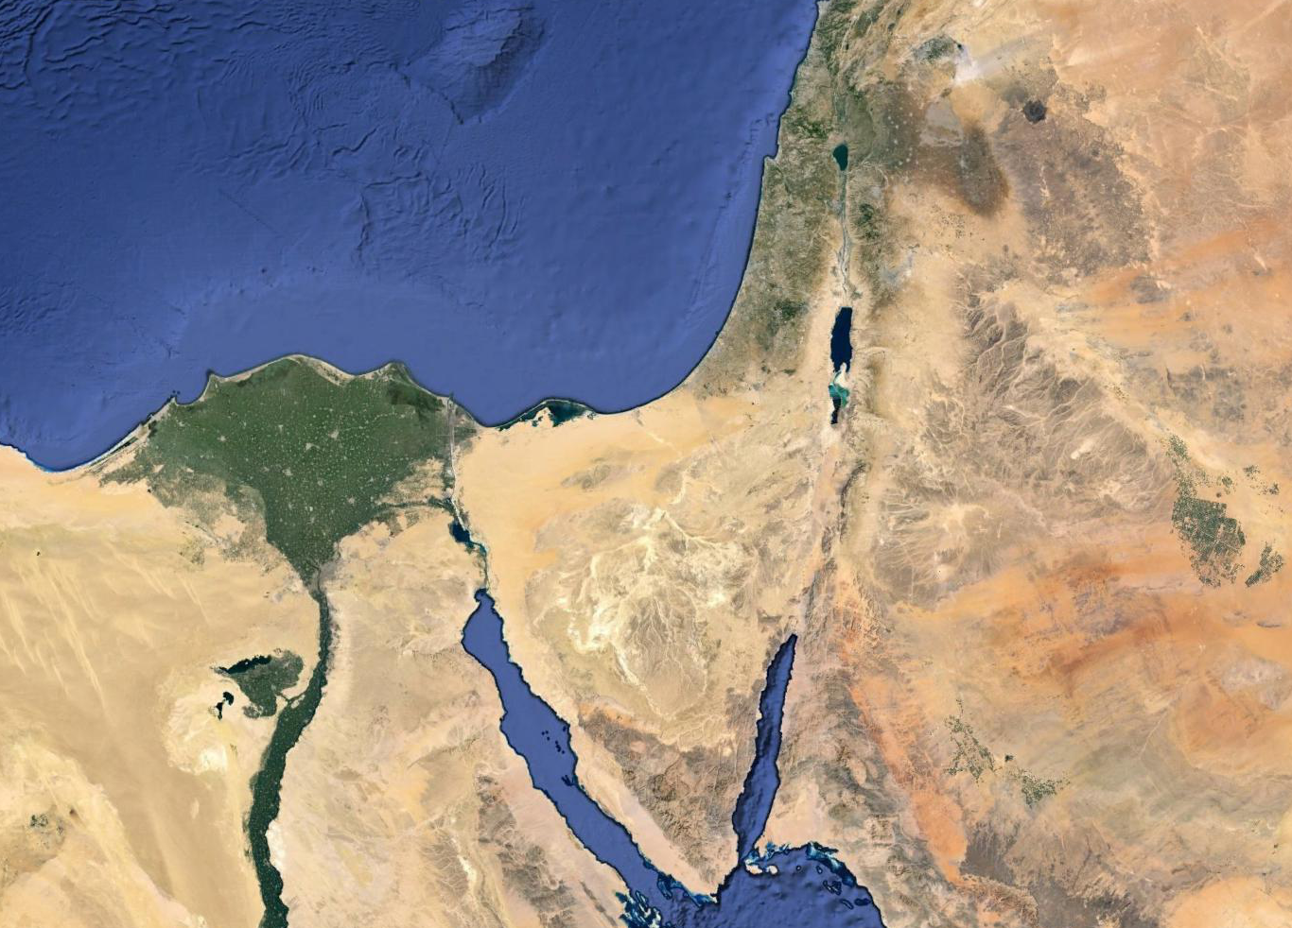
1 8 – 2 0
Almost 40 years
Kadesh Barnea

Slide 19
1 8 – 2 0

Slide 20
1 8 – 2 0
1 Cor. 10:4 ~ … and all drank the same spiritual drink. For they drank of that spiritual Rock that followed them, and that Rock was Christ.

Slide 21
1 8 – 2 0

Slide 22
1 8 – 2 0
Jacob ~ Israel
Esau ~ Edom

Slide 23
1 8 – 2 0

Slide 24
1 8 – 2 0
Edom
Kadesh Barnea
King’s Highway

Slide 25
1 8 – 2 0

Slide 26
1 8 – 2 0
Charles Wesley ~ “God buries His workmen, but carries on His work.”

Slide 27
1 8 – 2 0

