Slide 1



A CD of this message will available immediately following the service …
… or you may download a podcast later in this week
1 5 – 1 7

Slide 2

1 5 – 1 7
Presumptuously ~ (two words in Heb.) to sin with a high hand

Slide 3

1 5 – 1 7

Slide 4
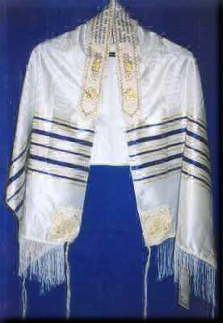
1 5 – 1 7
Matt. 9:20 ~ the woman with the issue of blood
Matt. 14:36 ~ they were healed by touching His hem

Slide 5
1 5 – 1 7

Slide 6
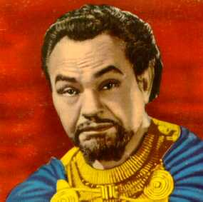
1 5 – 1 7
Edward G. Robinson as Dathan in “The Ten Commandments”

Slide 7
1 5 – 1 7

Slide 8
1 5 – 1 7
James 3:14-16 ~ ¹⁴ But if you have bitter envy and self-seeking in your hearts, do not boast and lie against the truth. ¹⁵ This wisdom does not descend from above, but is earthly, sensual, demonic. ¹⁶ For where envy and self-seeking exist, confusion and every evil thing are there.
Self-seeking ~ originally meant to spin wool
Used by Aristotle to apply to seeking political office through dishonest means

Slide 9
1 5 – 1 7

Slide 10
1 5 – 1 7
Heb. 13:17 ~ Obey those who rule over you, and be submissive, for they watch out for your souls, as those who must give account. Let them do so with joy and not with grief, for that would be unprofitable for you.
1 John 2:27 ~ But the anointing which you have received from Him abides in you, and you do not need that anyone teach you; but as the same anointing teaches you concerning all things, and is true, and is not a lie, and just as it has taught you, you will abide in Him.

Slide 11
1 5 – 1 7

Slide 12
1 5 – 1 7
Psalm 84
~ (A Psalm of the sons of Korah
v. 10 ~ For a day in Your courts is better than a thousand.
I would rather be a doorkeeper in the house of my God
Than dwell in the tents of wickedness.

Slide 13
1 5 – 1 7

Slide 14
1 5 – 1 7
3 reminders to obey:
1) Tassels
2) Bronze plates on the altar
3) Aaron’s rod that budded

Slide 15
1 5 – 1 7

Slide 16
1 5 – 1 7
Utterly die ~ “to breathe out”

Slide 17
1 5 – 1 7

