Slide 1
A CD of this message will available immediately following the service …
… or you may download a podcast later in this week
1 2 – 1 4

Slide 2
1 2 – 1 4
Kadesh Barnea
Mt. Sinai?

Slide 3
1 2 – 1 4

Slide 4
1 2 – 1 4
Hoshea ~ Salvation
Joshua ~ Jehovah is salvation

Slide 5
1 2 – 1 4

Slide 6
1 2 – 1 4
Hamath
Kadesh Barnea

Slide 7
1 2 – 1 4

Slide 8
1 2 – 1 4
Forty is typically the number of testing, trial and probation

Slide 9
1 2 – 1 4

Slide 10
1 2 – 1 4
Milk ~ fertility of the livestock
Honey ~ fertility of the date palms

Slide 11
1 2 – 1 4

Slide 12
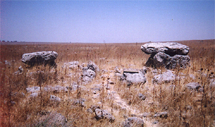
1 2 – 1 4
Dolmens
12-15’
Hamath

Slide 13
1 2 – 1 4

Slide 14
1 2 – 1 4
Four things Moses reminds God:
1. Your reputation
2. Your covenant promise
3. Your nature
4. Your track record

Slide 15
1 2 – 1 4

Slide 16
1 2 – 1 4
Presumed ~ to be lifted up with self-importance

Slide 17
1 2 – 1 4

Slide 18
1 2 – 1 4
Hormah ~ Utter destruction

Slide 19
1 2 – 1 4

