Slide 1
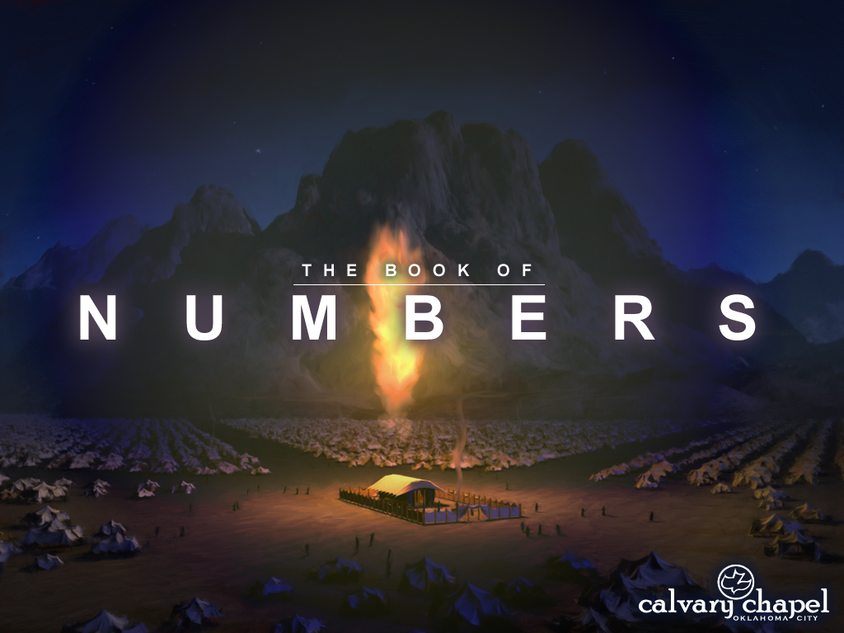


A CD of this message will available immediately following the service …
… or you may download a podcast later in this week
1 1

Slide 2
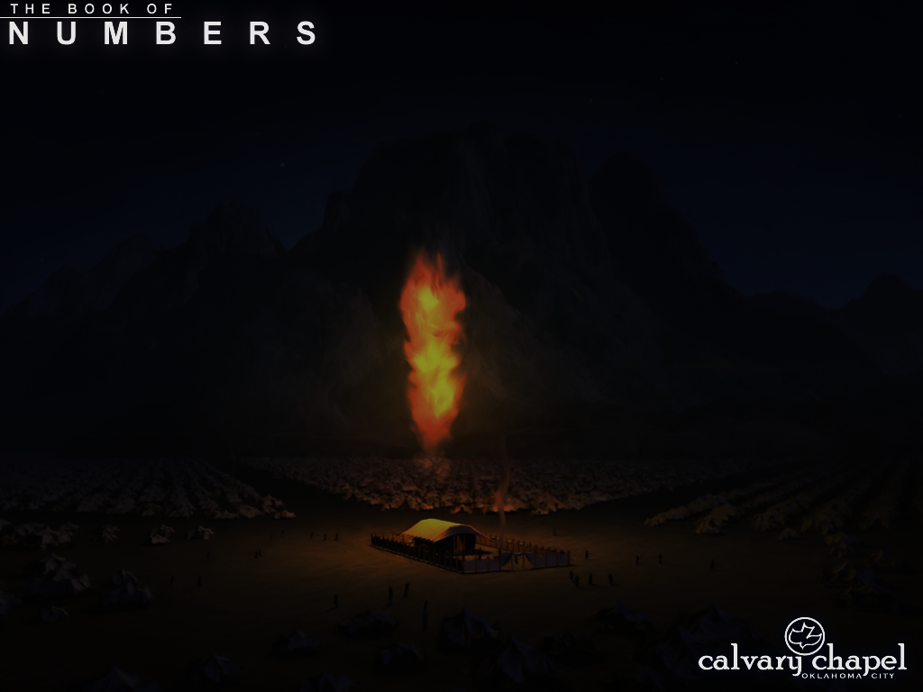
1 1
1 Cor. 10:1-2, 5-6 ~ ​¹ Moreover, brethren, I do not want you to be unaware that all our fathers were under the cloud, all passed through the sea, ² all were baptized into Moses in the cloud and in the sea,
⁵ But with most of them God was not well pleased, for their bodies were scattered in the wilderness. ⁶ Now these things became our examples, to the intent that we should not lust after evil things as they also lusted.
Examples ~ tupos – type

Slide 3
1 1
Kibroth Hataavah ~ kibv-rōth’ hat-tah-av-ä’
Graves of Lust

Slide 4
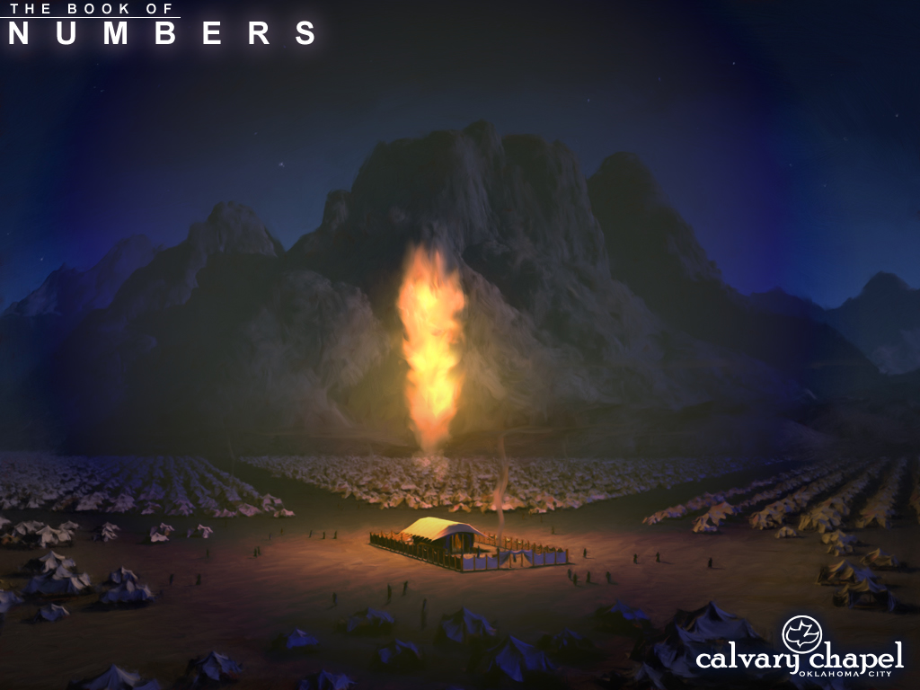
1 1

Slide 5
1 1
Taberah ~ burning

Slide 6
1 1

Slide 7

1 1

Slide 8
1 1

Slide 9
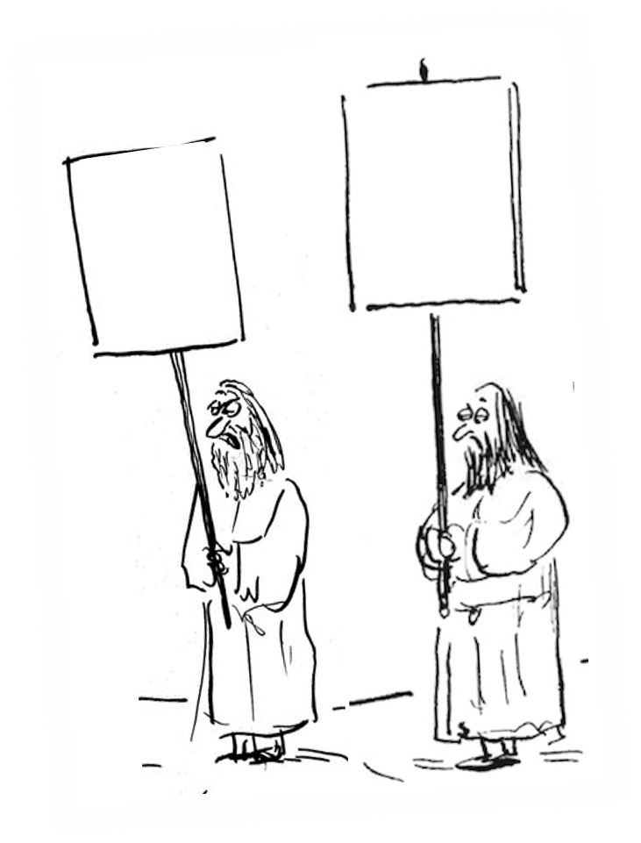
1 1
THAT WE MIGHT EAT!!
GIVE US MEAT

Slide 10
1 1 – 1 2

Slide 11
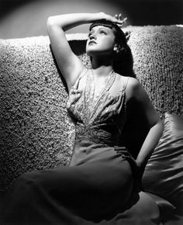
1 1

Slide 12
1 1

Slide 13
1 1
Spirit ~ KJV, spirit

Slide 14
1 1

Slide 15
1 1
They never did so again ~ KJV, they did not cease

Slide 16
1 1

Slide 17
1 1
Ten homers ~ not the same as an omer (Ex. 16:36)
NLT, No one gathered less than 50 bushels

Slide 18
1 1

Slide 19
1 1
Ps. 106:13-15 ~ ¹³ They soon forgot His works;
They did not wait for His counsel,
¹⁴ But lusted exceedingly in the wilderness,
And tested God in the desert.
¹⁵ He gave them their request but sent leanness into their soul.

Slide 20
1 1

Slide 21
1 1
Kibroth Hattaavah ~ Graves of Lust
Rom. 8:6a ~ For to be carnally minded is death,

Slide 22
1 1

