Slide 1
12-13

Slide 2
12-13
Singing 8x
Thanksgiving 6x
Rejoicing 7x
Musical instruments 3x in this chapter

Slide 3
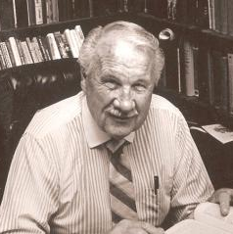
12-13
Ray Stedman (1917-1992) ~ “Joy is not
the same as happiness. Happiness is
liking the present moment because it
pleases us. But joy is much deeper and
more long-range. Joy appreciates the
past, the present, and the future, not
because the circumstances are pleasing,
but because the heart is right with God. That is what fills us with joy.”

Slide 4
12-13

Slide 5
12-13
Deut. 23:3-4 ~ ³ An Ammonite or Moabite shall not enter the assembly of the LORD; even to the tenth generation none of his descendants shall enter the assembly of the LORD forever, ⁴ because they did not meet you with bread and water on the road when you came out of Egypt, and because they hired against you Balaam the son of Beor from Pethor of Mesopotamia, to curse you.

Slide 6
12-13

Slide 7
12-13
Nehemiah’s 2nd term begins
424 BC
445 BC
440 BC
435 BC
430 BC
425 BC
420 BC
Nehemiah’s 1st term
(444-432 BC)
Nehemiah’s return to Shushan (432-424 BC)

Slide 8
12-13

Slide 9
12-13
Mal. 3:7-10 ~ ⁷ “Yet from the days of your fathers
You have gone away from My ordinances
And have not kept them.
Return to Me, and I will return to you,”
Says the LORD of hosts.
“But you said,
‘In what way shall we return?’

Slide 10
12-13
Mal. 3:7-10 ~ ⁸ “Will a man rob God?
Yet you have robbed Me!
But you say,
‘In what way have we robbed You?’
In tithes and offerings.
⁹ You are cursed with a curse,
For you have robbed Me,
Even this whole nation.

Slide 11
12-13
Mal. 3:7-10 ~ ¹⁰ Bring all the tithes into the storehouse,
That there may be food in My house,
And try Me now in this,”
Says the LORD of hosts,
“If I will not open for you the windows of heaven
And pour out for you such blessing
That there will not be room enough to receive it.”

Slide 12
12-13

Slide 13
12-13
Col. 2:16-17 ~ ¹⁶ So let no one judge you in food or in drink, or regarding a festival or a new moon or sabbaths, ¹⁷ which are a shadow of things to come, but the substance is of Christ.

Slide 14
12-13

Slide 15
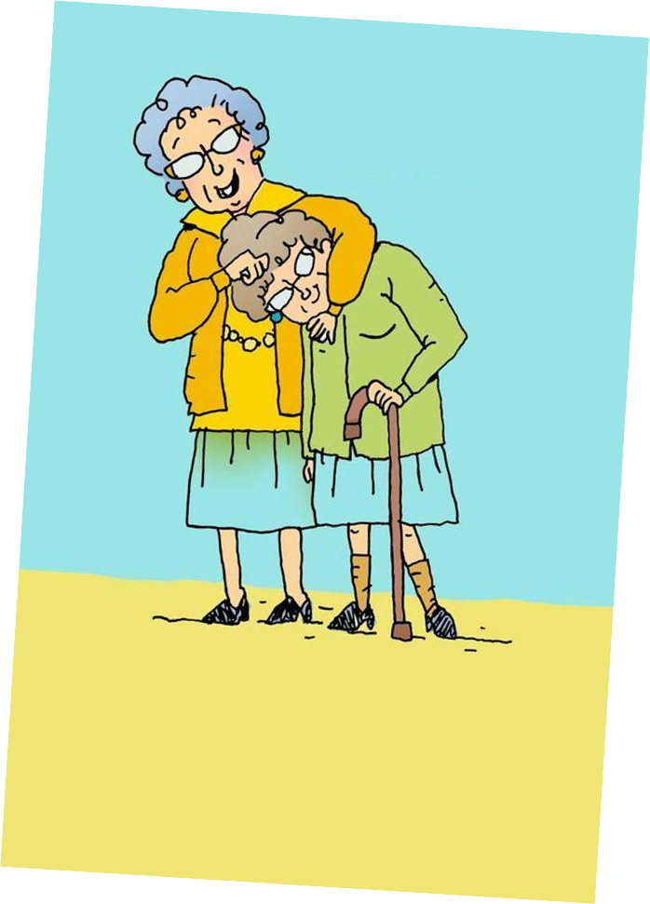
12-13
pulled out their hair ~ to polish or scour

Slide 16
12-13

Slide 17
12-13
pagan women (v. 26) ~ KJV, outlandish women

Slide 18
12-13

Slide 19
12-13
1 Pet. 2:23 ~ who, when He was reviled, did not revile in return; when He suffered, He did not threaten, but committed Himself to Him who judges righteously;

Slide 20
12-13

