Slide 1
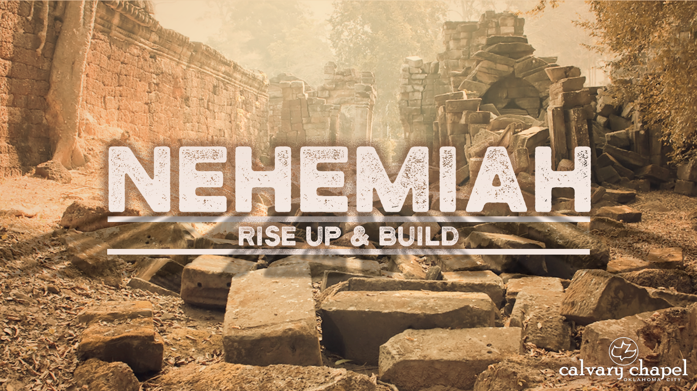
6:1-8:18

Slide 2
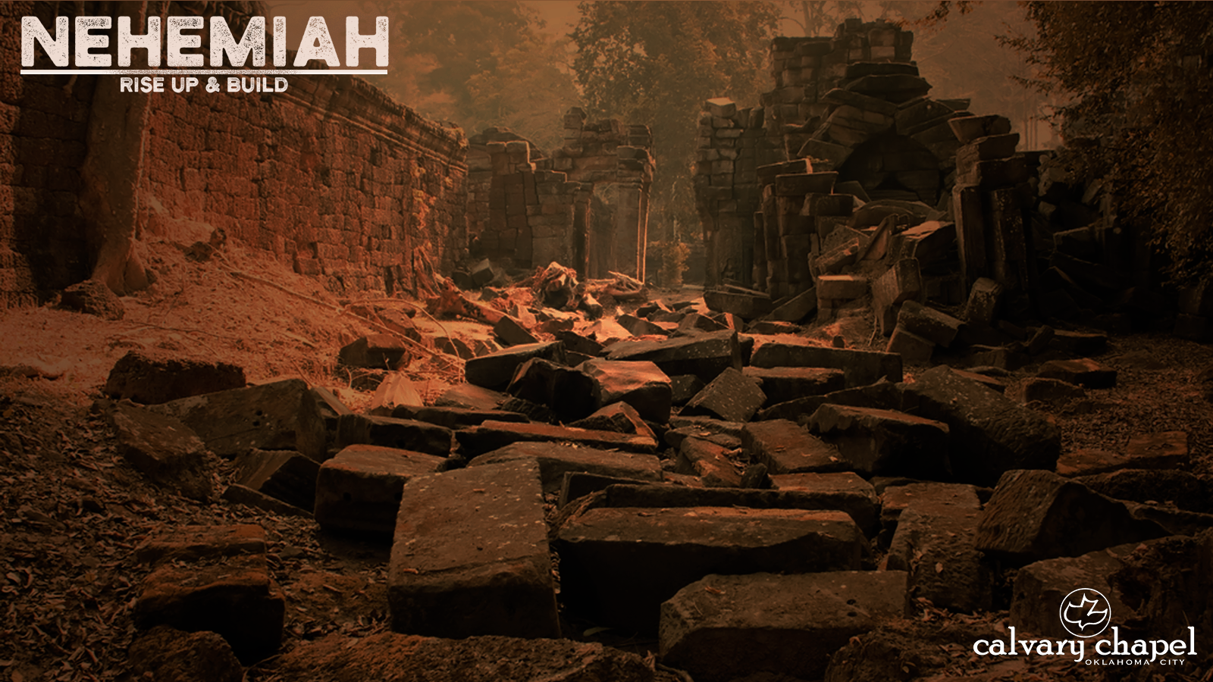
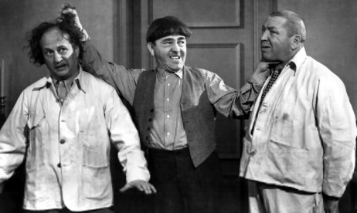
6:1-8:16
Sanballat
Tobiah
Geshem

Slide 3
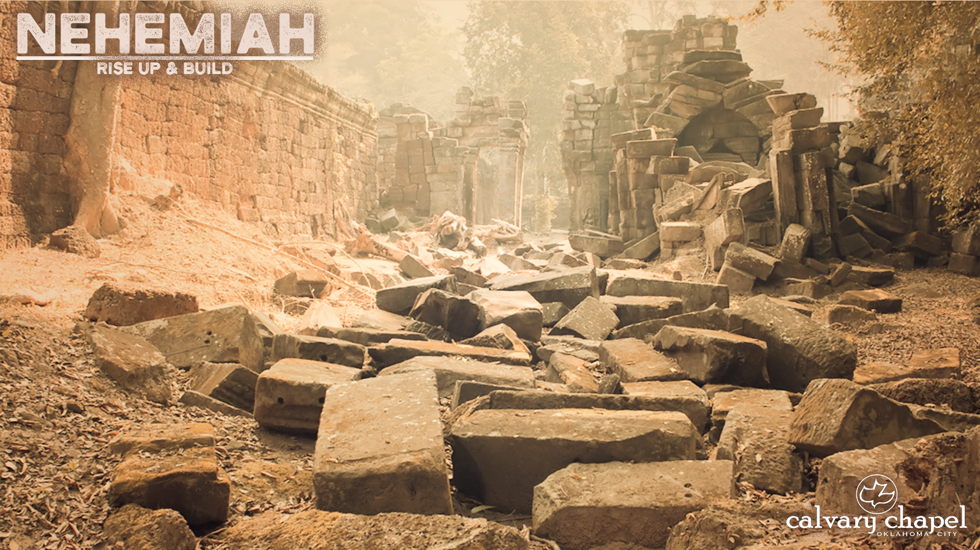
6:1-8:16

Slide 4

6:1-8:16
The Samaritan Times
Dateline 444 BC
Special Edition
Nehemiah rejects Olive Branch from Sanballat
Action fuels already incendiary situation
More unrest certain
Authorities believe wine-taster’s religious fanaticism to blame

Slide 5
6:1-8:16

Slide 6
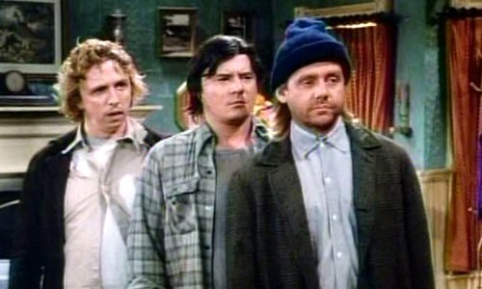
6:1-8:16
his brother,
Darrell
his other brother, Darrell
Larry

Slide 7
6:1-8:16

Slide 8
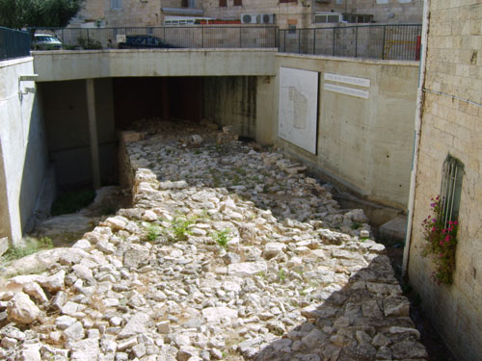
6:1-8:16
The Broad Wall in Jerusalem
23’ wide X 26’ high

Slide 9
6:1-8:16

Slide 10
6:1-8:16
Luke 19:17 ~ And he said to him, “Well done, good servant; because you were faithful in a very little, have authority over ten cities.”
1 Cor. 4:2 ~ Moreover it is required in stewards that one be found faithful.

Slide 11
6:1-8:16

Slide 12
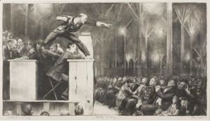
6:1-8:16
KJV ~ And Ezra the scribe stood upon a pulpit of wood,

Slide 13
6:1-8:16

Slide 14
6:1-8:16
Heb. 4:12-13 ~ ¹² For the word of God is living and powerful, and sharper than any two-edged sword, piercing even to the division of soul and spirit, and of joints and marrow, and is a discerner of the thoughts and intents of the heart.
¹³ And there is no creature hidden from His sight, but all things are naked and open to the eyes of Him to whom we must give account.

Slide 15
6:1-8:16

Slide 16
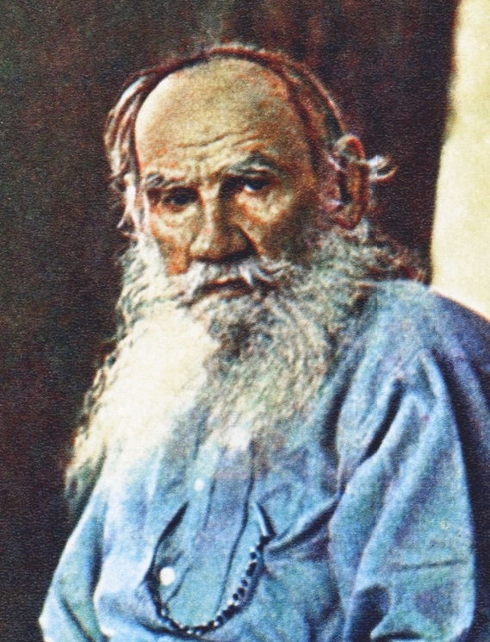
6:1-8:16
Leo Tolstoy (1828-1910) ~ “Everyone wants to change the world, but nobody wants to change themselves.”

Slide 17
6:1-8:16

Slide 18
6:1-8:16
Ezra 3:4 ~ They also kept the Feast of Tabernacles, as it is written, and offered the daily burnt offerings in the number required by ordinance for each day.

Slide 19
6:1-8:16

Slide 20
6:1-8:16
Emotional response ~ vv. 9-12
Intellectual response ~ vv. 1-8
Volitional response ~ vv. 13-18

Slide 21
6:1-8:16

