Slide 1
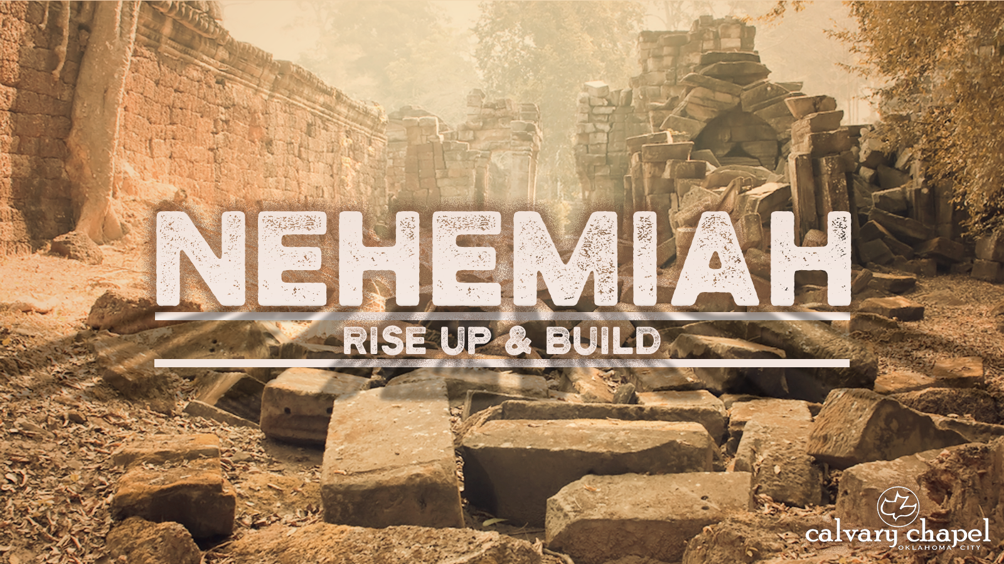
4:1-5:19

Slide 2
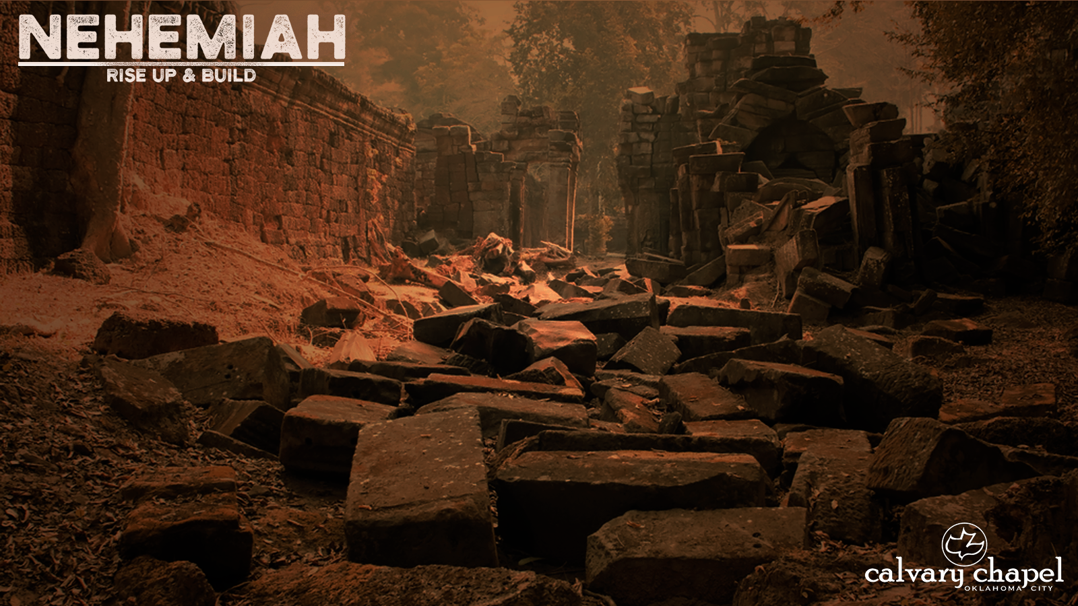
4:1-5:19
2nd week ~ corporate walls of the local church
1st week ~ personal walls of protection
3rd week ~ problems from within
Sanballat ~ Satan
Tobiah ~ the world
Nehemiah’s leaders ~ us

Slide 3
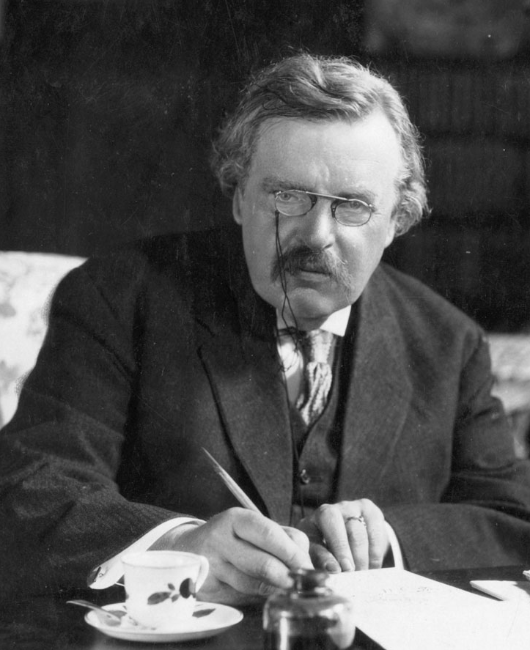
4:1-5:19
G. K. Chesterton (1874-1936) ~ “The Bible tells us to love our neighbors, and also to love our enemies; probably because they are generally the same people.”

Slide 4
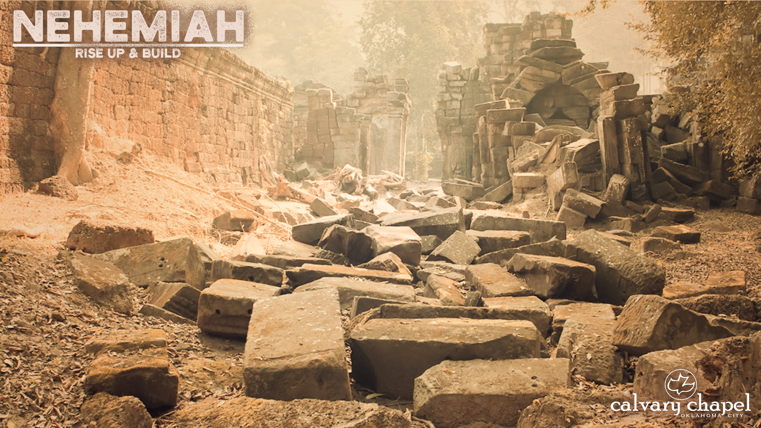
4:1-5:19

Slide 5
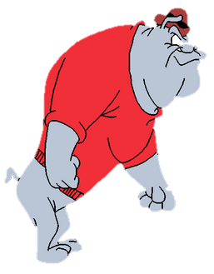

4:1-5:19
You are slimy – that’s why others make it and you don’t
Yeah …
what he
said

Slide 6
4:1-5:19

Slide 7

4:1-5:19
Pray for
the corn with a hoe in your hand.

Slide 8
4:1-5:19

Slide 9
4:1-5:19
Mexican-American War ~ “Remember the Alamo”
Spanish-American War ~ “Remember the Maine”
WWI ~ “Remember the Lusitania”
WWII ~ “Remember Pearl Harbor”
War on Terrorism ~ “Remember 9/11”
Nehemiah and wall builders ~ “Remember the LORD”

Slide 10
4:1-5:19
2 Cor. 10:4-5 ~ ⁴ For the weapons of our warfare are not carnal but mighty in God for pulling down strongholds, ⁵ casting down arguments and every high thing that exalts itself against the knowledge of God, bringing every thought into captivity to the obedience of Christ,

Slide 11
4:1-5:19

Slide 12
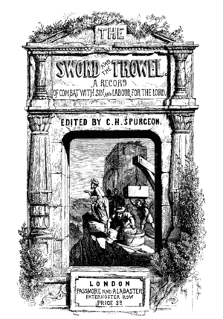


4:1-5:19

Slide 13
4:1-5:19

Slide 14
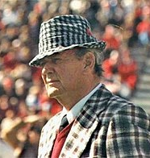
4:1-5:19
Bear Bryant (1913-1983) ~ “Team spirit: If anything goes bad, I did it. If anything goes real good, then we did it”

Slide 15
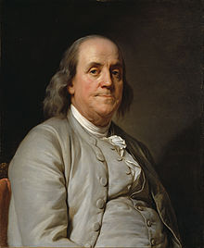
4:1-5:19
Ben Franklin (1706-1790) ~ “We must all hang together, or assuredly we shall all hang separately.”

Slide 16
4:1-5:19
I saw them tearing a building down
A gang of men in a dusty town
With a “yo heave ho” and a lusty yell
They swung a beam and a side wall fell
I asked the foreman if these men were as skilled
As the men he’d hire if he were to build
He laughed and said, “Oh, no indeed!”
Common labor is all I need"
(Author anonymous)

Slide 17
4:1-5:19
For those men can wreck in a day or two
What builders had taken years to do
I asked myself as I went my way
What kind of role am I to play?
Am I the builder who builds with care
Measuring life by the rule and square?
Or am I the wrecker who walks the town
Content with the role of tearing down?
(Author anonymous)

Slide 18
4:1-5:19

Slide 19
4:1-5:19
After serious thought ~ KJV; I consulted with myself,

Slide 20
4:1-5:19

Slide 21
4:1-5:19
ICHTHUS

Slide 22
4:1-5:19

Slide 23
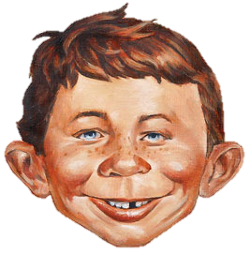
4:1-5:19
Y
U
OUTUBE
NIVERSITY
YU?

Slide 24
4:1-5:19

Slide 25
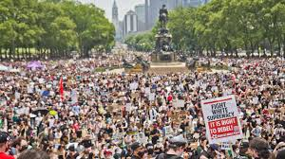
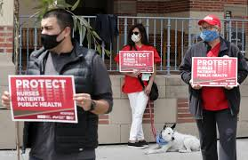
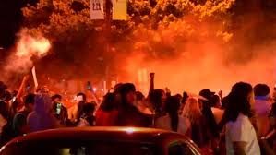
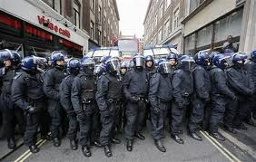
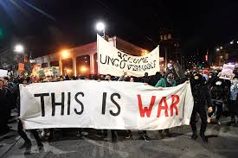
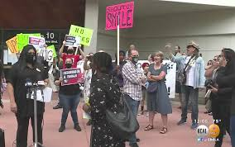
4:1-5:19

Slide 26
4:1-5:19

Slide 27
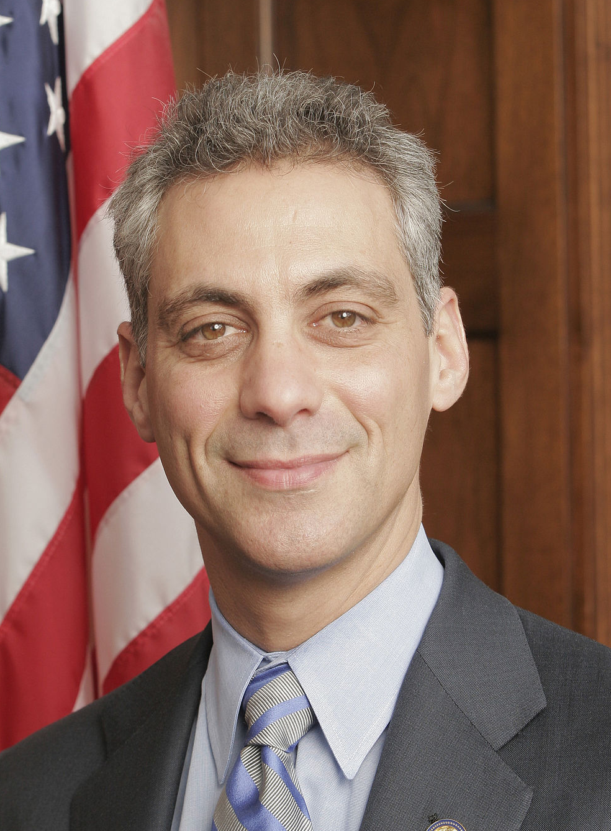
4:1-5:19
Rahm Emanuel (b. 1959) ~ “You never want to let a serious crisis go to waste”
This Photo by Unknown Author is licensed under CC BY-SA

Slide 28
4:1-5:19

Slide 29
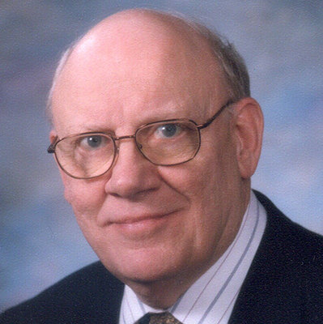
4:1-5:19
Warren Wiersbe (1927-2019) ~ “Opposition is not only an evidence that God is blessing, but it is also an opportunity for us to grow. The difficulties that came to the work brought out the best in Nehemiah and his people. Satan wanted to use these problems as weapons to destroy the work, but God used them as tools to build His people.”

Slide 30
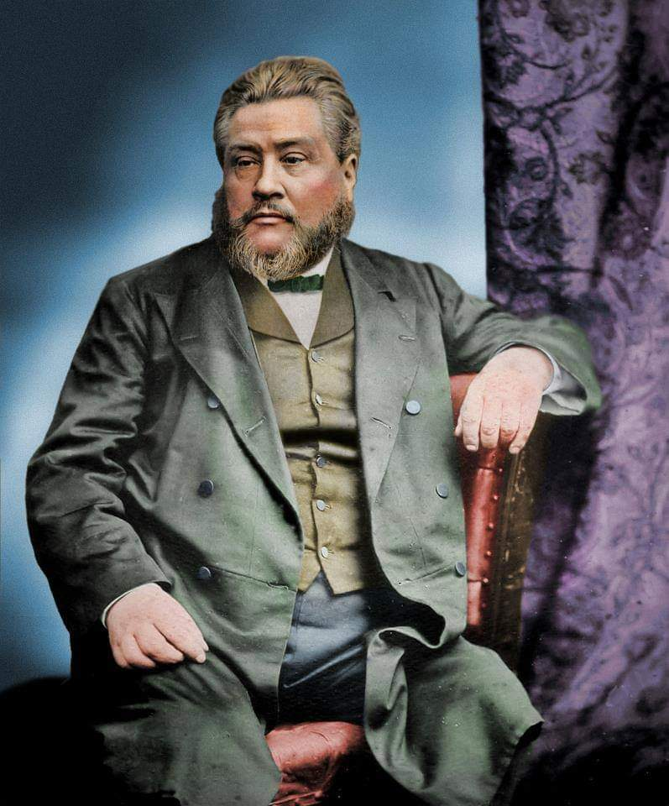
4:1-5:19
C. H. Spurgeon (1834-1892) ~ “God had one Son without sin, but He never had a son without trial.”

Slide 31
4:1-5:19

