Slide 1
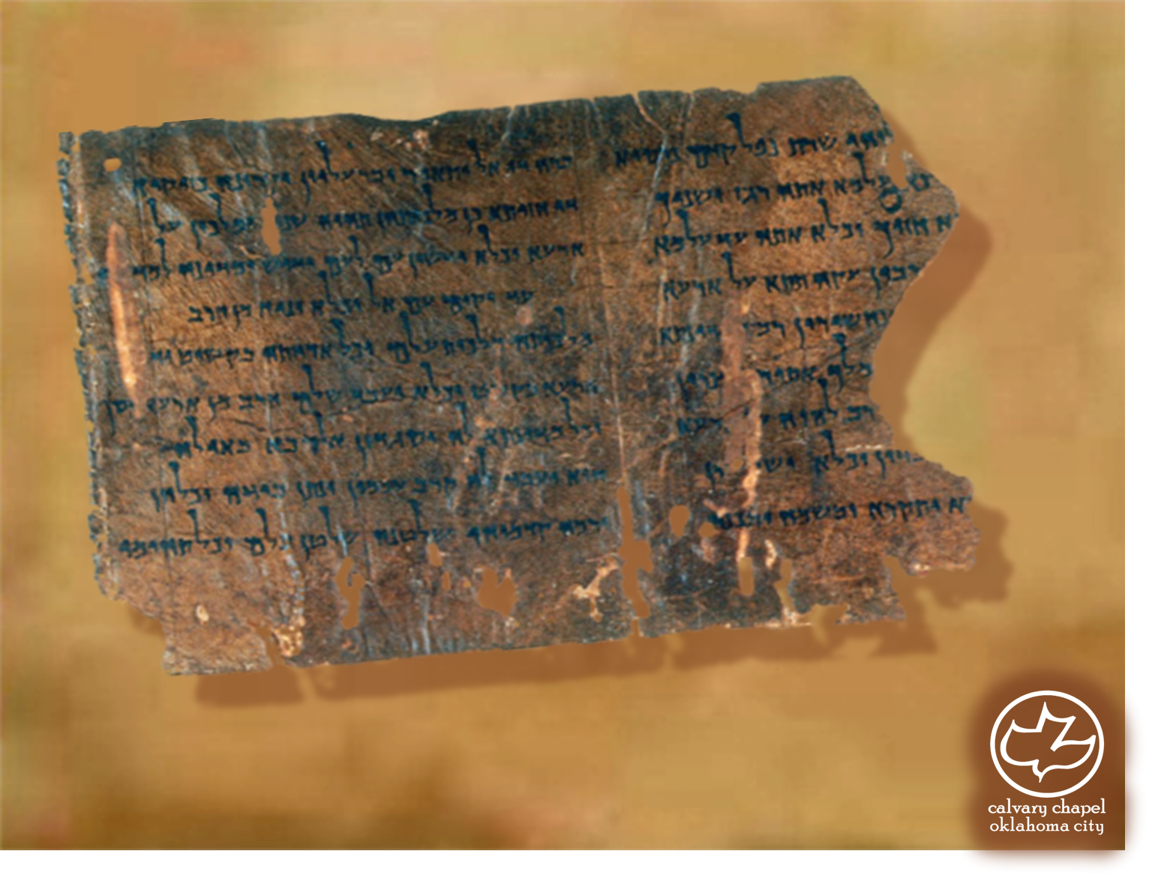

Minor Prophets … Major Message:
Nahum 1:1-3:19
A CD of this message will be available (free of charge) immediately following today's message
This message will be available via podcast later this week at calvaryokc.com

Slide 2
Nahum 1:1-3-19
760BC
730BC
700BC
670BC
640BC
610BC
Jonah
Nahum
Zephaniah
Habakkuk
Jeremiah

Slide 3
Nahum 1:1-3-19
Ashurbanipal ~ "through his jaw I passed a rope…"
their lips, and many perished of parching thirst. The others slit open camels, their only means of transportation, drinking blood and filthy water against their thirst."
"I ordered soldiers to stand on guard…where there were cisterns or water in the springs, thus refusing them the access to the water supply which alone could keep them alive. I thus made water to be very rare for

Slide 4
Nahum 1:1-3-19
Nahum ~ comfort
Capernaum ~ k’far na’um (Village of Nahum)

Slide 5
Nahum 1:1-3-19
C. H. Spurgeon ~ “Never once has he pardoned an unpunished sin; not in all the years of the Most High, not in all the days of his right hand, has he once blotted out sin without punishment.”

Slide 6
Nahum 1:1-3-19
Wicked ~ belial – worthless

Slide 7
Nahum 1:1-3-19
Spears are brandished ~ KJV, the fir trees shall be terribly shaken

Slide 8
Nahum 1:1-3-19
GNB ~ Nineveh is destroyed, deserted, desolate!

Slide 9
Nahum 1:1-3-19
Abominable filth ~ shiqquts – cp/ Dan. 9:27
Deut. 7:26 ~ Nor shall you bring an abomination into your house, lest you be doomed to destruction like it. You shall utterly detest it and utterly abhor it, for it is an accursed thing.
Anselm (AD 1033-1109) ~ “I would rather go to hell without sin, than
go to heaven with sin.”

Slide 10
Nahum 1:1-3-19
NIV ~ Look at your troops – they are all women!

Slide 11
Nahum 1:1-3-19
News ~KJV, bruit
Jonah 4:11 ~ And should I not pity Nineveh, that great city, in which are more than one hundred and twenty thousand persons who cannot discern between their right hand and their left—and much livestock?!

Slide 12
Nahum 1:1-3-19
Deut. 17:12 ~ Now the man who acts presumptuously and will not heed the priest who stands to minister there before the LORD your God, or the judge, that man shall die.

