Slide 1

Significance of Baptism
A CD of this message will be available (free of charge immediately following today's message
This message will be available via podcast later this week at calvaryokc.com

Slide 2
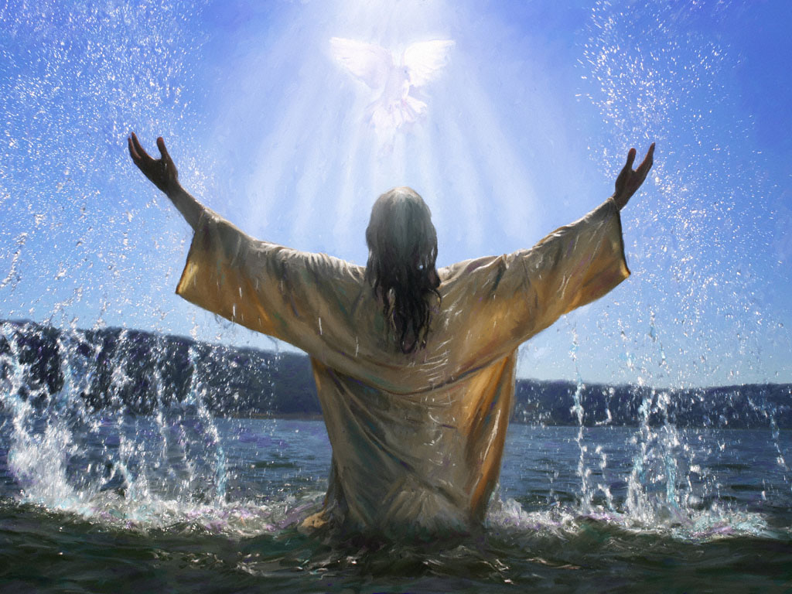
Significance of Baptism
Two Sacraments:
Communion
Christ in us
Baptism
Us in Christ

Slide 3
Significance of Baptism

Slide 4
Significance of Baptism
Reasons for not being baptized:
1. Ignorance
2. Pride
3. Indifference
4. Defiance
5. Unsaved

Slide 5
Significance of Baptism

Slide 6
Significance of Baptism
Five Questions:
1. What is the Form and Formula?
2. What does it represent?
3. Who is a candidate?
4. Am I saved through baptism?
5. Should I get re-baptized?

Slide 7
Significance of Baptism

Slide 8
Significance of Baptism
Eph. 2:8-9
⁸ For by grace you have been saved through faith, and that not of yourselves; it is the gift of God, ⁹ not of works, lest anyone should boast.

Slide 9
Significance of Baptism

Slide 10
Significance of Baptism
Baptizō
Translation vs. Transliteration
Immerse vs. Baptize
"To immerse in order to identify with"
John 3:23
Now John also was baptizing in Aenon near Salim, because there was much water there. And they came and were baptized.

Slide 11
Significance of Baptism

Slide 12
Significance of Baptism
Matt. 24:19
Go therefore and make disciples of all the nations, baptizing them in the name of the Father and of the Son and of the Holy Spirit,

Slide 13
Significance of Baptism

Slide 14
Significance of Baptism
Rom. 6:1-10 ~ Dead to Sin, Alive to God

Slide 15
Significance of Baptism

Slide 16
Significance of Baptism
1 Pet. 3:20-21
²⁰ … when God waited patiently in the days of Noah while the ark was being built. In it only a few people, eight in all, were saved through water, ²¹ There is also an antitype which now saves us—baptism (not the removal of the filth of the flesh, but the answer of a good conscience toward God), through the resurrection of Jesus Christ,

Slide 17
Significance of Baptism

Slide 18
Significance of Baptism
Joe Christian
Jesus
Judgment

Slide 19
Significance of Baptism

Slide 20
Significance of Baptism
Matt. 3:15
But Jesus answered and said to him, “Permit it to be so now, for thus it is fitting for us to fulfill all righteousness.” Then he allowed Him.

Slide 21
Significance of Baptism

Slide 22
Significance of Baptism
Acts 8:37
Then Philip said, “If you believe with all your heart, you may.”
And he answered and said, “I believe that Jesus Christ is the Son of God.”

Slide 23
Significance of Baptism

Slide 24
Significance of Baptism
Gal. 3:27
For as many of you as were baptized into Christ have put on Christ.

Slide 25
Significance of Baptism

Slide 26
Significance of Baptism
Mark 1:4
John came baptizing in the wilderness and preaching a baptism of repentance for the remission of sins
Acts 2:38
Then Peter said to them, “Repent, and let every one of you be baptized in the name of Jesus Christ for the remission of sins; and you shall receive the gift of the Holy Spirit.
Because of
In order to
With a view toward

Slide 27
Significance of Baptism

Slide 28
Significance of Baptism
1 Pet. 3:21(NLT)
And that water is a picture of baptism, which now saves you, not by removing dirt from your body, but as a response to God from a clean conscience. It is effective because of the resurrection of Jesus Christ.

Slide 29
Significance of Baptism

Slide 30
Significance of Baptism
Acts 19:1-4

Slide 31
Significance of Baptism

