Slide 1
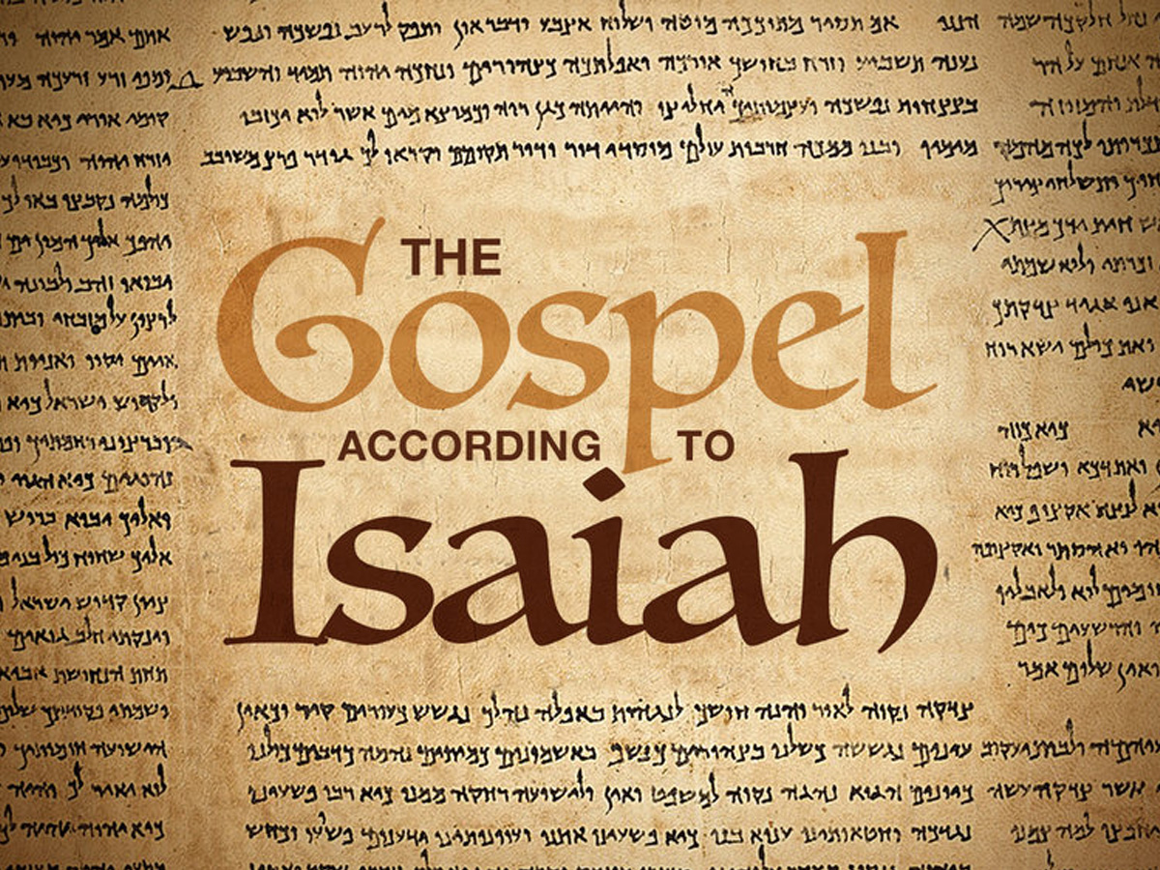

calvary chapel
oklahoma city

Slide 2




THE Gospel ACCORDING TO Isaiah
Jotham
739-735 BC
Hezekiah
715- 686BC
Uzziah
768-739 BC
Ahaz
735-715 BC
760 BC
750 BC
740 BC
730 BC
720 BC
710 BC
700 BC
690 BC
58 years
Uzziah’s death
Sennacherib’s death
calvary chapel
oklahoma city

Slide 3
THE Gospel ACCORDING TO Isaiah
Dr. Jeffrey Seif, ZLM: ~ Quoted 411x in New Testament
Isaiah
Isaiah Jr.
Isaiah Sr.
Isaiah III
Genesis - Malachi
66 chapters
Matthew - Revelation
3
6
9
12
15
18
21
24
27
30
33
36
39
42
45
48
51
54
57
60
63
39 books
40-55
27 books
57-66
1-39
40-66
Old Testament
New Testament
calvary chapel
oklahoma city

Slide 4
calvary chapel
oklahoma city

Slide 5
THE Gospel ACCORDING TO Isaiah
5 areas:
His Ministry
His Birth
His Sacrifice
His Resurrection
His Millennial Kingdom
calvary chapel
oklahoma city

Slide 6
calvary chapel
oklahoma city

Slide 7
THE Gospel ACCORDING TO Isaiah
Is. 40.1-4 ~ ¹ “Comfort, yes, comfort My people!” Says your God.
² “Speak comfort to Jerusalem, and cry out to her,
That her warfare is ended,
That her iniquity is pardoned;
For she has received from the Lord's hand
Double for all her sins.”
³ The voice of one crying in the wilderness:
“Prepare the way of the Lord;
Make straight in the desert
A highway for our God.
calvary chapel
oklahoma city

Slide 8
THE Gospel ACCORDING TO Isaiah
Is. 40.1-4 ~ ⁴ Every valley shall be exalted
And every mountain and hill brought low;
he crooked places shall be made straight
And the rough places smooth;
calvary chapel
oklahoma city

Slide 9
THE Gospel ACCORDING TO Isaiah
Is. 7.14 ~ Therefore the Lord Himself will give you a sign: Behold, a virgin will shall conceive and bear a Son, and shall call His name Immanuel.
virgin ~ almah – young woman, maid, virgin
Matt. 1.23 ~ “Behold, the virgin shall be with child, and bear A Son, and they shall call His name Immanuel,” which is translated, “God with us.”
virgin ~ parthenos – virgin
Also in the LXX of Is. 7.14
calvary chapel
oklahoma city

Slide 10
THE Gospel ACCORDING TO Isaiah
Is. 9.6-7 ~ ⁶ For unto us a Child is born,
Unto us a Son is given;
And the government will be upon His shoulder.
And His name will be called
Wonderful, Counselor, Mighty God,
Everlasting Father, Prince of Peace.
⁷ Of the increase of His government and peace
There will be no end,
Upon the throne of David and over His kingdom,
To order it and establish it with judgment and justice
From that time forward, even forever.
The zeal of the Lord of hosts will perform this.
calvary chapel
oklahoma city

Slide 11
THE Gospel ACCORDING TO Isaiah
Is. 11.1-3a ~ ¹ There shall come forth a Rod from the stem of Jesse,
And a Branch shall grow out of his roots.
² The Spirit of the Lord shall rest upon Him,
The Spirit of wisdom and understanding,
The Spirit of counsel and might,
The Spirit of knowledge and of the fear of the Lord.
³ His delight is in the fear of the Lord,
calvary chapel
oklahoma city

Slide 12
THE Gospel ACCORDING TO Isaiah
Is. 53.1-2 (NLT) ~ ¹ Who has believed our message?
To whom has the Lord revealed his powerful arm?
² My servant grew up in the Lord’s presence like a tender green shoot, like a root in dry ground.
There was nothing beautiful or majestic about his appearance, nothing to attract us to him.
calvary chapel
oklahoma city

Slide 13
calvary chapel
oklahoma city

Slide 14
THE Gospel ACCORDING TO Isaiah
Is. 61.1-2a ~ ¹ “The Spirit of the Lord God is upon Me, Because the Lord has anointed Me
To preach good tidings to the poor;
He has sent Me to heal the brokenhearted,
To proclaim liberty to the captives,
And the opening of the prison to those who are bound;
^{2a} To proclaim the acceptable year of the Lord,
Fulfilled in Luke 4:16-21
calvary chapel
oklahoma city

Slide 15
THE Gospel ACCORDING TO Isaiah
Is. 42.1-4 ~ ¹ “Behold! My Servant whom I uphold,
My Elect One in whom My soul delights!
I have put My Spirit upon Him;
He will bring forth justice to the Gentiles.
² He will not cry out, nor raise His voice,
Nor cause His voice to be heard in the street.
³ A bruised reed He will not break,
And smoking flax He will not quench;
He will bring forth justice for truth.
⁴ He will not fail nor be discouraged,
Till He has established justice in the earth;
And the coastlands shall wait for His law.”
calvary chapel
oklahoma city

Slide 16
THE Gospel ACCORDING TO Isaiah
Is. 8.13-14 ~ ¹³ The Lord of hosts, Him you shall hallow;
Let Him be your fear,
And let Him be your dread.
¹⁴ He will be as a sanctuary,
But a stone of stumbling and a rock of offense
To both the houses of Israel,
As a trap and a snare to the inhabitants of Jerusalem.
calvary chapel
oklahoma city

Slide 17
THE Gospel ACCORDING TO Isaiah
Rom. 9.31-33 ~ ³¹ but Israel, pursuing the law of righteousness, has not attained to the law of righteousness. ³² Why? Because they did not seek it by faith, but as it were, by the works of the law. For they stumbled at that stumbling stone. ³³ As it is written: “Behold, I lay in Zion a stumbling stone and rock of offense,
And whoever believes on Him will not be put to shame.”
calvary chapel
oklahoma city

Slide 18
THE Gospel ACCORDING TO Isaiah
1 Peter 2.6-8 ~ ⁶ Therefore it is also contained in the Scripture,
“Behold, I lay in Zion
A chief cornerstone, elect, precious,
And he who believes on Him will by no means be put to shame.”
⁷ Therefore, to you who believe, He is precious; but to those who are disobedient,
“The stone which the builders rejected
Has become the chief cornerstone,”
calvary chapel
oklahoma city

Slide 19
THE Gospel ACCORDING TO Isaiah
1 Peter 2.6-8 ~ ⁸ and
“A stone of stumbling
And a rock of offense.” They stumble, being disobedient to the word, to which they also were appointed.
calvary chapel
oklahoma city

Slide 20
calvary chapel
oklahoma city

Slide 21
THE Gospel ACCORDING TO Isaiah
Is. 53.1-3 (NLT) ~ ¹ Who has believed our message?
To whom has the Lord revealed his powerful arm?
² My servant grew up in the Lord’s presence like a tender green shoot, like a root in dry ground.
There was nothing beautiful or majestic about his appearance, nothing to attract us to him.
³ He was despised and rejected—
a man of sorrows, acquainted with deepest grief.
We turned our backs on him and looked the other way.
He was despised, and we did not care.
What if God was one of us
Just a slob like one of us
Like a stranger on the bus
Trying to make His way home
– Joan Osborne, 1996
calvary chapel
oklahoma city

Slide 22
THE Gospel ACCORDING TO Isaiah
Is. 50.6 ~ I gave My back to those who struck Me,
And My cheeks to those who plucked out the beard;
I did not hide My face from shame and spitting.
calvary chapel
oklahoma city

Slide 23
THE Gospel ACCORDING TO Isaiah
Is. 53.4-8 ~ ⁴ Yet it was our weaknesses he carried;
it was our sorrows that weighed him down.
And we thought his troubles were a punishment from God,
a punishment for his own sins!
⁵ But he was pierced for our rebellion,
crushed for our sins.
He was beaten so we could be whole.
He was whipped so we could be healed.
pierced ~ chalal – carries the idea of violated; raped
⁶ All of us, like sheep, have strayed away.
We have left God’s paths to follow our own.
Yet the Lord laid on him
the sins of us all.
calvary chapel
oklahoma city

Slide 24
THE Gospel ACCORDING TO Isaiah
Is. 53.4-8 ~ ⁷ He was oppressed and treated harshly,
yet he never said a word.
He was led like a lamb to the slaughter.
And as a sheep is silent before the shearers,
he did not open his mouth.
⁸ Unjustly condemned,
he was led away.
No one cared that he died without descendants,
that his life was cut short in midstream.
But he was struck down
for the rebellion of my people.
calvary chapel
oklahoma city

Slide 25
THE Gospel ACCORDING TO Isaiah
Is. 53.10 (NLT) ~ But it was the Lord’s good plan to crush him
and cause him grief.
Yet when his life is made an offering for sin,
he will have many descendants.
He will enjoy a long life,
and the Lord’s good plan will prosper in his hands.
life ~ nephesh – better, soul (KJV, NKJV, ESV)
calvary chapel
oklahoma city

Slide 26
THE Gospel ACCORDING TO Isaiah
Is. 53.11 (NLT) ~ When he sees all that is accomplished by his anguish,
he will be satisfied.
And because of his experience,
my righteous servant will make it possible
for many to be counted righteous,
for he will bear all their sins.
calvary chapel
oklahoma city

Slide 27
calvary chapel
oklahoma city

Slide 28
THE Gospel ACCORDING TO Isaiah
Isaiah 25:8 ~ He will swallow up death for all time,
And the Lord God will wipe tears away from all faces,
And He will remove the reproach of His people from all the earth;
For the Lord has spoken.
Isaiah 26:19 ~ Your dead will live;
Their corpses will rise.
You who lie in the dust, awake and shout for joy,
For your dew is as the dew of the dawn,
And the earth will give birth to the departed spirits.
calvary chapel
oklahoma city

Slide 29
calvary chapel
oklahoma city

Slide 30
THE Gospel ACCORDING TO Isaiah
Is. 61:1-2 ~ ¹ “The Spirit of the Lord God is upon Me, Because the Lord has anointed Me
To preach good tidings to the poor;
He has sent Me to heal the brokenhearted,
To proclaim liberty to the captives,
And the opening of the prison to those who are bound;
² To proclaim the acceptable year of the Lord,
And the day of vengeance of our God;
calvary chapel
oklahoma city

Slide 31
THE Gospel ACCORDING TO Isaiah
Is. 63.1-4 ~ ¹ Who is this who comes from Edom,
With dyed garments from Bozrah,
This One who is glorious in His apparel,
Traveling in the greatness of His strength? —
“I who speak in righteousness, mighty to save.”
² Why is Your apparel red,
And Your garments like one who treads in the winepress?
³ “I have trodden the winepress alone,
And from the peoples no one was with Me.
For I have trodden them in My anger,
And trampled them in My fury;
calvary chapel
oklahoma city

Slide 32
THE Gospel ACCORDING TO Isaiah
Is. 63.1-4 ~ Their blood is sprinkled upon My garments,
And I have stained all My robes.
⁴ For the day of vengeance is in My heart,
And the year of My redeemed has come.
Is. 63.10 ~ But they rebelled and grieved His Holy Spirit;
So He turned Himself against them as an enemy,
And He fought against them.
calvary chapel
oklahoma city

Slide 33
THE Gospel ACCORDING TO Isaiah
Is. 35.4-6 ~ ⁴ Say to those who are fearful-hearted,
“Be strong, do not fear!
Behold, your God will come with vengeance,
With the recompense of God;
He will come and save you.”
⁵ Then the eyes of the blind shall be opened,
And the ears of the deaf shall be unstopped.
⁶ Then the lame shall leap like a deer,
And the tongue of the dumb sing.
For waters shall burst forth in the wilderness,
And streams in the desert.
calvary chapel
oklahoma city

Slide 34
THE Gospel ACCORDING TO Isaiah
Is. 65.20 ~ No more shall an infant from there live but a few days,
Nor an old man who has not fulfilled his days;
For the child shall die one hundred years old,
But the sinner being one hundred years old shall be accursed.
NLT ~ No longer will people be considered old at one hundred!
Only the cursed will die that young!
calvary chapel
oklahoma city

Slide 35
THE Gospel ACCORDING TO Isaiah
Is. 65.21-23 ~ ²¹ They shall build houses and inhabit them;
They shall plant vineyards and eat their fruit.
²² They shall not build and another inhabit;
They shall not plant and another eat;
For as the days of a tree, so shall be the days of My people,
And My elect shall long enjoy the work of their hands.
²³ They shall not labor in vain,
Nor bring forth children for trouble;
For they shall be the descendants of the blessed of the Lord,
And their offspring with them.
calvary chapel
oklahoma city

Slide 36
THE Gospel ACCORDING TO Isaiah
Is. 65.25 ~ The wolf and the lamb shall feed together,
The lion shall eat straw like the ox,
And dust shall be the serpent's food.
They shall not hurt nor destroy in all My holy mountain,”
Says the Lord.
calvary chapel
oklahoma city

Slide 37
THE Gospel ACCORDING TO Isaiah
Is. 66.14 ~ When you see this, your heart shall rejoice,
And your bones shall flourish like grass; The hand of the Lord shall be known to His servants,
And His indignation to His enemies.
calvary chapel
oklahoma city

Slide 38
calvary chapel
oklahoma city

