Slide 1
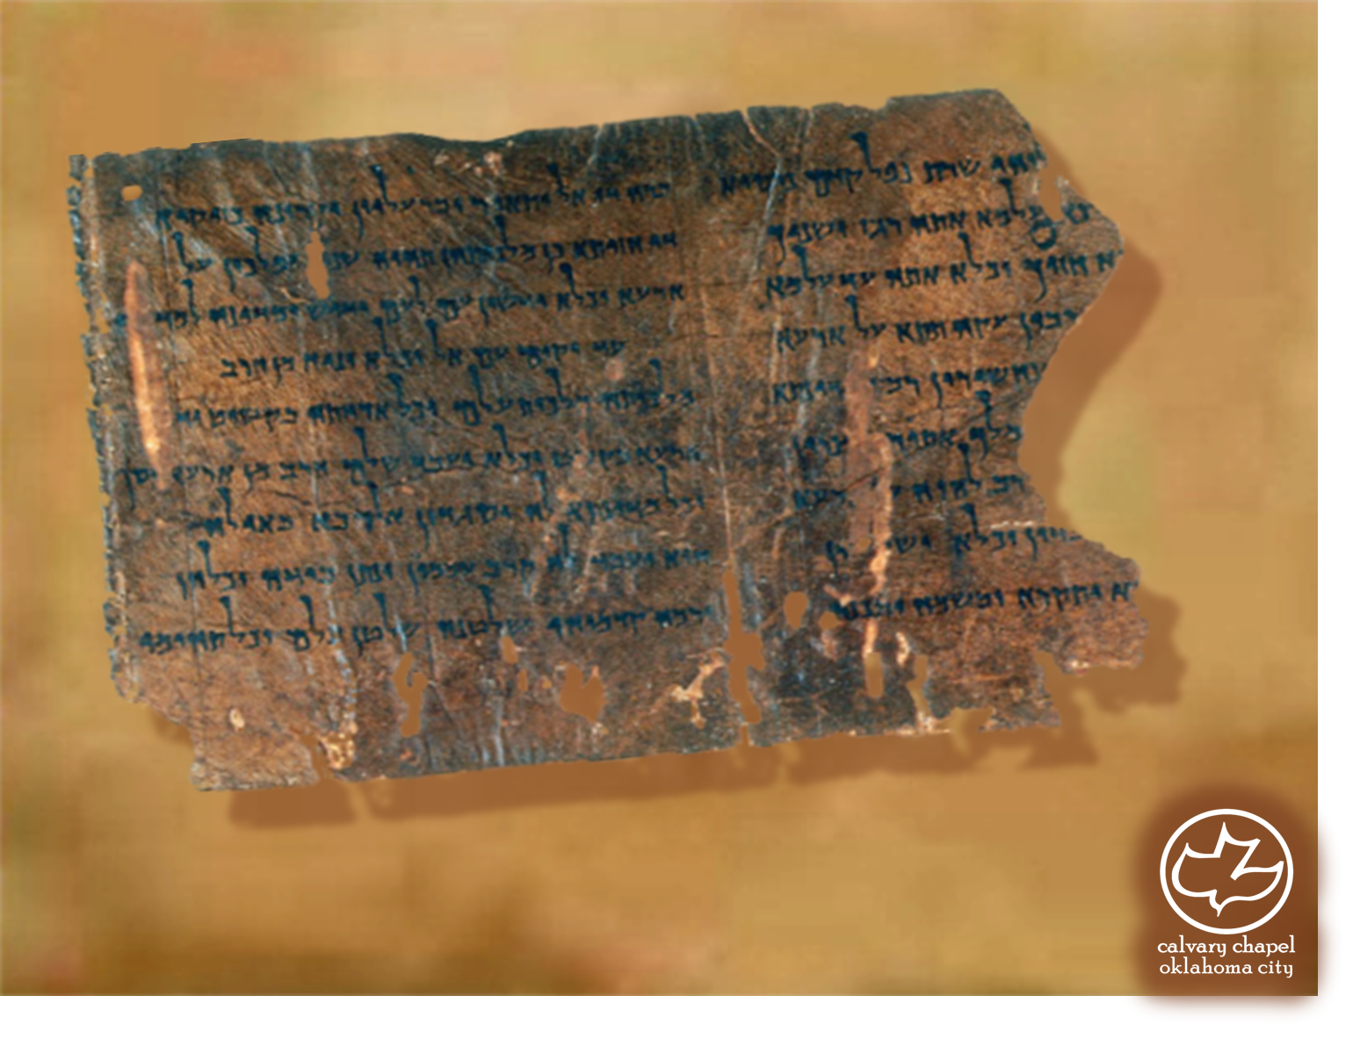

Minor Prophets … Major Message:
Micah 6:1-7:20
A CD of this message will be available (free of charge) immediately following today's message
This message will be available via podcast later this week at calvaryokc.com

Slide 2
Micah 6:1-7:20
Complaint ~ riyb – case at law

Slide 3
Micah 6:1-7:20
1 Cor. 10:1-6 ~ ¹ Moreover, brethren, I do not want you to be unaware that all our fathers were under the cloud, all passed through the sea, ² all were baptized into Moses in the cloud and in the sea, ³ all ate the same spiritual food, ⁴ and all drank the same spiritual drink. For they drank of that spiritual Rock that followed them, and that Rock was Christ. ⁵ But with most of them God was not well pleased, for their bodies were scattered in the wilderness.
⁶ Now these things became our examples, to the intent that we should not lust after evil things as they also lusted.

Slide 4
Micah 6:1-7:20
D
Exhibit “A”
Deliverance

Slide 5
Micah 6:1-7:20
D
Exhibit “B”
Leaders

Slide 6
Micah 6:1-7:20
D
Exhibit “C”
Reversed curse

Slide 7
Micah 6:1-7:20
D
Exhibit “D”
Brought to Promised Land

Slide 8
Micah 6:1-7:20
2 things render a sacrifice unacceptable:
Disobedience
1 Jn. 2:4 - He who says, "I know Him," and does not keep His commandments, is a liar, and the truth is not in him.

Slide 9
Micah 6:1-7:20
2 things render a sacrifice unacceptable:
Disobedience
1 Jn. 4:20 - If someone says, "I love God," and hates his brother, he is a liar; for he who does not love his brother whom he has seen, how can he love God whom he has not seen?

Slide 10
Micah 6:1-7:20
Deut. 10:12 ~ And now, Israel, what does the LORD your God require of you, but to fear the LORD your God, to walk in all His ways and to love Him, to serve the LORD your God with all your heart and with all your soul,

Slide 11
Micah 6:1-7:20
Mercy ~ chesed – lovingkindness
Pro. 11:2 ~ When pride comes, then comes shame; But with the humble is wisdom.

Slide 12
Micah 6:1-7:20
C. H. Spurgeon ~ “True humility is thinking rightly of thyself, not meanly. When you have found out what you really are, you will be humble, for you are nothing to boast of. To be humble will make you safe. To be humble will make you happy. To be humble will make music in your heart when you go to bed. To be humble here will make
you wake up in the likeness of your Master by-and-by.”

Slide 13
Micah 6:1-7:20
Message ~ But he’s already made it plain how to live, what to do, what GOD is looking for in men and women. It’s quite simple: Do what is fair and just to your neighbor, be compassionate and loyal in your love, And don’t take yourself too seriously—take God seriously.

Slide 14
Micah 6:1-7:20
Eccl. 9:10 ~ Whatever your hand finds to do, do it with your might; for there is no work or device or knowledge or wisdom in the grave where you are going.

Slide 15
Micah 6:1-7:20
G. Campbell Morgan ~ “Herein is discovered the difference between remorse and penitence. In remorse a man is sorry for himself; he mourns over his sin because it has brought suffering to him. In penitence he is grieved by the wrong sin has done to God; he yields his personal suffering in the confidence that by it God is setting him free from his sin.”

Slide 16
Micah 6:1-7:20
C. H. Spurgeon ~ “Whatever despair may whisper or doubt may suggest, one text of Scripture is worth fifty fears and doubts, or fifty thousand either . . . All objections to the delight of God in mercy are but illusions of your brain, or delusions of your heart.”

Slide 17
Micah 6:1-7:20
NASB ~ Because He delights in unchanging love. (chesed)

