Slide 1
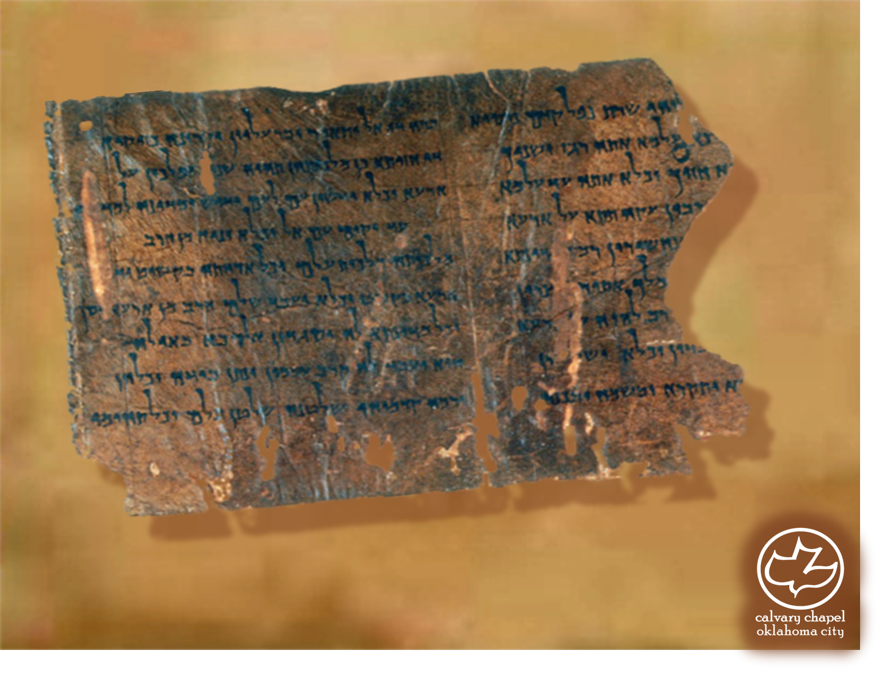

Minor Prophets … Major Message:
Micah 3:1-5:15
A CD of this message will be available (free of charge) immediately following today's message
This message will be available via podcast later this week at calvaryokc.com

Slide 2
Micah 3:1-5:15
NASB ~ Thus says the Lord concerning the prophets who lead my people astray; when they have something to bite with their teeth, they cry, "Peace," but against him who puts nothing in their mouths, they declare holy war.

Slide 3
Micah 3:1-5:15
1 Kings 22:1-28

Slide 4
Micah 3:1-5:15
Rom. 5:1~ Therefore, having been justified by faith, we have peace with God through our Lord Jesus Christ,
Phil. 4:6-7 ~ ⁶ Be anxious for nothing, but in everything by prayer and supplication, with thanksgiving, let your requests be made known to God; ⁷ and the peace of God, which surpasses all understanding, will guard your hearts and minds through Christ Jesus.

Slide 5
Micah 3:1-5:15
NO
GOD
K
W
NO
PEACE
K
W

Slide 6
Micah 3:1-5:15
Jer. 29:17-19 ~ ¹⁷ Then certain of the elders of the land rose up and spoke to all the assembly of the people, saying: ¹⁸ "Micah of Moresheth prophesied in the days of Hezekiah king of Judah, and spoke to all the people of Judah, saying, ‘Thus says the LORD of hosts: "Zion shall be plowed like a field, Jerusalem
shall become heaps of ruins,
And the mountain of the temple Like the bare hills of the forest."’ ¹⁹ "Did Hezekiah king of Judah and all Judah ever put him to death? Did he not fear the LORD and seek the LORD’S favor? And the LORD relented concerning the doom which He had pronounced against them. But we are doing great evil
against ourselves."
Notes:
assembly of the people, saying: ¹⁸

Slide 7
Micah 3:1-5:15
Hezekiah
(715-686 BC)
Jehoiakim
(608-598 BC)
700BC
680BC
660BC
640BC
620BC
600BC
Micah
Jeremiah
100 + years

Slide 8
Micah 3:1-5:15
Micah 4:1-3 = Is. 2:2-4

Slide 9
Micah 3:1-5:15
Gen 49:10 ~ The scepter shall not depart from Judah, Nor a lawgiver from between his feet, Until Shiloh comes; And to Him shall be the obedience of the people.

Slide 10
Micah 3:1-5:15
Luke 2:41-49
The scepter shall not depart from Judah, nor a lawgiver from between his feet, until Shiloh comes
“Woe unto us for the scepter has departed from Judah and the Messiah has not come”
Jesus about His Father’s business
12 years
6
5
4
3
2
1
1
2
3
4
5
6
7
BC AD
Jesus born around 6 BC
Right of capital punishment removed
around 7 AD
Gen. 49:10
Talmud

Slide 11
Micah 3:1-5:15
C. H. Spurgeon ~ “And now for that word Ephrathah. That was the old name of the place which the Jews retained and loved. The meaning of it is, ‘fruitfulness,’ or ‘abundance.’ Ah! well was Jesus born in the house of fruitfulness; for whence cometh my fruitfulness and thy fruitfulness, my brother, but from Bethlehem?
Our poor barren hearts never produced one fruit or flower, till they were watered with the Savior’s blood.”

Slide 12
Micah 3:1-5:15
Thousands ~ more literal than clans (NASB, NIV, ESV)
Everlasting
NASB ~ are from long ago, from the days of eternity
NIV ~ are from of old, from ancient times
Literally, from beyond the vanishing point

Slide 13
Micah 3:1-5:15
Heard ~ shamah (NIV, NASB – obey)

