Slide 1
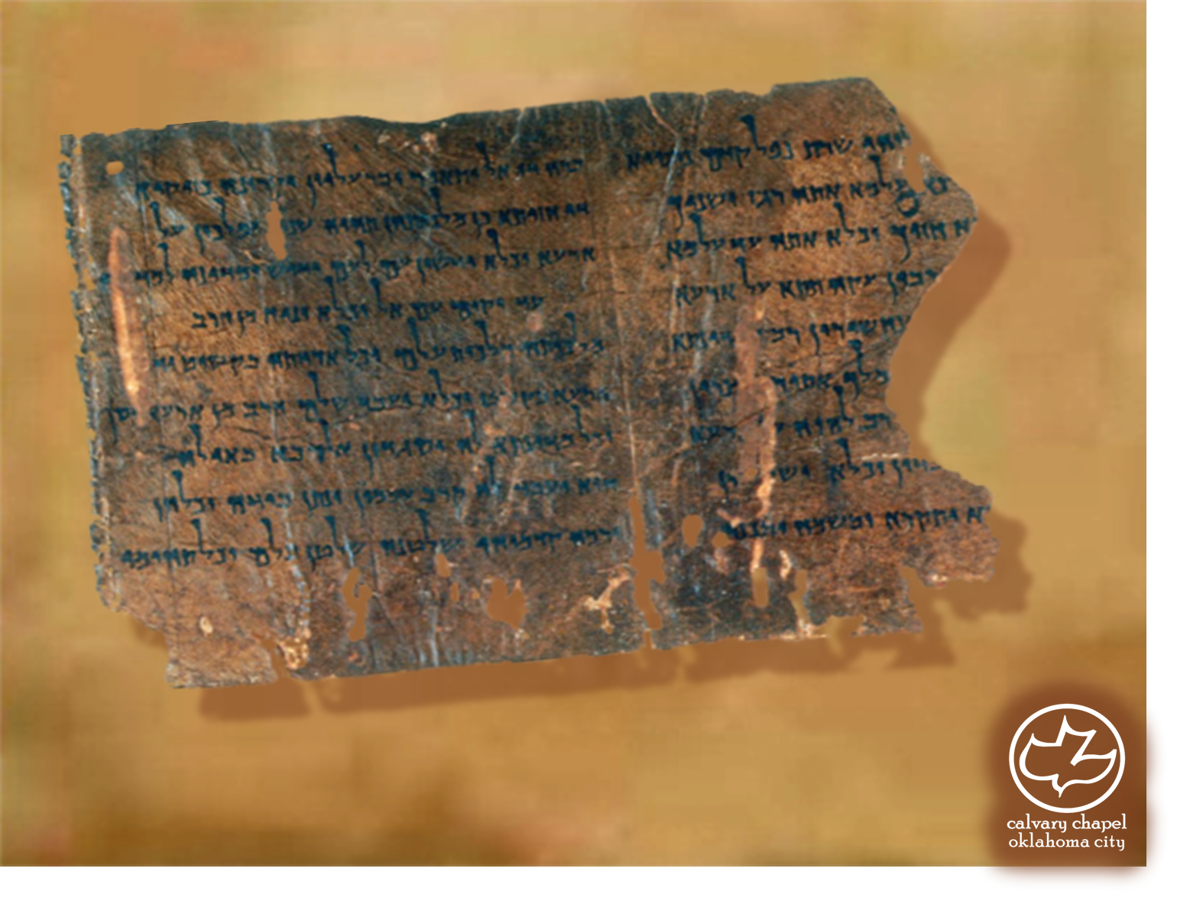

Minor Prophets … Major Message:
Micah 1:1-2:13
A CD of this message will be available (free of charge) immediately following today's message
This message will be available via podcast later this week at calvaryokc.com

Slide 2
Micah 1:1-2:13
Shortened form of Micaiah
Who is like Yahweh?

Slide 3
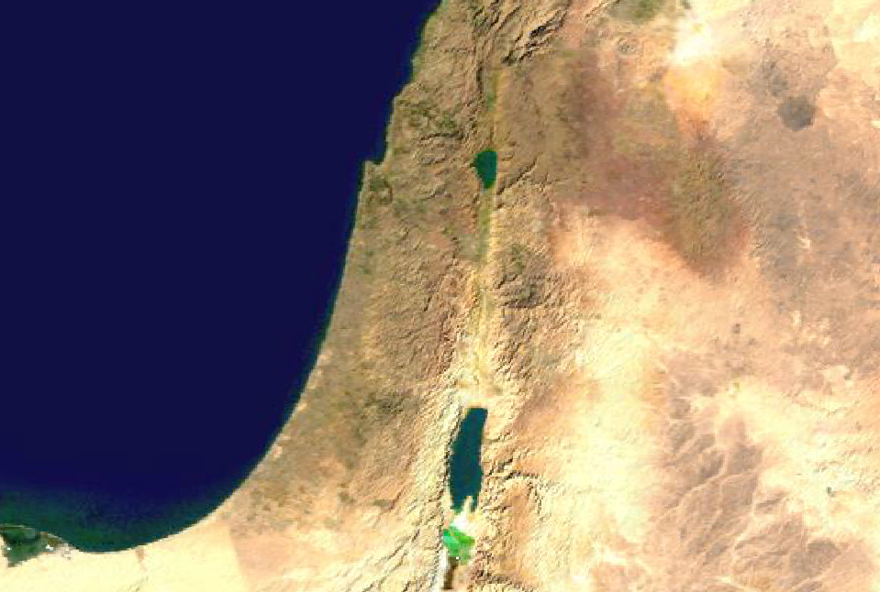
Micah 1:1-2:13
Jerusalem
Moresheth

Slide 4
Micah 1:1-2:13
Jotham
(739-735 BC)
Ahaz
(735-715 BC)
Hezekiah
(715-686 BC)
740BC
730BC
720BC
710BC
700BC
690BC
Micah
Isaiah

Slide 5
Micah 1:1-2:13
Earth ~ eretz – possibly a reference to Israel

Slide 6
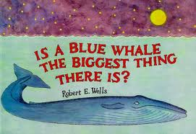
Micah 1:1-2:13
100 whales in huge jar
1 million whale jars in Mt. Everest
100 Everests = whisker on face of Earth
100 million Earths inside of Sun
50 million Suns inside Antares
Billions of stars in Milky Way
Billions of galaxies in universe
Universe mostly space

Slide 7
Micah 1:1-2:13
Jackals ~ KJV, dragons
Ostriches ~ KJV, owls (literally, unclean birds)

Slide 8
Micah 1:1-2:13
Shaphir ~ beauty
Maroth ~ bitterness

Slide 9
Micah 1:1-2:13
Moresheth ~ possession
Achzib ~ deceit or lie

Slide 10
Micah 1:1-2:13
Disaster ~ evil, KJV

Slide 11
Micah 1:1-2:13
Lately ~ literally, yesterday
NLT ~ Yet to this very hour my people rise against me like an enemy!

