Slide 1


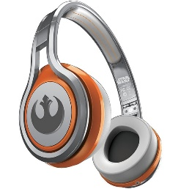
MATTHEW 26:31-56
A free CD of this message will be available following the service
IT WILL ALSO be available LATER THIS WEEK
VIA cALVARYOKC.COM

Slide 2

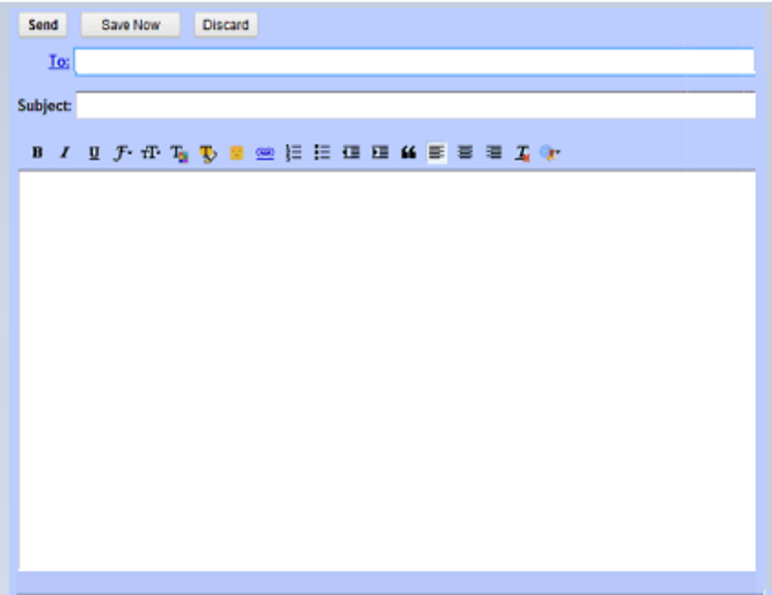
MATTHEW 26:31-56
JenJohnson@gmail.com
JJohnson@gmail.com
Arrived Safely
To My Loving Wife: I’ve just been checked in. Everything has been prepared for your arrival here tomorrow. Looking forward to seeing you then.
Your Devoted Husband.
P. S. It sure is hot down here.

Slide 3

MATTHEW 26:31-56

Slide 4
MATTHEW 26:31-56
Luke 22:31-32 ~ ³¹ And the Lord said, “Simon, Simon! Indeed, Satan has asked for you (plural), that he may sift you as wheat. ³² But I have prayed for you (singular), that your faith should not fail; and when you have returned to Me, strengthen your brethren.”

Slide 5
MATTHEW 26:31-56

Slide 6
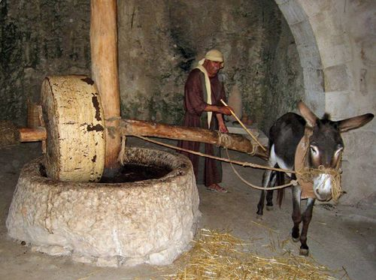
MATTHEW 26:31-56
Gethsemane ~ oil press

Slide 7
MATTHEW 26:31-56

Slide 8
MATTHEW 26:31-56
Mark 14:33 ~ … and He began to be troubled and deeply distressed.
Troubled ~ to throw into terror; to be utterly horrified
Deeply distressed ~ strongest of 3 Greek words for depression

Slide 9
MATTHEW 26:31-56

Slide 10
MATTHEW 26:31-56
Jon Courson ~ “Not name it and claim it, but request and rest”

Slide 11
MATTHEW 26:31-56

Slide 12
MATTHEW 26:31-56
Great multitude ~ speira (1/10 of a legion – 600 men)
John 18:3 ~ detachment

Slide 13
MATTHEW 26:31-56

Slide 14
MATTHEW 26:31-56
Kissed ~ kataphileō – 4x
Matt. 26:49
Luke 15:20 ~ forgiving father before prodigal son
Luke 7:38, 45 ~ repentant woman before Jesus
Acts 20:37~ Ephesian elders before Paul

Slide 15
MATTHEW 26:31-56
I wonder how it makes you feel when the prodigal won't come home
I wonder how it makes you feel when he'd rather be on his own
I wonder what it's like for you when a lamb has gone astray
I wonder what it's like for you when your children disobey

Slide 16
MATTHEW 26:31-56
I wonder how it makes you feel when no one seeks your face
I wonder how it makes you feel when they give up in the race
I wonder what it's like for you when they willingly disobey
I wonder what it's like for you when they willingly walk away

Slide 17
MATTHEW 26:31-56
It must be like another thorn struck in your brow
It must be like another close friend's broken vow
It must be like another nail right through your wrist
It must be just like
Judas’ kiss
… just like

Slide 18
MATTHEW 26:31-56

Slide 19
MATTHEW 26:31-56
NASB ~ Friend, do what you have come for.

Slide 20
MATTHEW 26:31-56

Slide 21
MATTHEW 26:31-56
1 Pet. 2:21-24 ~ ²¹ For to this you were called, because Christ also suffered for us, leaving us an example, that you should follow His steps:
²² “Who committed no sin,
Nor was deceit found in His mouth”;
²³ who, when He was reviled, did not revile in return; when He suffered, He did not threaten, but committed Himself to Him who judges righteously; ²⁴ who Himself bore our sins in His own body on the tree, that we, having died to sins, might live for righteousness— by whose stripes you were healed.

Slide 22

MATTHEW 26:31-56
God’s Holiness
God’s Mercy
God’s Holiness
God’s Mercy

Slide 23
MATTHEW 26:31-56

Slide 24
MATTHEW 26:31-56
C. H. Spurgeon ~ “It would have been to the eternal honor of any one of the disciples to have kept close to Christ right up to the last, but neither the loving John nor the boastful Peter stood the test of that solemn time. Human nature is such poor stuff, even at the best, that we cannot hope that any of us would have been braver or more faithful than the apostles were.”

Slide 25
MATTHEW 26:31-56

