Slide 1
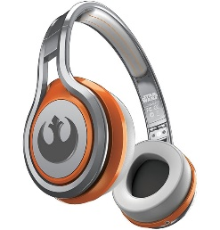
MATTHEW 26:17-39
A free CD of this message will be available following the service
IT WILL ALSO be available LATER THIS WEEK
VIA cALVARYOKC.COM

Slide 2
MATTHEW 26:17-30
Supper?

Slide 3
MATTHEW 26:17-30

Slide 4
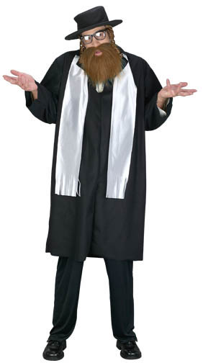
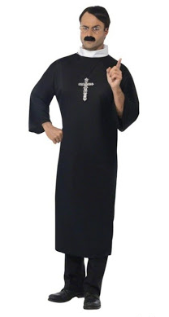
MATTHEW 26:17-30

Slide 5
MATTHEW 26:17-30

Slide 6
MATTHEW 26:17-30
Rom. 14:14-21 ~ ¹⁴ I know and am convinced by the Lord Jesus that there is nothing unclean of itself; but to him who considers anything to be unclean, to him it is unclean. ¹⁵ Yet if your brother is grieved because of your food, you are no longer walking in love. Do not destroy with your food the one for whom Christ died. ¹⁶ Therefore do not let your good be spoken of as evil; ¹⁷ for the kingdom of God is not eating and drinking, but righteousness and peace and joy in the Holy Spirit.

Slide 7
MATTHEW 26:17-30
Rom. 14:14-21 ~ ¹⁸ For he who serves Christ in these things is acceptable to God and approved by men.
¹⁹ Therefore let us pursue the things which make for peace and the things by which one may edify another. ²⁰ Do not destroy the work of God for the sake of food. All things indeed are pure, but it is evil for the man who eats with offense. ²¹ It is good neither to eat meat nor drink wine nor do anything by which your brother stumbles or is offended or is made weak.

Slide 8
MATTHEW 26:17-30

Slide 9
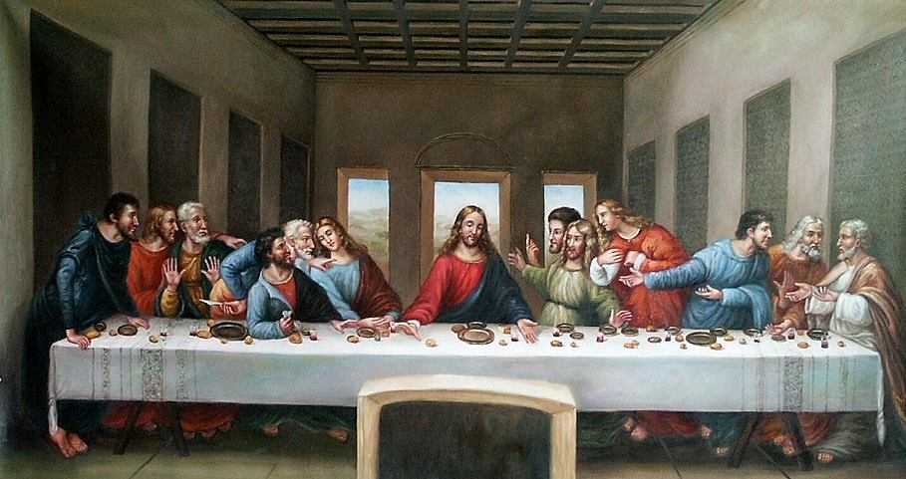
MATTHEW 26:17-30

Slide 10
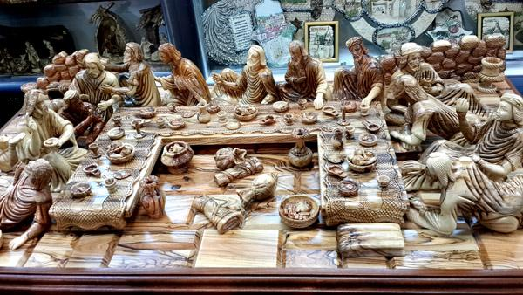
MATTHEW 26:17-30
Judas
Other Disciples
Jesus
Peter
John

Slide 11
MATTHEW 26:17-30

Slide 12
MATTHEW 26:17-30
Two ritual sacraments:
Baptism
~ us in Christ
Communion
~ Christ in us
1 Cor. 11:23-25 ~ ²³ For I received from the Lord that which I also delivered to you: that the Lord Jesus on the same night in which He was betrayed took bread; ²⁴ and when He had given thanks, He broke it and said, “Take, eat; this is My body which is broken for you; do this in remembrance of Me.” ²⁵ In the same manner He also took the cup after supper, saying, “This cup is the new covenant in My blood. This do, as often as you drink it, in remembrance of Me.”

Slide 13
MATTHEW 26:17-30
Eucharist ~ literally, good grace – to be thankful
The Lord’s Supper
The Lord’s Table
Communion ~ fellowship

Slide 14
MATTHEW 26:17-30
Genesis
Exodus
Ezra
Leviticus
Nehemiah
Numbers
Hosea
Esther
Deuteronomy
Amos
Job
Joshua
Obadiah
Psalms
Judges
Jonah
Proverbs
Ruth
Ecclesiastes
Nahum
Last Supper
Numbers
Habakkuk
Song of Songs
Deuteronomy
Zephaniah
Isaiah
Joshua
Jeremiah
Haggai
Judges
Zechariah
Lamentations
Ruth
Malachi
Ezekiel
1 & 2 Samuel
Daniel
1 & 2 Kings
1 & 2 Chronicles

Slide 15
MATTHEW 26:17-30

Slide 16
MATTHEW 26:17-30
2 Cor. 5:21 ~ For He made Him who knew no sin to be sin for us, that we might become the righteousness of God in Him.

Slide 17
MATTHEW 26:17-30

Slide 18
MATTHEW 26:17-30
Lev. 17:11 ~ For the life of the flesh is in the blood,
Life ~ nepesh – often translated, soul
Blood
Life
The blood is the visible representation of the life/soul

Slide 19
MATTHEW 26:17-30

Slide 20
MATTHEW 26:17-30
Hymn ~ Hallel Psalms (113-118) – sung during Passover
113-114 ~ sung at the beginning
115-118 ~ sung at the conclusion

Slide 21
MATTHEW 26:17-30
Ps. 115:2-3 ~ ² Why should the Gentiles say,
“So where is their God?”
³ But our God is in heaven;
He does whatever He pleases.
Psalm 116:1–2 ~ ¹ I love the Lord, because He has heard My voice and my supplications.
² Because He has inclined His ear to me,
Therefore I will call upon Him as long as I live.

Slide 22
MATTHEW 26:17-30
Ps. 116:3-4 ~ ³ The pains of death surrounded me,
And the pangs of Sheol laid hold of me;
I found trouble and sorrow.
⁴ Then I called upon the name of the Lord:
“O Lord, I implore You, deliver my soul!”
Psalm 116:7-8 ~ ⁷ Return to your rest, O my soul,
For the Lord has dealt bountifully with you.
⁸ For You have delivered my soul from death,
My eyes from tears,
And my feet from falling.

Slide 23
MATTHEW 26:17-30
Ps. 116:12-13 ~ ¹² What shall I render to the Lord
For all His benefits toward me?
¹³ I will take up the cup of salvation,
And call upon the name of the Lord.
Ps. 118:1 ~ Oh, give thanks to the Lord, for He is good!
For His mercy endures forever.

Slide 24
MATTHEW 26:17-30
Ps. 118:5-6 ~ ⁵ I called on the Lord in distress;
The Lord answered me and set me in a broad place.
⁶ The Lord is on my side;
I will not fear.
What can man do to me?
Ps. 118:10-11 ~ ¹⁰ All nations surrounded me,
But in the name of the Lord I will destroy them.
¹¹ They surrounded me,
Yes, they surrounded me;
But in the name of the Lord I will destroy them.

Slide 25
MATTHEW 26:17-30
Ps. 118:12-14 ~ ¹² They surrounded me like bees;
They were quenched like a fire of thorns;
For in the name of the Lord I will destroy them.
¹³ You pushed me violently, that I might fall,
But the Lord helped me.
¹⁴ The Lord is my strength and song,
And He has become my salvation.

Slide 26
MATTHEW 26:17-30
Ps. 118:22-24 ~ ²² The stone which the builders rejected
Has become the chief cornerstone.
²³ This was the Lord’s doing;
It is marvelous in our eyes.
²⁴ This is the day the Lord has made;
We will rejoice and be glad in it.

Slide 27
MATTHEW 26:17-30

