Slide 1


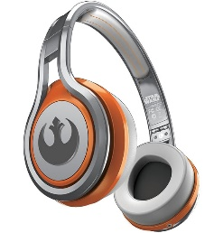
MATTHEW 26:1-16
A free CD of this message will be available following the service
IT WILL ALSO be available LATER THIS WEEK
VIA cALVARYOKC.COM

Slide 2

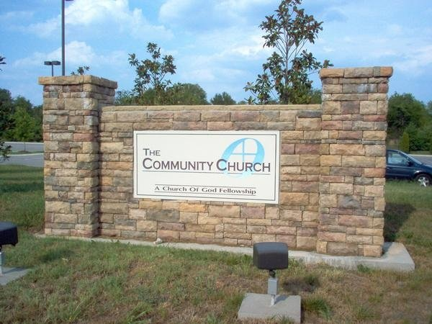
MATTHEW 26:1-16
Bēma = Judgment Seat
Bēma Seat = Judgment Seat Seat
Bēma Judgment
= Judgment Seat Judgment?
1st Church of the Arcane Baloney
“Bēma Seat Judgment = the Judgment Seat Judgment Seat”
“Straining at gnats; swallowing camels”

Slide 3

MATTHEW 26:1-16

Slide 4
MATTHEW 26:1-16
Great error to avoid when studying the closing chapters of the Gospels …
Shame
Sovereignty
Disgrace
Destiny
Guilt
Grace

Slide 5
MATTHEW 26:1-16

Slide 6
MATTHEW 26:1-16
Trickery ~ word meaning to bait
John 1:47b ~ Behold, an Israelite indeed, in whom is no deceit!

Slide 7
MATTHEW 26:1-16

Slide 8
MATTHEW 26:1-16
Mark 14:5 ~ 300 denarii
John 12:3 ~ Then Mary took a pound of very costly oil of spikenard, anointed the feet of Jesus, and wiped His feet with her hair.
Mary of Bethany

Slide 9
MATTHEW 26:1-16
Comparison of Luke 7:36-50 with Matt. 26:1-13
Similarities
Dissimilarities
Both hosts named “Simon”
Different times/locations
Both woman anointed Jesus with perfume
Luke 7, Simon the Pharisee; Matt. 26, Simon the Leper
Luke 7, act of repentance; Matt. 26, act of devotion

Slide 10
MATTHEW 26:1-16

Slide 11
MATTHEW 26:1-16
John 12:4-6 ~ ⁴ But one of His disciples, Judas Iscariot, Simon's son, who would betray Him, said, ⁵ “Why was this fragrant oil not sold for three hundred denarii and given to the poor? ⁶ This he said, not that he cared for the poor, but because he was a thief, and had the money box; and he used to take what was put in it.

Slide 12
MATTHEW 26:1-16

Slide 13
MATTHEW 26:1-16
Luke 10:38-42 ~ ³⁸ Now it happened as they went that He entered a certain village; and a certain woman named Martha welcomed Him into her house. ³⁹ And she had a sister called Mary, who also sat at Jesus’ feet and heard His word. ⁴⁰ But Martha was distracted with much serving,
and she approached Him and said, “Lord, do You not care that sister has left to serve alone? Therefore tell her to help me.”
⁴¹ And Jesus answered and said to her, “Martha,
my
me

Slide 14
MATTHEW 26:1-16
Luke 10:38-42 ~ Martha, you are worried and troubled about many things. ⁴² But one thing is needed, and Mary has chosen that good part, which will not be taken away from her.”

Slide 15
MATTHEW 26:1-16
Mary of Bethany is found 3x in the New Testament
Luke 10:38-42
John 11:32 ~ At the tomb of Lazarus
Matt. 26:7

Slide 16
MATTHEW 26:1-16

Slide 17
MATTHEW 26:1-16
Zech. 11:12-13 ~ ¹² Then I said to them, “If it is agreeable to you, give me my wages; and if not, refrain.” So they weighed out for my wages thirty pieces of silver.
¹³ And the Lord said to me, “Throw it to the potter”—that princely price they set on me. So I took the thirty pieces of silver and threw them into the house of the Lord for the potter.

Slide 18
MATTHEW 26:1-16
Ex. 21:32 ~ If the ox gores a male or female servant, he shall give to their master thirty shekels of silver, and the ox shall be stoned.

Slide 19
MATTHEW 26:1-16

