Slide 1


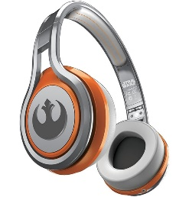
MATTHEW 25:31-46
A free CD of this message will be available following the service
IT WILL ALSO be available LATER THIS WEEK
VIA cALVARYOKC.COM

Slide 2
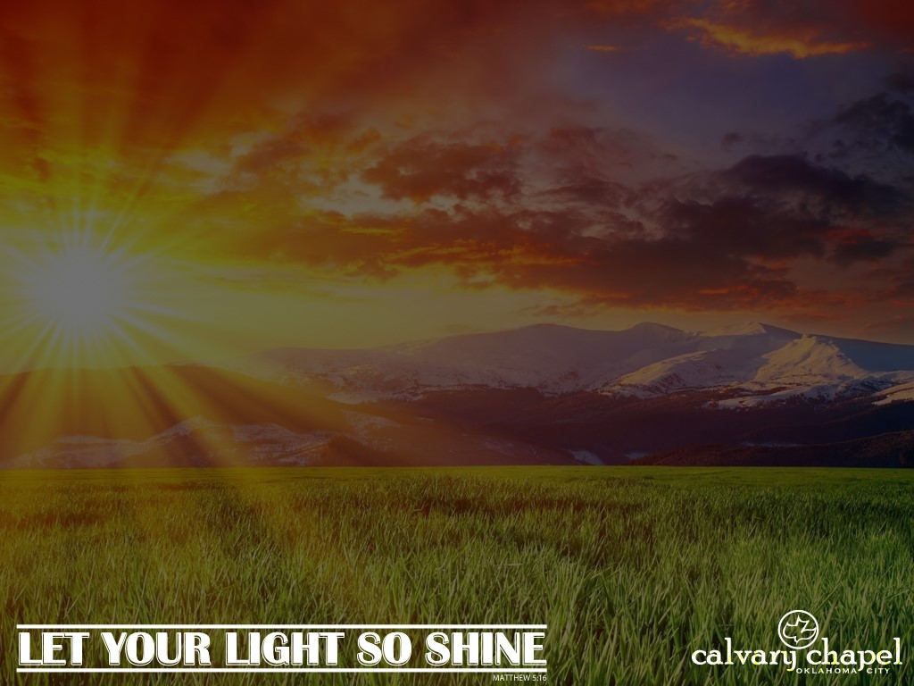
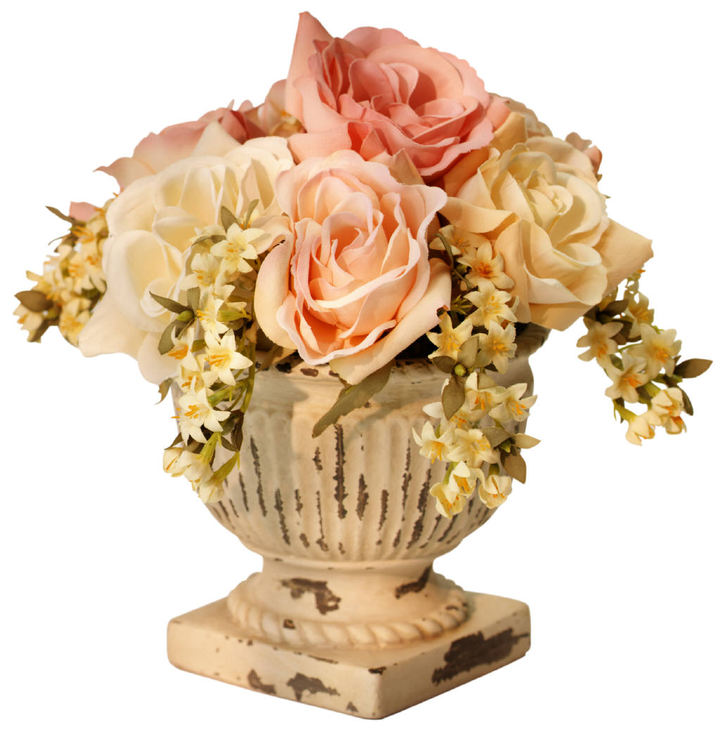

MATTHEW 25:31-46
Deepest
Sympathies
Congratulations on your
new location

Slide 3
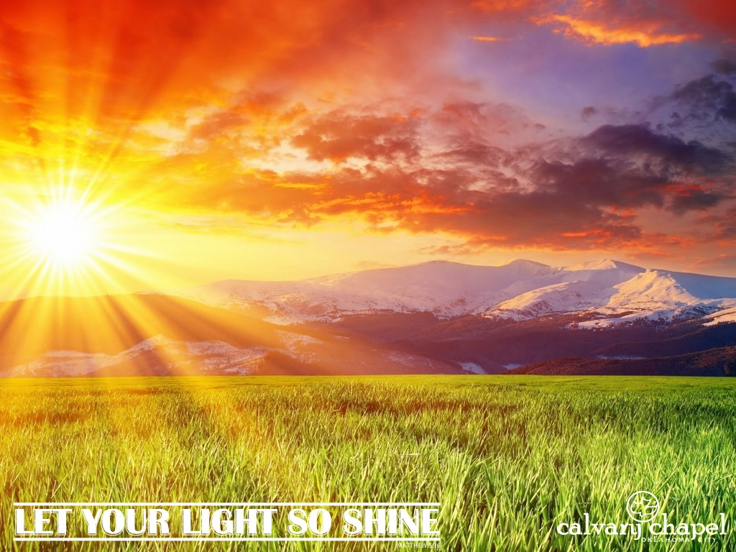
MATTHEW 25:31-46

Slide 4
MATTHEW 25:31-46
Comes in His glory ~ establishing His throne in Jerusalem
At the end of the Tribulation and the beginning of the Millennium

Slide 5
MATTHEW 25:31-46

Slide 6
MATTHEW 25:31-46
Four “End Times” Judgments:
The Bēma Judgment ~ 2 Cor. 5:10
The Sheep and the Goats Judgment ~ Matt. 25:31-46
The Israelites Judgment ~ Dan. 12:1-3
The Great, White Throne Judgment ~ Rev. 20:11-15

Slide 7
MATTHEW 25:31-46

Slide 8
MATTHEW 25:31-46
The Bēma Judgment
2 Cor. 5:10 ~ For we must all appear before the judgment seat of Christ, that each one may receive the things done in the body, according to what he has done, whether good or bad.
Judgment seat ~ Bēma
Takes place following the Rapture
Only for believers
Judgment of works, not sins

Slide 9
MATTHEW 25:31-46
The Bēma Judgment
Rom. 8:1 ~ There is therefore now no condemnation to those who are in Christ Jesus, who do not walk according to the flesh, but according to the Spirit.

Slide 10
MATTHEW 25:31-46
The Bēma Judgment
1 Cor. 3:11-15 ~ ¹¹ For no other foundation can anyone lay than that which is laid, which is Jesus Christ. ¹² Now if anyone builds on this foundation with gold, silver, precious stones, wood, hay, straw, ¹³ each one’s work will become clear; for the Day will declare it, because it will be revealed by fire; and the fire will test each one’s work, of what sort it is. ¹⁴ If anyone’s work which he has built on it endures, he will receive a reward.

Slide 11
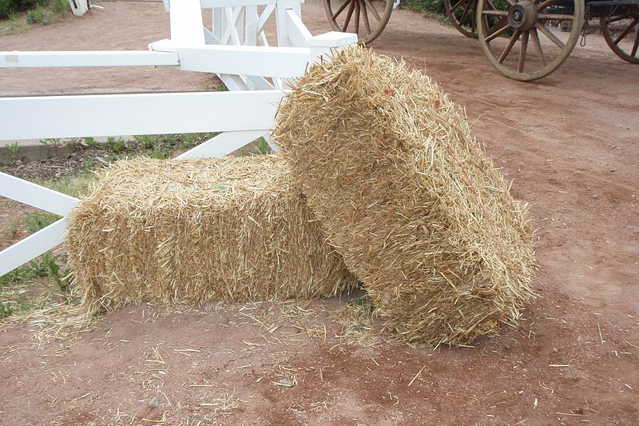

MATTHEW 25:31-46
The Bēma Judgment
1 Cor. 3:11-15 ~ ¹⁵ If anyone’s work is burned, he will suffer loss; but he himself will be saved, yet so as through fire.

Slide 12

MATTHEW 25:31-46
Bēma
Tribulation
The Four Judgments

Slide 13
MATTHEW 25:31-46

Slide 14
MATTHEW 25:31-46
The Sheep and Goats Judgment
Matt. 25:31-46
First administrative function after Jesus sets up His Kingdom
Those that survive the Tribulation

Slide 15
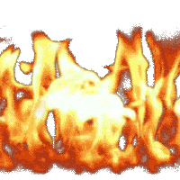
MATTHEW 25:31-46
The Sheep and Goats Judgment
My Brethren (vv.40, 45)
– Tribulation Jews
Repopulate earth during Millennium
Sheep (vv. 32, 33)
– Tribulation saints
Goats (vv. 32, 33)
– Tribulation sinners
Goats
Sheep
My Brethren

Slide 16
MATTHEW 25:31-46
Bēma
Millennial Kingdom
Tribulation
The Four Judgments
Sheep and Goats

Slide 17
MATTHEW 25:31-46

Slide 18
MATTHEW 25:31-46
The Israelites Judgment
Dan. 12:1-3 ~ ¹ At that time Michael shall stand up,
The great prince who stands watch over the sons of your people;
And there shall be a time of trouble,
Such as never was since there was a nation,
Even to that time.
And at that time your people shall be delivered,
Every one who is found written in the book.

Slide 19
MATTHEW 25:31-46
The Israelites Judgment
Dan. 12:1-3 ~ ² And many of those who sleep in the dust of the earth shall awake,
Some to everlasting life,
Some to shame and everlasting contempt.
³ Those who are wise shall shine
Like the brightness of the firmament,
And those who turn many to righteousness
Like the stars forever and ever.

Slide 20
MATTHEW 25:31-46
The Israelites Judgment
Dallas Seminary: judgment of the Tribulation Jews
Following the rise and fall of Antichrist (Dan. 11:21-45)
Those that lived by faith will be saved, those didn't aren't

Slide 21
MATTHEW 25:31-46
Bēma
Israelites
Millennial Kingdom
Tribulation
The Four Judgments
Sheep and Goats

Slide 22
MATTHEW 25:31-46
The Israelites Judgment (alternate view)
In that day (Dan. 12:1) ~ literally, in that era
Daniel 11 ~ a panorama of Israel’s future from Alexander the Great to the Antichrist
From Daniel’s perspective, seen as singular
1 Cor. 15:20-23 ~ Jesus is the “firstfruits of those who have fallen asleep”

Slide 23
MATTHEW 25:31-46
The Israelites Judgment (alternate view)
Rev. 20:5-6a ~ ⁵ But the rest of the dead did not live again until the thousand years were finished. This is the first resurrection. ^{6a} Blessed and holy is he who has part in the first resurrection. Over such the second death has no power,

Slide 24
MATTHEW 25:31-46
1st Resurrection (“Everlasting life”)
2nd Resurrection (“Everlasting contempt”)
Approximately 3000 yr.
500
1000
1550
2000
Church Age
The Four Judgments
Tribulation
Millennium

Slide 25
MATTHEW 25:31-46

Slide 26
MATTHEW 25:31-46
The Great, White Throne Judgment
Following the Millennium
Satan will be released from the Bottomless Pit (abussō)
He will rally the nations of the earth
He will be destroyed by fire and cast into the Lake of Fire
Rev. 20:11 ~ And they will be tormented day and night forever and ever.

Slide 27
MATTHEW 25:31-46
The Great, White Throne Judgment
Rev. 20:11-15 ~ ¹¹ Then I saw a great white throne and Him who sat on it, from whose face the earth and the heaven fled away. And there was found no place for them. ¹² And I saw the dead, small and great, standing before God, and books were opened. And another book was opened, which is the Book of Life. And the dead were judged according to their works, by the things which were written in the books.

Slide 28
MATTHEW 25:31-46
The Great, White Throne Judgment
Rev. 20:11-15 ~ ¹³ The sea gave up the dead who were in it, and Death and Hades delivered up the dead who were in them. And they were judged, each one according to his works. ¹⁴ Then Death and Hades were cast into the lake of fire. This is the second death. ¹⁵ And anyone not found written in the Book of Life was cast into the lake of fire.
No appeals, reprieves, acquittals, paroles or probations

Slide 29
MATTHEW 25:31-46
Great, White Throne
Bēma
Israelites
Saved
Unsaved
Millennial Kingdom
Tribulation
The Four Judgments
Sheep and Goats

Slide 30
MATTHEW 25:31-46

Slide 31
MATTHEW 25:31-46
“We have been the recipients of the choicest bounties of heaven; we have been preserved these many years in peace and prosperity; we have grown in numbers, wealth, and power as no other nation has ever grown. But we have forgotten God. We have forgotten the gracious hand which preserved us in peace and multiplied and enriched and strengthened us, and we have vainly imagined, in the deceitfulness of our hearts, that all these blessings were produced by some superior wisdom and virtue of our own. Intoxicated with unbroken success, we have become too self-sufficient to feel the necessity of redeeming and preserving grace, too proud to pray to the God that made us.”
~ Abraham Lincoln, 1863

Slide 32
MATTHEW 25:31-46
“Rom. 11:25-26 ~ ²⁵ For I do not desire, brethren, that you should be ignorant of this mystery, lest you should be wise in your own opinion, that blindness in part has happened to Israel until the fullness of the Gentiles has come in. ²⁶ And so all Israel will be saved,

Slide 33
MATTHEW 25:31-46

