Slide 1
MATTHEW 24:32-51
A free CD of this message will be available following the service
IT WILL ALSO be available LATER THIS WEEK
VIA cALVARYOKC.COM

Slide 2
MATTHEW 24:32-51

Slide 3
MATTHEW 24:32-51

Slide 4
MATTHEW 24:32-51
Reformation
200
600
1000
1400
1800
Aug 30, AD 70
Modern Zionism
Balfour Declaration
May 14, 1948

Slide 5
MATTHEW 24:32-51

Slide 6
MATTHEW 24:32-51
7-year Tribulation
Return with Jesus
1,000 yr.
Two ways into the
Millennial Kingdom
Antichrist and followers cast into Lake of Fire
Endure the Tribulation
Satan bound in the abussō
Effects of the curse lifted

Slide 7
MATTHEW 24:32-51

Slide 8
MATTHEW 24:32-51
Leviticus 23 Prophetic Feasts
2. Unleavened Bread Nisan 15 (Remission)
6. Day of Atonement
Tishri 10 (Redemption)
4. Pentecost 49 days after Firstfruits (Regeneration)
1st Coming
Church Age
2nd Coming
Mar
Apr
May
Jun
Jul
Aug
Sep
Oct
Nov
Dec
Jan
Feb
Mar
Nisan
Iyar
Sivan
Tammuz
Av
Elul
Tishri
Heshvan
Chislev
Tevet
Shevat
Adar
3. Firstfruits Sunday after Passover (Resurrection)
7. Tabernacles
Tishri 15-22 (Residing)
1. Passover
Nisan 14 (Rest)
5. Trumpets
Tishri 1 (Rapture)

Slide 9
MATTHEW 24:32-51
Generation begins
1948
Generation
+ 40
Generation ends
1988
40 yr.?
Minus Tribulation
7
Rapture
1981
1950
1960
1970
1980
1990
May 14, 1948
Sept. 28, 1981
Nov. 7, 1981
May 14, 1988

Slide 10
MATTHEW 24:32-51
Two lessons from fulfilled Bible prophecy:
1. Always fulfilled literally
2. Hardly ever according to prevailing sentiment

Slide 11
MATTHEW 24:32-51

Slide 12
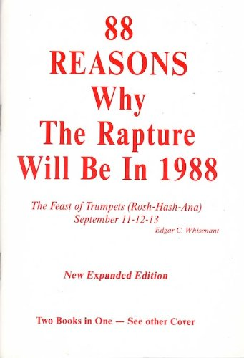
MATTHEW 24:32-51
“The Final Shout: Rapture Report 1989”
“23 Reasons Why a Pre-Tribulation Rapture Looks Like it Will Occur on Rosh-Hashanah 1993”
“And Now the Earth’s Destruction by Fire, Nuclear Bomb Fire” (1994)

Slide 13
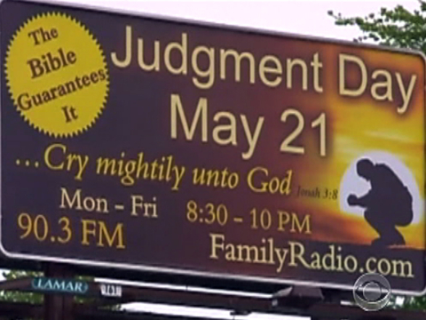
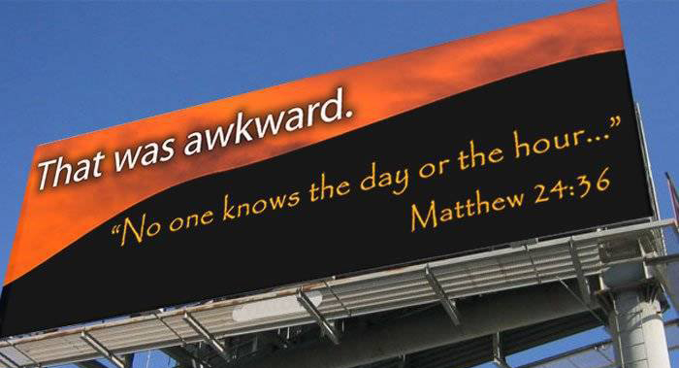
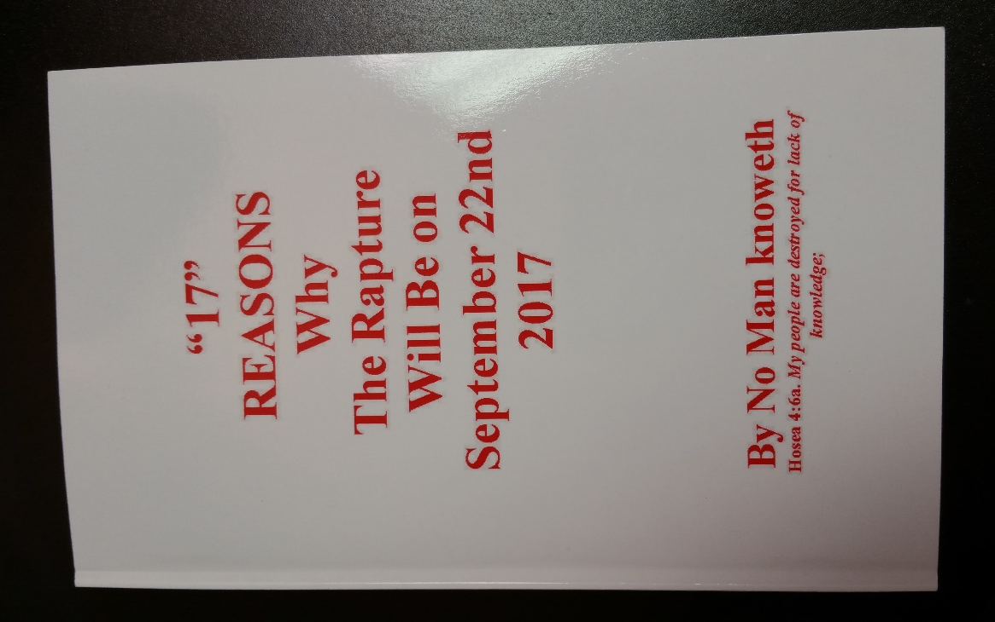
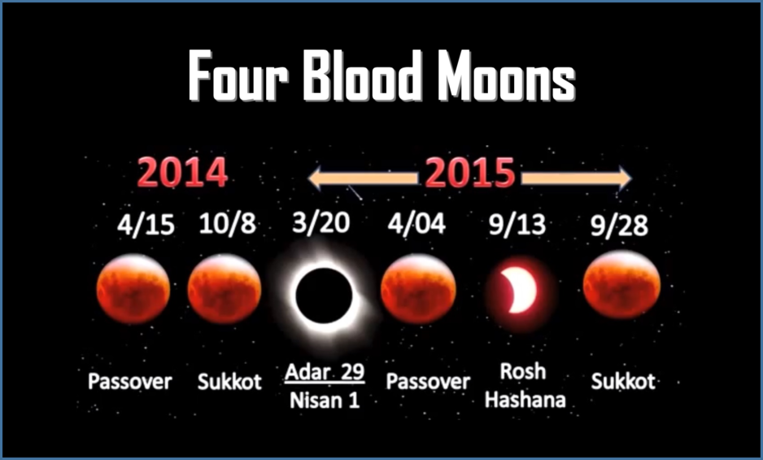
MATTHEW 24:32-51
May 22,2011

Slide 14
MATTHEW 24:32-51

Slide 15
MATTHEW 24:32-51
1 Thess. 4:18 ~ Therefore comfort one another with these words.

Slide 16
MATTHEW 24:32-51

Slide 17
MATTHEW 24:32-51
Took (v. 39) ~ to lift up (often used in reference to judgment)
Taken (vv. 40-41) ~ to receive to one’s self

Slide 18
MATTHEW 24:32-51

Slide 19
MATTHEW 24:32-51
Watch ~ grēgoreuō (Latin, vigilate)

Slide 20
MATTHEW 24:32-51

Slide 21
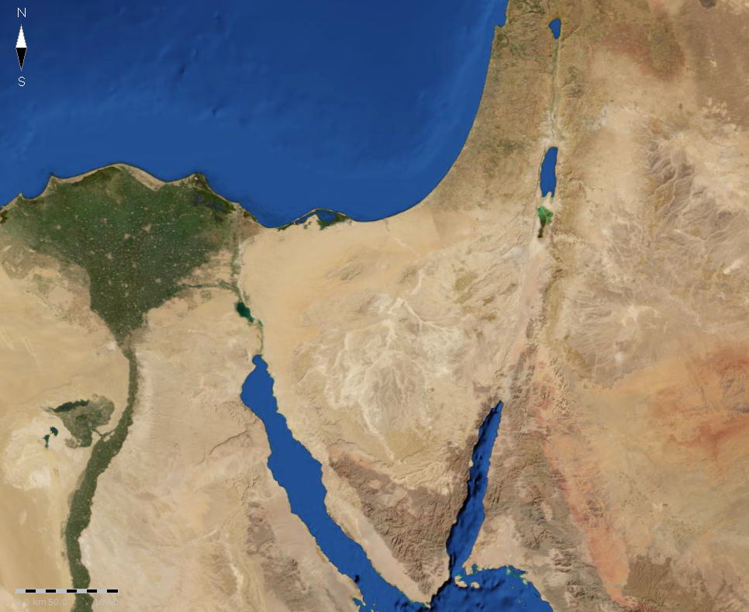
MATTHEW 24:32-51
Israel’s borders on June 5, 1967
Israel’s borders on June 10, 1967
1967 Six-day War

Slide 22
MATTHEW 24:32-51

