Slide 1
MATTHEW 24:23-31
A free CD of this message will be available following the service
IT WILL ALSO be available LATER THIS WEEK
VIA cALVARYOKC.COM

Slide 2
MATTHEW 24:23-31
Is. 26:20-21 ~ ²⁰ Come, my people, enter your chambers, And shut your doors behind you; Hide yourself, as it were, for a little moment,
Until the indignation is past.
²¹ For behold, the Lord comes out of His place To punish the inhabitants of the earth for their iniquity; The earth will also disclose her blood,
And will no more cover her slain.

Slide 3
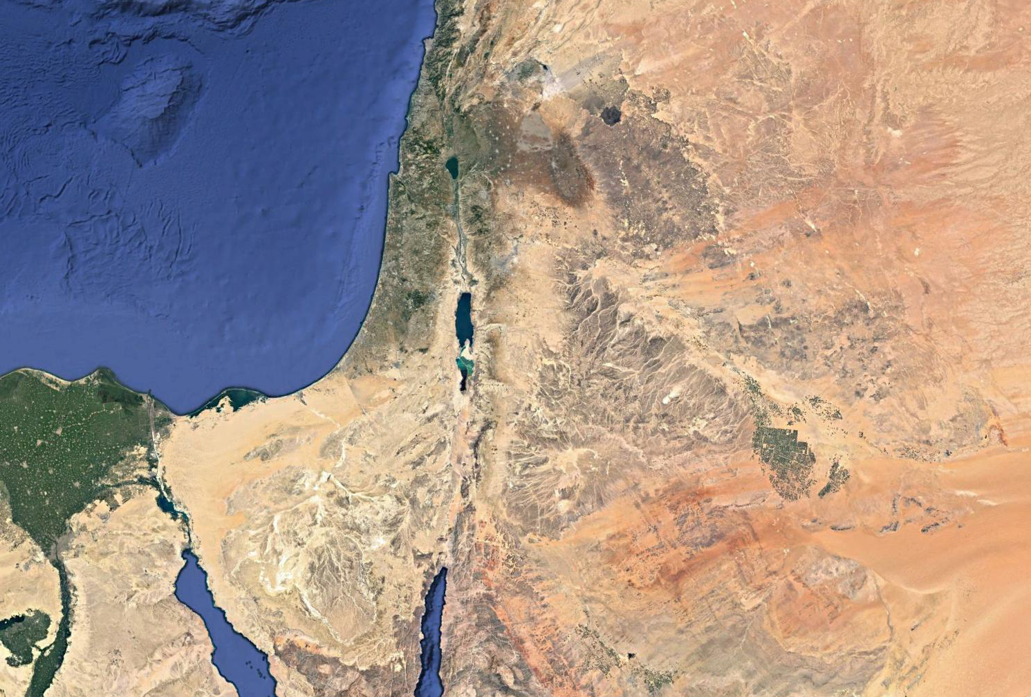
MATTHEW 24:23-31
Petra
(Sela)

Slide 4
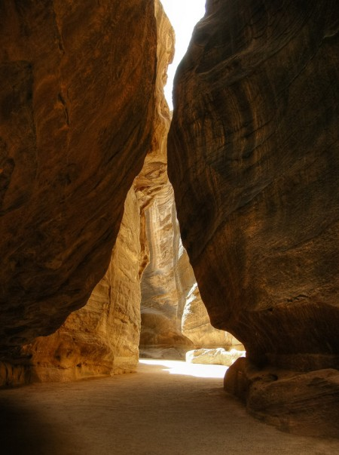
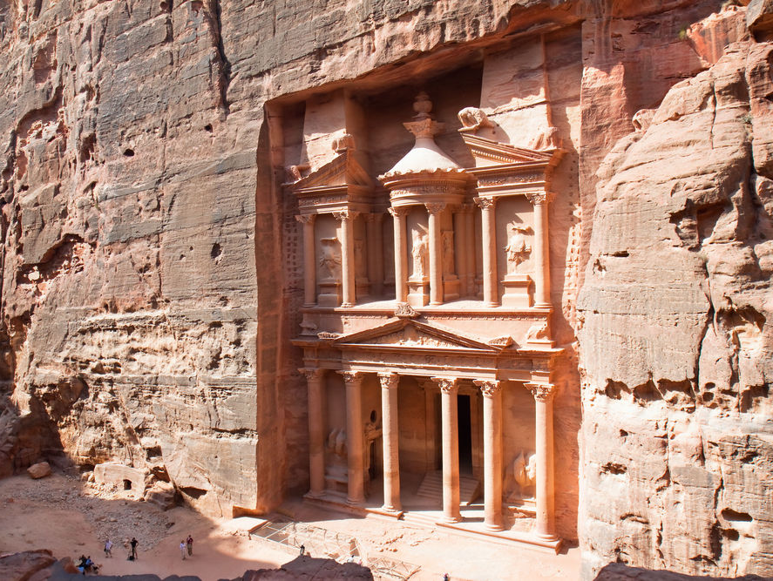
MATTHEW 24:23-31

Slide 5
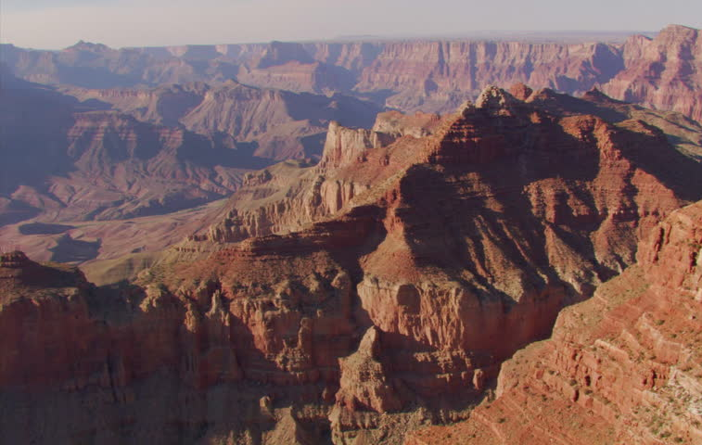
MATTHEW 24:23-31

Slide 6
MATTHEW 24:23-31

Slide 7
MATTHEW 24:23-31
Ezekiel
38-39
Ukraine
Russia
Kazakhstan
Bulgaria
Georgia
Azerbaijan
Romania
Armenia
Turkey
Iran
Syria
Israel
Saudi Arabia
Libya
Sudan

Slide 8
MATTHEW 24:23-31
2000 yr.?
7 yr.
1000 yr.
Church age
Millennium
Rapture
Christ returns
Ezekiel 38-39
Antichrist revealed

Slide 9
MATTHEW 24:23-31

Slide 10
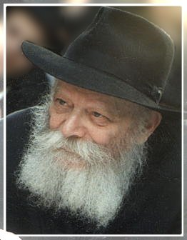
MATTHEW 24:23-31
Menachem Mendel Schneerson
(1902-1994)

Slide 11
MATTHEW 24:23-31
José Luis de Jesús Miranda
(1946-2013)

Slide 12
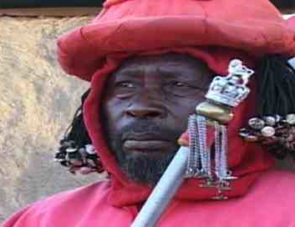
MATTHEW 24:23-31
Jehovah Wanyonyi
(1924 – 2015)

Slide 13
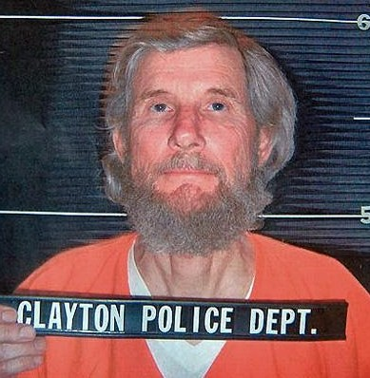
MATTHEW 24:23-31
Wayne Bent
(1941 – present)

Slide 14
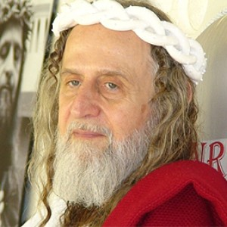
MATTHEW 24:23-31
Inri Cristo
(1848 – present)

Slide 15
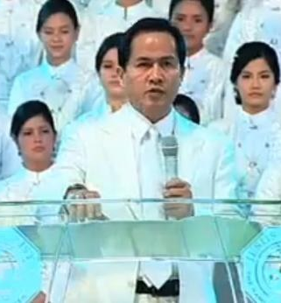
MATTHEW 24:23-31
Apollo Quiboloy
(1950 – present)

Slide 16
MATTHEW 24:23-31
Alan John (AJ) Miller
(1963 – present)

Slide 17
MATTHEW 24:23-31

Slide 18
MATTHEW 24:23-31
Eagles ~ aetos – NASB, NIV ~ vultures
From aēr ~ air

Slide 19
MATTHEW 24:23-31

Slide 20
MATTHEW 24:23-31
Is. 63:1-4 ~ ¹ Who is this who comes from Edom,
With dyed garments from Bozrah,
This One who is glorious in His apparel,
Traveling in the greatness of His strength?—
“I who speak in righteousness, mighty to save.”
² Why is Your apparel red,
And Your garments like one who treads in the winepress?

Slide 21
MATTHEW 24:23-31
Is. 63:1-4 ~ ³ “I have trodden the winepress alone,
And from the peoples no one was with Me.
For I have trodden them in My anger,
And trampled them in My fury;
Their blood is sprinkled upon My garments,
And I have stained all My robes.
⁴ For the day of vengeance is in My heart,
And the year of My redeemed has come.

Slide 22
MATTHEW 24:23-31

Slide 23
MATTHEW 24:23-31
Rapture
2nd Coming
Christ comes for His own in the air
Christ comes with His own to the earth
Rapture/Translation of all Christians
No one is translated
Christians taken to Father’s House
Tribulation martyrs do not see the Father’s House
No judgment on earth at Rapture
Christ judges the nations
Church taken to heaven at Rapture
Christ sets up His Kingdom on earth

Slide 24
MATTHEW 24:23-31
Rapture
2nd Coming
Rapture imminent
2nd Coming not for at least 7 years
No signs at Rapture
Many signs for Christ’s physical return
For believers only
Affects all humanity
Time for joy
Time for mourning
Prior to Day of Wrath (Tribulation)
Immediately following Day of Wrath (Tribulation)
No mention of Satan at the Rapture
Satan bound for 1,000 years

Slide 25
MATTHEW 24:23-31
Rapture
2nd Coming
Judgment Seat of Christ
Judgment of the Nations
Marriage of the Lamb
His Bride returns with Him
Only His own will see Him
Every eye will see Him
Tribulation begins
Millennial Kingdom begins

Slide 26
MATTHEW 24:23-31
Jerusalem
Bozrah
Petra
(Sela)

Slide 27
MATTHEW 24:23-31
Zech. 14:4 ~ And in that day His feet will stand on the Mount of Olives,
Which faces Jerusalem on the east.
And the Mount of Olives shall be split in two,
From east to west,
Making a very large valley;
Half of the mountain shall move toward the north
And half of it toward the south.

Slide 28
MATTHEW 24:23-31
Praetorium
Bethpage
Gethsemane
Temple
Mt. of Olives
Jerusalem
Kidron Valley
Bethany

Slide 29
MATTHEW 24:23-31

