Slide 1
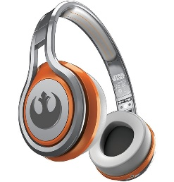
MATTHEW 23:1-12
A free CD of this message will be available following the service
IT WILL ALSO be available LATER THIS WEEK
VIA cALVARYOKC.COM

Slide 2
MATTHEW 23:1-12
1. You throw a little girl a ball, and it will hit her in the nose.
You throw a little boy a ball, and he will try to catch it. Then it will hit him in the nose.
2. You dress your little girl in her Easter Sunday best, and she'll look just as pretty when you finally make it to church an hour later.
You dress a boy in his Easter Sunday best, and he'll somehow find every mud puddle from your home to the church, even if you're driving there.

Slide 3
MATTHEW 23:1-12
3. Boys' rooms are usually messy.
Girls' rooms are usually messy, except it's a good smelling mess
4. A baby girl will pick up a stick and look in wonderment at what God has made.
A baby boy will pick up a stick and turn it into a gun.
5. When girls play with Barbie and Ken dolls, they like to dress them up and play house with them.
When boys play with Barbie and Ken dolls, they like to tear off their appendages.

Slide 4
MATTHEW 23:1-12
6. Boys couldn't care less if their hair is unruly.
If their bangs got cut a quarter-inch too short, girls would rather lock themselves in their room for two weeks than be seen in public.
7. Baby girls find mommy's makeup and almost instinctively start painting their face.
Baby boys find mommy's makeup and almost instinctively start painting the walls.

Slide 5
MATTHEW 23:1-12
8. If a girl accidentally burps, she will be embarrassed.
If a boy accidently burps, he will follow it with a dozen fake burps.
9. Boys grow their fingernails long because they're too lazy to cut them.
Girls grow their fingernails long - not because they look nice - but because they can dig them into a boy’s arm.

Slide 6
MATTHEW 23:1-12
10. Girls are attracted to boys, even at an early age.
At an early age, boys are attracted to dirt.
11. Most baby girls talk before boys do.
Before boys talk, they learn how to make machine-gun noises.
12. Girls will cry if someone dies in a movie.
Boys will cry if you turn off the DVD after they've watched the “Teenage Mutant Ninja Turtles” movie only three times in a row.

Slide 7
MATTHEW 23:1-12
13. Girls turn into women.
Boys turn into bigger boys.

Slide 8
MATTHEW 23:1-12

Slide 9
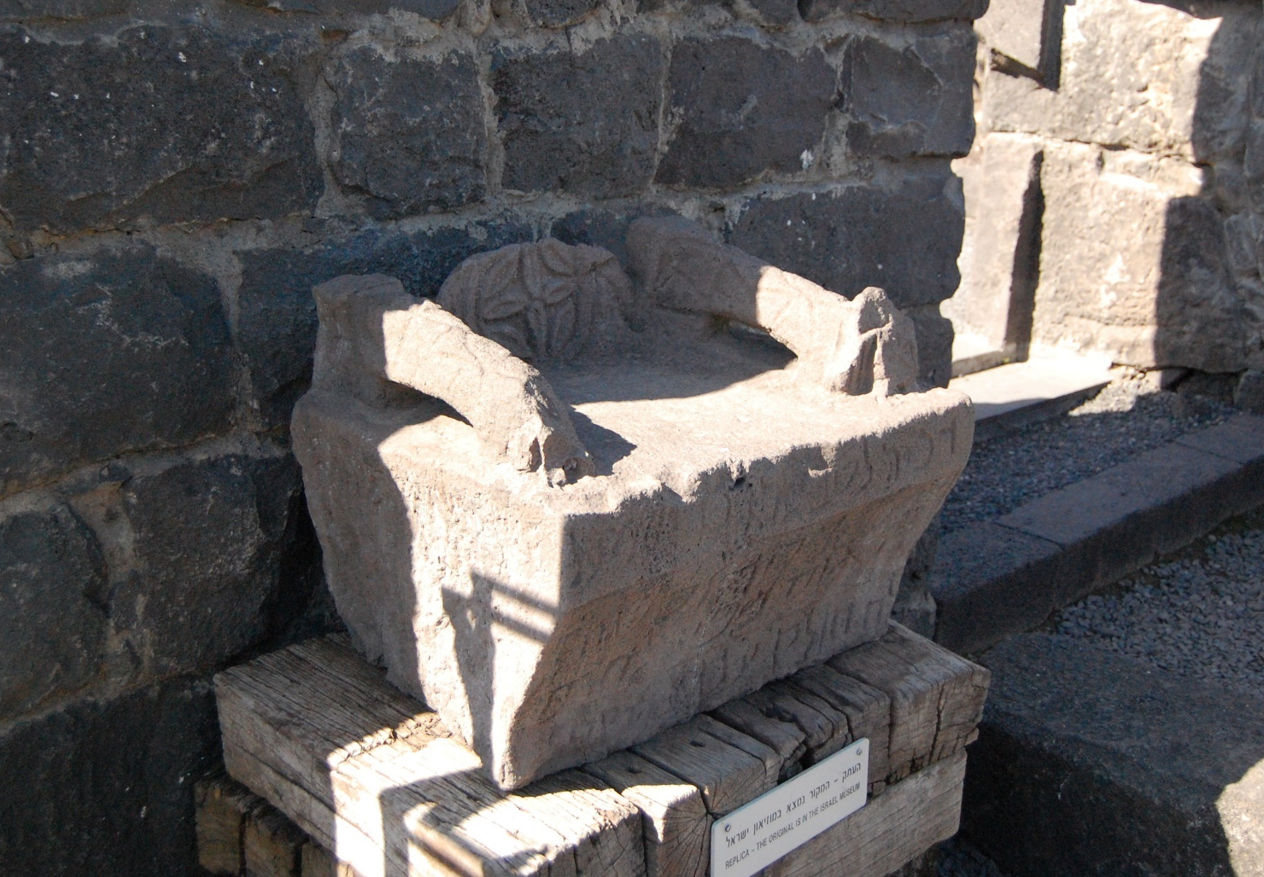
MATTHEW 23:1-12
“Moses’ seat” from 4th century synagogue in Chorazin

Slide 10
MATTHEW 23:1-12

Slide 11
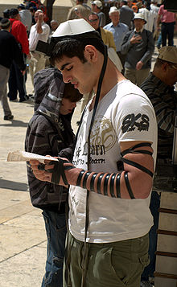
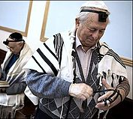
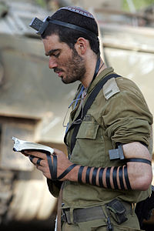
MATTHEW 23:1-12
Deut. 6:8 ~ You shall bind them as a sign on your hand, and they shall be as
frontlets between your eyes.

Slide 12
MATTHEW 23:1-12

Slide 13
MATTHEW 23:1-12
Rabbi ~ from Hebrew word rab
Meaning more, great or much
Literally, “my great one”
Guru

Slide 14
MATTHEW 23:1-12

Slide 15
MATTHEW 23:1-12
Father ~ giver of life
1 Cor. 4:15 ~ For though you might have ten thousand instructors in Christ, yet you do not have many fathers; for in Christ Jesus I have begotten you through the gospel.

Slide 16
MATTHEW 23:1-12

Slide 17
MATTHEW 23:1-12
Teacher ~ better, guide
Only here and in v. 8
John 14:6 ~ Jesus said to him, “I am the way, the truth, and the life. No one comes to the Father except through Me.”

Slide 18
MATTHEW 23:1-12

Slide 19
MATTHEW 23:1-12
Ps. 111:9 (KJV) ~ He sent redemption unto his people: he hath commanded his covenant forever: holy and reverend is his name.
yare` (yaw-RAY) ~ usually translated to fear or to be afraid
Ps. 11:9 (NKJV) ~ He has sent redemption to
His people;
He has commanded His covenant forever:
Holy and awesome is His name.

Slide 20
MATTHEW 23:1-12
Title
As opposed to
Most Reverend
Not-so-much Reverend
Right Reverend
Left/Wrong Reverend
Very Reverend
Kinda-sorta Reverend
Reverend
Plain ol’ Christian

Slide 21
MATTHEW 23:1-12

Slide 22
MATTHEW 23:1-12
Ex cathedra: “By a definition ‘ex cathedra’ is meant a formal infallible decision of the pope, obligatory on all the faithful.” – The Catholic Encyclopedia, ref. Cathedra
Infallibility: “In general, exemption or immunity from liability to error or failure; in particular in theological usage, the supernatural prerogative by which the Church of Christ is, by a special Divine assistance, preserved from liability to error in her definitive dogmatic teaching regarding matters of faith and morals.” – The Catholic Encyclopedia, ref. Infallibility

Slide 23
MATTHEW 23:1-12

Slide 24
MATTHEW 23:1-12
1 Sam. 24:1-6 ~
⁶ … “The Lord forbid that I should do this thing to my master, the Lord’s anointed, to stretch out my hand against him, seeing he is the anointed of the Lord.”
1 Sam. 26:5-11 ~
¹¹ “The Lord forbid that I should stretch out my hand against the Lord’s anointed. But please, take now the spear and the jug of water that are by his head, and let us go.”

Slide 25
MATTHEW 23:1-12
Ps. 62:2 ~ He only is my rock and my salvation;
He is my defense;
I shall not be greatly moved.

Slide 26
MATTHEW 23:1-12

Slide 27
MATTHEW 23:1-12
Eph. 2:19-20 ~ ¹⁹ Now, therefore, you are no longer strangers and foreigners, but fellow citizens with the saints and members of the household of God, ²⁰ having been built on the foundation of the apostles and prophets, Jesus Christ Himself being the chief cornerstone,

Slide 28
MATTHEW 23:1-12
G. Campbell Morgan ~ “The essential thing in religion is Life. The false knew nothing of life in the soul, the false spent its time in making burdens, and binding them on men. There is the difference between false and true religion. False religion is on; true religion is in … The difference between the two is Life.”

Slide 29
MATTHEW 23:1-12

Slide 30
MATTHEW 23:1-12
D. L. Moody (1837–1899) ~ “A man can counterfeit love, he can counterfeit faith, he can counterfeit hope and all the other graces, but it is very difficult to counterfeit humility.”
C. H. Spurgeon (1834–1892) ~ “He whose garments are the whitest will best perceive the spots upon them. He whose crown shines the brightest will know when he has lost a jewel. He who gives the most light to the world will always be able to discover his own darkness.”

Slide 31
MATTHEW 23:1-12
Roy M. Pearson ~ “Being humble involves the willingness to be reckoned a failure in everyone’s sight but God’s.”

Slide 32
MATTHEW 23:1-12

