Slide 1


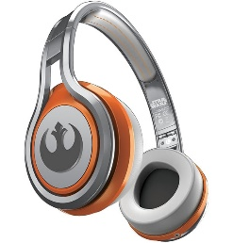
MATTHEW 22:34-46
A free CD of this message will be available following the service
IT WILL ALSO be available LATER THIS WEEK
VIA cALVARYOKC.COM

Slide 2


MATTHEW 22:34-46
The Torah (the Law) is the Old Testament standard (613 precepts)
365 negative
248 positive
Deuteronomy
numbers
Leviticus
exodus
genesis

Slide 3

MATTHEW 22:34-46

Slide 4
MATTHEW 22:34-46
Shema (Deut. 6:4-9)

Slide 5
MATTHEW 22:34-46

Slide 6
MATTHEW 22:34-46
William Barclay (1907-1978) ~ “It means that to God we must give a total love, a love which dominates our emotions, and a love which directs our thoughts.”
William Law (1686-1781) ~ “To love God wholeheartedly, we must be convinced that our only happiness is in him alone. We cannot believe this until we renounce all other efforts at happiness. If we look to God to supply half our happiness, we can only love him with half our hearts.”

Slide 7
MATTHEW 22:34-46

Slide 8




MATTHEW 22:34-46
Heat
Good
Light
Love
Cold
Evil
Dark
Hate

Slide 9
MATTHEW 22:34-46
James 3:6-10 ~ ⁶ And the tongue is a fire, a world of iniquity. The tongue is so set among our members that it defiles the whole body, and sets on fire the course of nature; and it is set on fire by hell. ⁷ For every kind of beast and bird, of reptile and creature of the sea, is tamed and has been tamed by mankind. ⁸ But no man can tame the tongue. It is an unruly evil, full of deadly poison. ⁹ With it we bless our God and Father, and with it we curse men, who have been made in the similitude of God. ¹⁰ Out of the same mouth proceed blessing and cursing. My brethren, these things ought not to be so.

Slide 10
MATTHEW 22:34-46
1 John 4:20 ~ If someone says, “I love God,” and hates his brother, he is a liar; for he who does not love his brother whom he has seen, how can he love God whom he has not seen?

Slide 11
MATTHEW 22:34-46

Slide 12
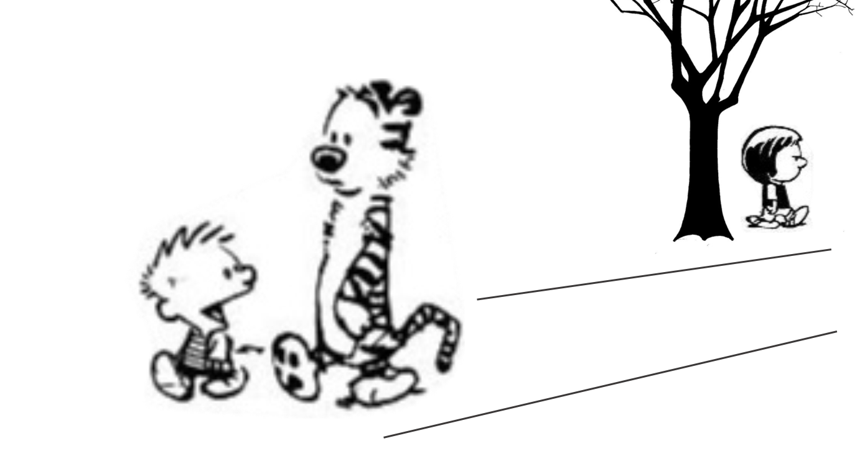
MATTHEW 22:34-46
“I feel bad that
I called Susie names and hurt her feelings. I'm sorry I did it.”
“Maybe you should apologize to her.”

Slide 13
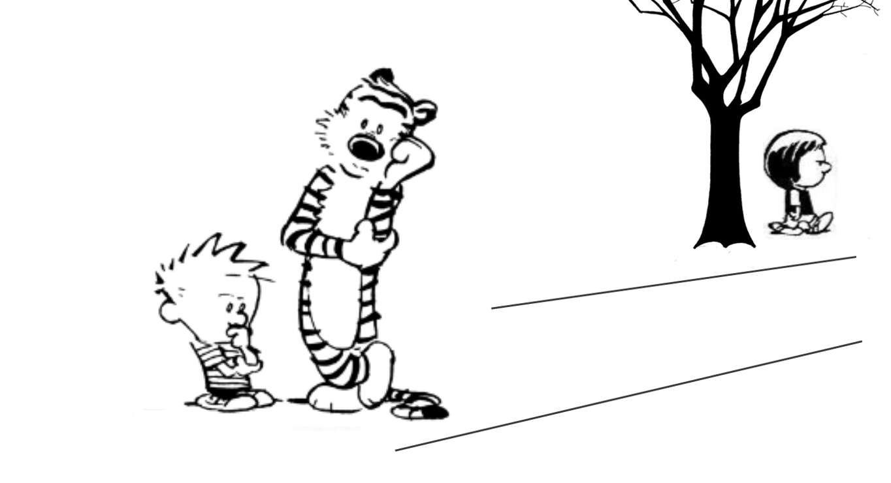
MATTHEW 22:34-46

Slide 14
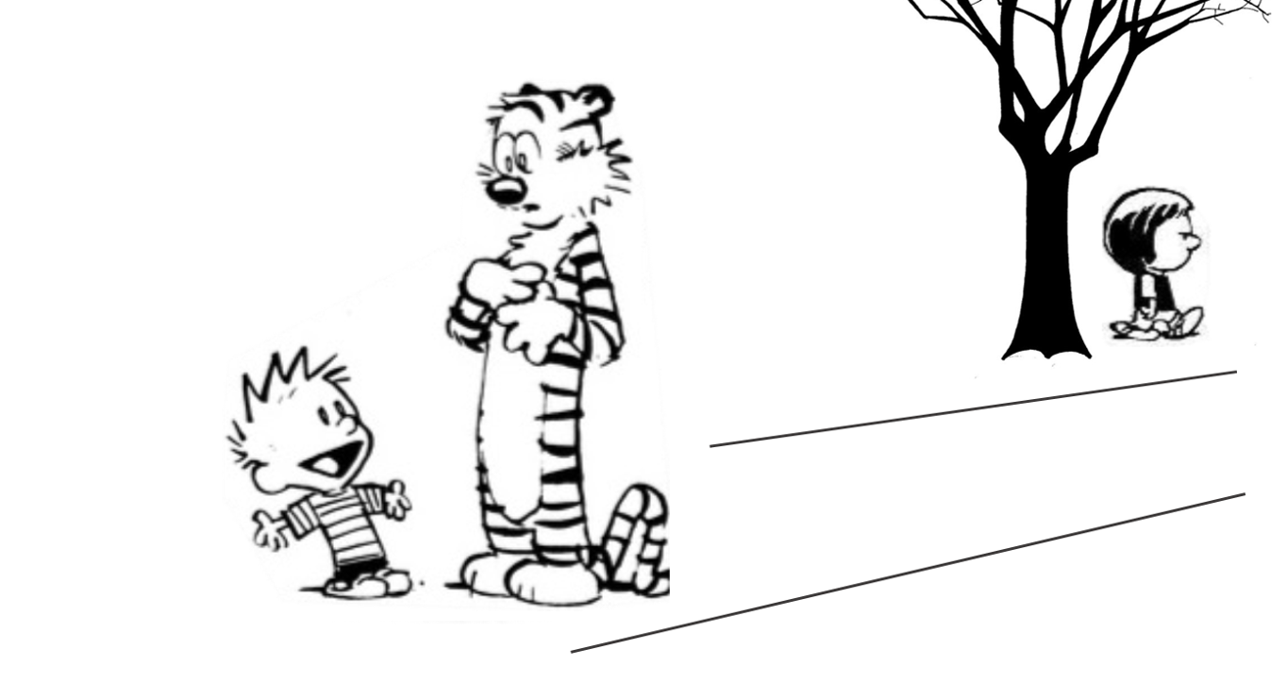
MATTHEW 22:34-46
“I keep hoping there's a less obvious solution.”

Slide 15
MATTHEW 22:34-46

Slide 16
MATTHEW 22:34-46
Psalm 110:1 ~
The said to my
Lord
LORD
YHWH
Adonai
John Knox ~ “If David calls Christ his Master; how can he also be his son?”

Slide 17
MATTHEW 22:34-46

