Slide 1



MATTHEW 21:1-17
A free CD of this message will be available following the service
IT WILL ALSO be available LATER THIS WEEK
VIA cALVARYOKC.COM

Slide 2

MATTHEW 21:1-17
John ~ Son of God
Luke ~ Son of Man
Mark ~ Quintessential Servant
Matthew ~ Promised Messiah

Slide 3

MATTHEW 21:1-17

Slide 4
MATTHEW 21:1-17
Matt. 9:27-31 ~ healing two blind guys
Mark 1:40-45 ~ cleansing the leper
Mark 5:35-43 ~ raising Jairus’ daughter
Mark 7:31-37 ~ healing the deaf-mute

Slide 5
MATTHEW 21:1-17

Slide 6
MATTHEW 21:1-17
Zech. 9:9 ~ Rejoice greatly, O daughter of Zion!
Shout, O daughter of Jerusalem!
Behold, your King is coming to you;
He is just and having salvation,
Lowly and riding on a donkey,
A colt, the foal of a donkey.

Slide 7
MATTHEW 21:1-17
Zech. 12:10 ~ And I will pour on the house of David and on the inhabitants of Jerusalem the Spirit of grace and supplication; then they will look on Me whom they pierced. Yes, they will mourn for Him as one mourns for his only son, and grieve for Him as one grieves for a firstborn.

Slide 8
MATTHEW 21:1-17

Slide 9
MATTHEW 21:1-17
Hosanna ~ yasha’ – to save or be delivered;
na’ – primary particle of incitement (with sense of immediacy), usually rendered I pray now
“Save now”
Phillips ~ The crowds … all shouted, “God save the Son of David!”

Slide 10
MATTHEW 21:1-17

Slide 11
MATTHEW 21:1-17
Luke 3:1 tells us Jesus began ministry in the 15th year of the reign of Caesar Tiberius
Tiberius begins reign (AD 14)
Jesus begins ministry(AD 29)
April 6, AD 32 (10 Nisan)
AD 15
AD 20
AD 25
AD 30
15 years
4 Passovers

Slide 12
MATTHEW 21:1-17
Ex. 12:3 ~ Speak to all the congregation of Israel, saying: “On the tenth of this month every man shall take for himself a lamb, according to the house of his father, a lamb for a household.
Lamb chosen
Lamb sacrificed
11
12
Nisan
13
14
Ex. 12:6 ~ Now you shall keep it until the fourteenth day of the same month. Then the whole assembly of the congregation of Israel shall kill it at twilight.”

Slide 13
MATTHEW 21:1-17
Ps. 118:27 ~ God is the Lord,
And He has given us light;
Bind the sacrifice with cords to the horns of the altar.

Slide 14
MATTHEW 21:1-17

Slide 15
MATTHEW 21:1-17
Zech. 14:4 ~ And in that day His feet will stand on the Mount of Olives,
Which faces Jerusalem on the east.
And the Mount of Olives shall be split in two,
From east to west,
Making a very large valley;
Half of the mountain shall move toward the north
And half of it toward the south.

Slide 16
MATTHEW 21:1-17
Praetorium
Bethpage
Gethsemane
Temple
Mt. of Olives
Jerusalem
Kidron Valley
Bethany

Slide 17
MATTHEW 21:1-17

Slide 18
MATTHEW 21:1-17
Praetorium
Bethpage
Gethsemane
Temple
Mt. of Olives
Jerusalem
Kidron Valley
Bethany

Slide 19
MATTHEW 21:1-17

Slide 20
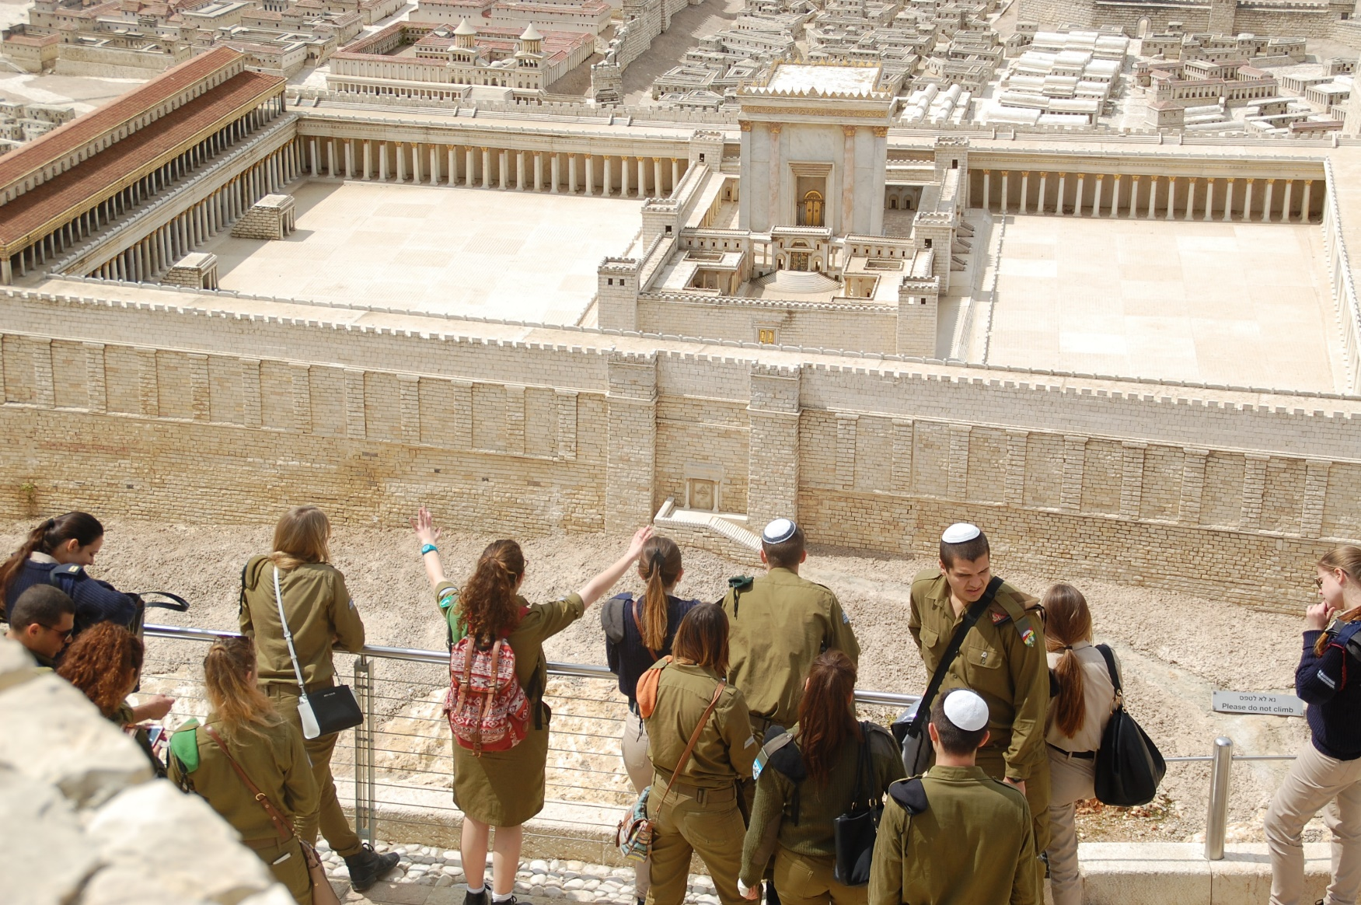
MATTHEW 21:1-17

Slide 21
MATTHEW 21:1-17

