Slide 1
MATTHEW 20:17-34
A free CD of this message will be available following the service
IT WILL ALSO be available LATER THIS WEEK
VIA cALVARYOKC.COM

Slide 2
MATTHEW 20:17-34
Par 5

Slide 3
MATTHEW 20:17-34

Slide 4
MATTHEW 20:17-34
Mark 15:40
Matt. 27:56
John 19:25
Mary, mother of Jesus
Mary, mother of Jesus
Mary, mother of Jesus
Mary Magdalene
Mary Magdalene
Mary Magdalene
Mary, mother of James and Joses
Mary, mother of James and Joses
Mary, wife of Clopas
Mother of Zebedee’s sons
His mother’s sister
Salome

Slide 5
MATTHEW 20:17-34

Slide 6
MATTHEW 20:17-34
Kneeling down ~ KJV, worship
proskuneō
pros ~ before
kuōn ~ dog
Wuest, The New Testament: An Expanded Translation ~ Then there came to Him the mother of the sons of Zebedee with her sons, falling upon her knees and touching the ground with her forehead in an expression of profound reverence, and begging something from Him.

Slide 7
MATTHEW 20:17-34

Slide 8
MATTHEW 20:17-34
Matt. 19:28 ~ So Jesus said to them, “Assuredly I say to you, that in the regeneration, when the Son of Man sits on the throne of His glory, you who have followed Me will also sit on twelve thrones, judging the twelve tribes of Israel.”
Charles Spurgeon ~ “There are no crown-wearers in heaven who were not cross-bearers here below.”

Slide 9
MATTHEW 20:17-34

Slide 10
MATTHEW 20:17-34
Servant ~ diakonos
Literally, through the dust
The servant with relationship to his work
Slave ~ doulos
From deō ~ to bind
The servant with relationship to his master

Slide 11
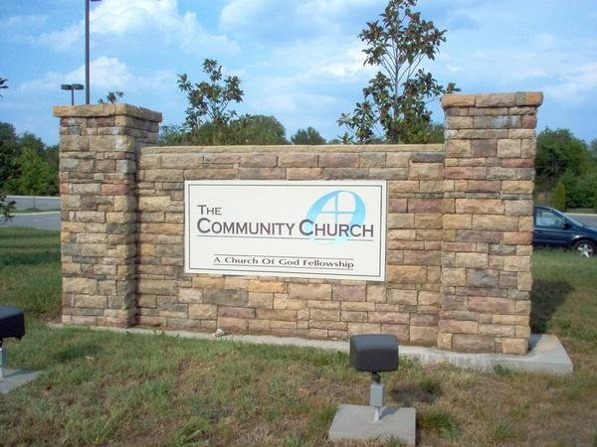
MATTHEW 20:17-34
Destination Station Church
“You were born for slavery!”

Slide 12
MATTHEW 20:17-34

Slide 13
MATTHEW 20:17-34
Cried out ~ krazō – to cry out, often of a brutish, inarticulate sound

Slide 14
MATTHEW 20:17-34

Slide 15
MATTHEW 20:17-34
2 Cor. 4:3-7 ~ ³ But even if our gospel is veiled, it is veiled to those who are perishing, ⁴ whose minds the god of this age has blinded, who do not believe, lest the light of the gospel of the glory of Christ, who is the image of God, should shine on them. ⁵ For we do not preach ourselves, but Christ Jesus the Lord, and ourselves your bondservants for Jesus’ sake. ⁶ For it is the God who commanded light to shine out of darkness, who has shone in our hearts to

Slide 16
MATTHEW 20:17-34
2 Cor. 4:3-7 ~ give the light of the knowledge of the glory of God in the face of Jesus Christ.
⁷ But we have this treasure in earthen vessels, that the excellence of the power may be of God and not of us.

Slide 17
MATTHEW 20:17-34

