Slide 1
MATTHEW 19:1-9
A free CD of this message will be available following the service
IT WILL ALSO be available LATER THIS WEEK
VIA cALVARYOKC.COM

Slide 2
MATTHEW 19:1-9
“The Essential Guide to Women's English”
Yes
=
No
No
=
Yes
Maybe
=
No
I’m sorry
=
You’ll be sorry
We need
=
I want
It’s your decision
=
Yeah, right
Do what you want
=
You’ll pay for it later
We need to talk
=
I need to complain
Sure, go ahead
=
I don’t want you to

Slide 3
MATTHEW 19:1-9
“The Essential Guide to Women's English”
I’m not upset
=
Of course I’m upset, You moron!
Be romantic, turn off the lights
=
I have flabby thighs
This kitchen is so inconvenient
=
I want a new house
I want new curtains
=
And carpets and furniture and wall paper

Slide 4
MATTHEW 19:1-9
“The Essential Guide to Women's English”
I heard a noise
=
I noticed you were almost asleep
Do you love me?
=
I’m about to ask for something expensive
How much to you love me?
=
I wrecked the car today
I’ll be ready in a few minutes
=
Kick off your shoes and find a good game on the TV

Slide 5
MATTHEW 19:1-9
“The Essential Guide to Women's English”
You have to learn to communicate
=
Just agree with me and we’ll be fine
Are you listening to me?
=
Too late … you’re dead!

Slide 6
MATTHEW 19:1-9
Is it male or female?
Swiss army knife ~
male – because even though it appears useful for a wide variety of work, it spends most of its time just opening bottles.
Kidneys ~
female – because they always go to the bathroom in pairs.
Tire ~
male – because it goes bald and is often over-inflated.

Slide 7
MATTHEW 19:1-9
Is it male or female?
Hot air balloon ~
male – because to get it to go anywhere, you have to light a fire under it . . . and, of course, there's the hot air part.
Sponges ~
female – because they are soft and squeezable and retain water.
Ziploc bags ~
male – because they hold everything in, but you can always see right through them.

Slide 8
MATTHEW 19:1-9
Is it male or female?
Subway ~
male – because it uses the same old lines to pick people up.
Remote control~
DEFINITELY female – because it gives men pleasure; he'd be lost without it, and while he doesn't always know the right buttons to push, he keeps trying.

Slide 9
MATTHEW 19:1-9

Slide 10
MATTHEW 19:1-9
Deut. 24:1 ~ When a man takes a wife and marries her, and it happens that she finds no favor in his eyes because he has found some uncleanness in her, and he writes her a certificate of divorce, puts it in her hand, and sends her out of his house …

Slide 11
MATTHEW 19:1-9
Rabbi Shammai (50 BC – AD 30) ~ only adultery
Hillel the Elder (c. 110 BC – AD 10) ~ any reason
Akiva ben Joseph (AD 50 – 135) ~ if you find a woman you like better

Slide 12
MATTHEW 19:1-9

Slide 13
MATTHEW 19:1-9
Joined ~ proskallaō – to glue upon
Eve was produced out of the first Adam’s side
We are produced out of the last Adam’s side
J. Vernon McGee ~ “When a man and a woman give themselves to each other in an act of marital love, they can know the love of Christ as no one else can know it.”

Slide 14
MATTHEW 19:1-9

Slide 15
MATTHEW 19:1-9
Zig Ziglar ~ “Many marriages would be better if the husband and the wife clearly understood that they are on the same side.”

Slide 16
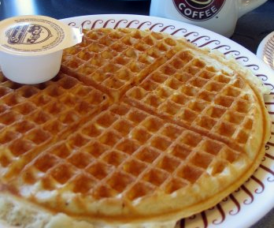
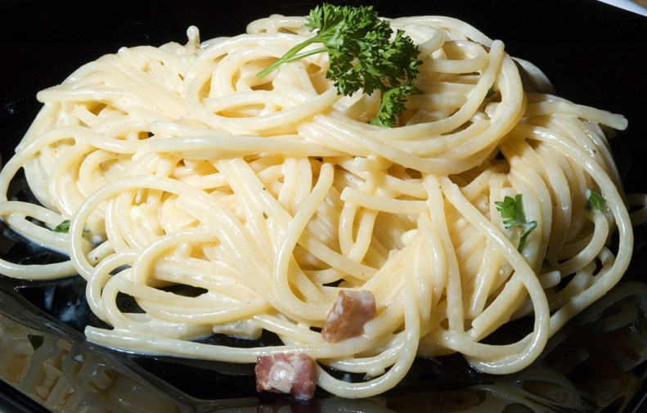
MATTHEW 19:1-9
Spouse
Kids
Job
Etc.

Slide 17
MATTHEW 19:1-9

Slide 18
MATTHEW 19:1-9
Command ~ not, parangellō – to command, order or charge
But, entellomai – to enjoin or instruct

Slide 19
MATTHEW 19:1-9

Slide 20
MATTHEW 19:1-9
Sexual immorality ~ (not moichaō – adultery)
But, porneia ~ all improper sexual activity

Slide 21
MATTHEW 19:1-9

Slide 22
MATTHEW 19:1-9
John and Martha Slugglesworth
John Slugglesworth
Martha Slimington
No slug divorce
No slug porn
No spouse abuse
No homosexual slugs
No sluglet abuse
No slug adultery

Slide 23
MATTHEW 19:1-9

Slide 24
MATTHEW 19:1-9
Rom. 8:38 (NLT) ~ And I am convinced that nothing can ever separate us from God’s love. Neither death nor life, neither angels nor demons, neither our fears for today nor our worries about tomorrow—not even the powers of hell can separate us from God’s love.
Separate ~ same word as in v. 6

Slide 25
MATTHEW 19:1-9
Benjamin Disraeli ~ “There are three kinds of lies: lies, darned lies and statistics.”

Slide 26
MATTHEW 19:1-9

Slide 27
MATTHEW 19:1-9
In the Old Testament, idolatry = spiritual fornication
Lev. 17:7 ~ They shall no more offer their sacrifices to demons, after whom they have played the harlot.
KJV, And they shall no more offer – their sacrifices unto devils, after whom they have gone a whoring.

Slide 28
MATTHEW 19:1-9
In the New Testament, covetousness = idolatry
Col. 3:5 ~ Therefore put to death your members which are on the earth: fornication, uncleanness, passion, evil desire, and covetousness, which is idolatry.
Divorce is:
1. Serious (God hates it)
2. Forgivable

Slide 29
MATTHEW 19:1-9

