Slide 1


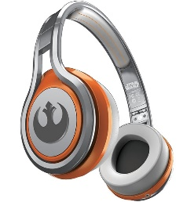
MATTHEW 17:22-18:11
A free CD of this message will be available following the service
IT WILL ALSO be available LATER THIS WEEK
VIA cALVARYOKC.COM

Slide 2

MATTHEW 17:22-18:11
25 Things You Can Learn From Children
1. There is no such thing as child-proofing your house
2. If you spray hair spray on dust bunnies and run over them with roller blades, they can ignite
3. A 3 year-old's voice is louder than 200 adults in a crowded restaurant
4. If you hook a dog leash over a ceiling fan, the motor is not strong enough to rotate a 42-pound boy wearing Spiderman underwear and a Superman cape
5. It is strong enough however to spread paint on all four walls of a 20 by 20 foot room

Slide 3
MATTHEW 17:22-18:11
25 Things You Can Learn From Children
6. Baseballs make marks on ceilings
7. You should not throw baseballs up when the ceiling fan is on
8. When using the ceiling fan as a bat you have to throw the ball up a few times before you get a hit
9. A ceiling fan can hit a baseball a long way
10. The glass in windows (even double pane) doesn't stop a baseball hit by a ceiling fan
11. If you hear the toilet flush followed by the words “Uh-oh,” it's already too late

Slide 4
MATTHEW 17:22-18:11
25 Things You Can Learn From Children
12. A magnifying glass can start a fire even on an overcast day
13. Legos will pass through the digestive tract of a four-year-old
14. Duplos, however, will not
15. Play Doh and Microwave should never be used in the same sentence
16. No matter how much Jell-O you put in a swimming pool you still can't walk on water
17. Pool filters do not like Jell-O

Slide 5
MATTHEW 17:22-18:11
25 Things You Can Learn From Children
18. Pancakes do not work in the Blu-ray player
19. Garbage bags do not make good parachutes
20. Always look in the oven before you turn it on
21. Plastic toys do not like ovens
22. The spin cycle on the washing machine does not make earth worms dizzy
23. It will however make cats dizzy
24. Cats throw up twice their body weight when dizzy
25. Quiet does not necessarily mean don't worry

Slide 6

MATTHEW 17:22-18:11

Slide 7
MATTHEW 17:22-18:11
½ shekel (silver) ~ Temple tax)
Ex. 30:13 ~ This is what everyone among those who are numbered shall give: half a shekel according to the shekel of the sanctuary (a shekel is twenty gerahs). The half-shekel shall be an offering to the Lord.

Slide 8
MATTHEW 17:22-18:11

Slide 9
MATTHEW 17:22-18:11
Offend ~ skandalilzō (v.) – 13x; skandalon (n.) ~ 3x;
45x in New Testament

Slide 10
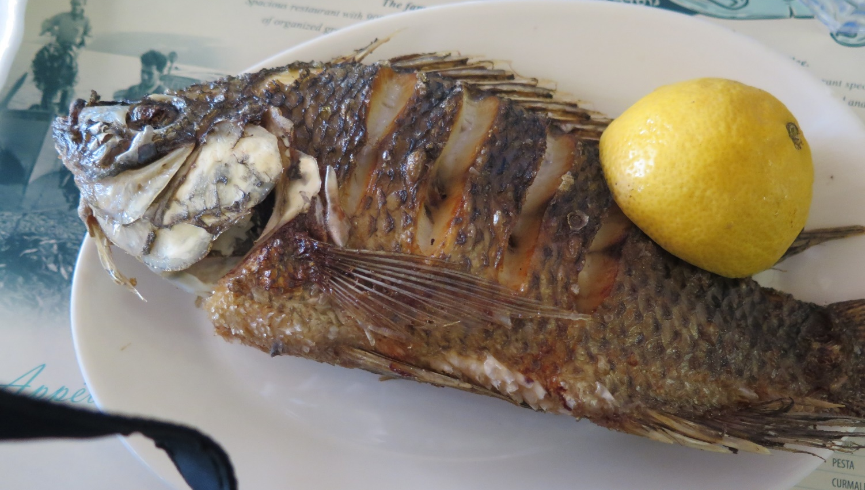
MATTHEW 17:22-18:11
“St. Peter’s fish” (Talapia)

Slide 11
MATTHEW 17:22-18:11

Slide 12
MATTHEW 17:22-18:11
Luke 9:46 ~ Then a dispute arose among them as to which of them would be greatest.
Warren Wiersbe ~ “The selfishness and disunity of God’s people is a scandal to the Christian faith. What causes these problems?
Pride — thinking ourselves more important than we really are. It was pride that led man into sin at the beginning (Gen. 3:5). When Christians are living for themselves and not for others, then there is bound to be conflict and division.”

Slide 13
MATTHEW 17:22-18:11

Slide 14
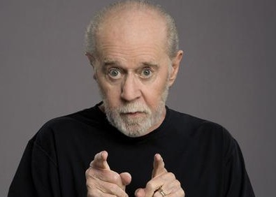
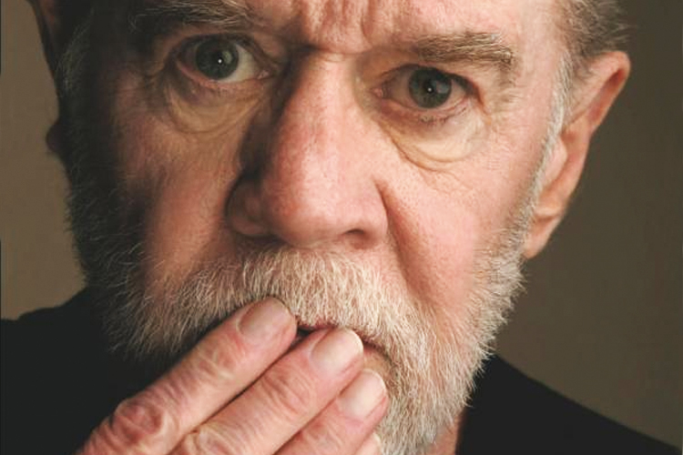
MATTHEW 17:22-18:11
Converted ~ usually translated turn
Wuest ~ Assuredly, I am saying to you, unless you reverse your present trend of thought and become as the little children, in no case shall you enter the kingdom of heaven.
“Religion is like a pair of shoes … Find one that fits for you, but don't make me wear your shoes.”
George Carlin (1937-2008)

Slide 15
MATTHEW 17:22-18:11
A child is:
Dependent
Trusting
Open
Honest
Imperfect
Forgiving
Humble

Slide 16
MATTHEW 17:22-18:11

Slide 17
MATTHEW 17:22-18:11
it is simply thinking of oneself less.
True humility is not thinking less of oneself;
Vincent De Paul (1580-1660) ~ “Humility is nothing but truth, while pride is nothing but lying.”
Golda Meir (1898-1978) ~ “Don't be so humble. You're not that great.”
Oswald Chambers (1874-1917) ~ “There is nothing more awful than conscious humility; it is the most satanic type of pride.”

Slide 18
MATTHEW 17:22-18:11

Slide 19
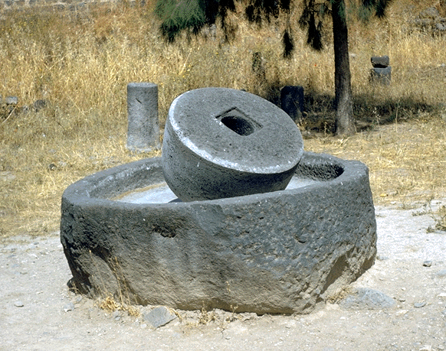
MATTHEW 17:22-18:11
Causes … to sin (also in NIV) ~ skandalizō
KJV ~ offend; NASB ~ to stumble
NLT ~ But if anyone causes one of these little ones who trusts in me to lose faith, it would be better for that person to be thrown into the sea with a large millstone tied around the neck.
Literally, millstone of a donkey

Slide 20
MATTHEW 17:22-18:11

Slide 21
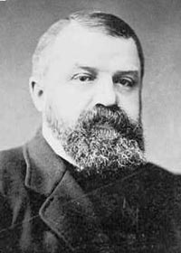
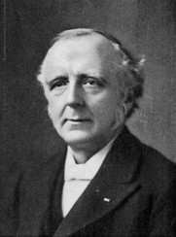
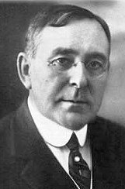
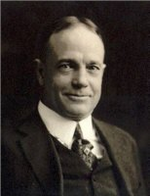
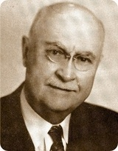
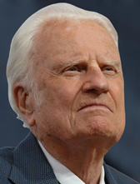
MATTHEW 17:22-18:11
Mr. Kimball
One Single Life
D. L. Moody
F. B. Meyer
J. Wilbur Chapman
Billy Sunday
Mordecai Ham (1877 – 1961)
Billy Graham

Slide 22
MATTHEW 17:22-18:11

Slide 23
MATTHEW 17:22-18:11
1st woe ~ pity
2nd woe ~ judgment

Slide 24
MATTHEW 17:22-18:11

Slide 25

MATTHEW 17:22-18:11
Emotionally: I’m done
Mentally: I’m drained
Spiritually: I’m dead
Physically: I smile

Slide 26
MATTHEW 17:22-18:11

