Slide 1
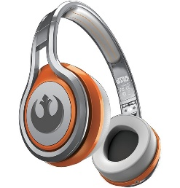
MATTHEW 17:10-21
A free CD of this message will be available following the service
IT WILL ALSO be available LATER THIS WEEK
VIA cALVARYOKC.COM

Slide 2
MATTHEW 1:17-21
C. H. Spurgeon ~ “There are no crown-wearers in heaven who were not cross-bearers here below.”

Slide 3
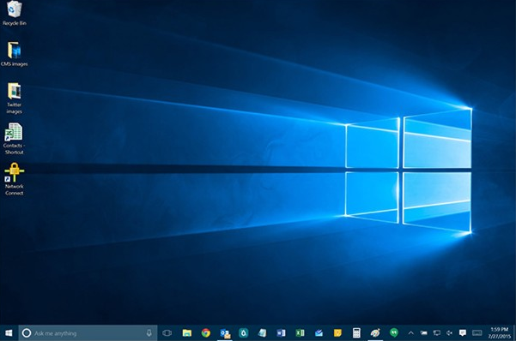
MATTHEW 1:17-21
How to start your day with a positive outlook.
3
Housework
New folder
Are you sure you move this folder and its contents to the Recycle Bin?
Housework
Date created 3/7/16 9:45 am
Yes
No
Yes

Slide 4
MATTHEW 1:17-21

Slide 5
MATTHEW 1:17-21
C. H. Spurgeon ~ “It is a better thing for a man to live near to Christ, and to enjoy his presence, than it would be for him to be overshadowed with a bright cloud, and to hear the divine Father himself speaking out of it.”

Slide 6
MATTHEW 1:17-21

Slide 7
MATTHEW 1:17-21
Mal. 4:5-6 ~ ⁵ Behold, I will send you Elijah the prophet
Before the coming of the great and dreadful day of the Lord.
⁶ And he will turn
The hearts of the fathers to the children,
And the hearts of the children to their fathers,
Lest I come and strike the earth with a curse.

Slide 8
MATTHEW 1:1-17

Slide 9
MATTHEW 1:17-21
Epileptic ~ literally moonstruck
KJV, lunatick; NASB, lunatic
NIV, seizures

Slide 10
MATTHEW 1:17-21

Slide 11
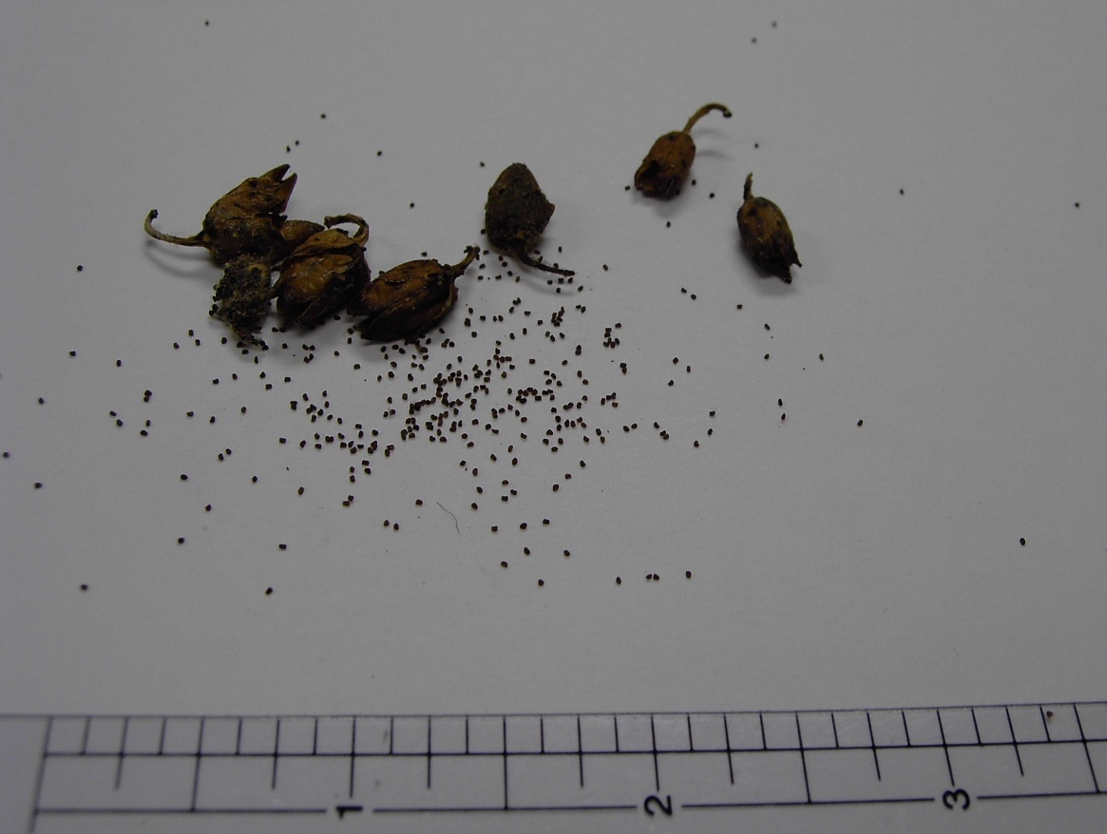
MATTHEW 1:17-21
1 John 5:14 ~ Now this is the confidence that we have in Him, that if we ask anything according to His will, He hears us.
Rom. 12:3 ~ …God has dealt each one a measure of faith.
Luke 19:12-27 ~ Parable of the Minas
1”

Slide 12
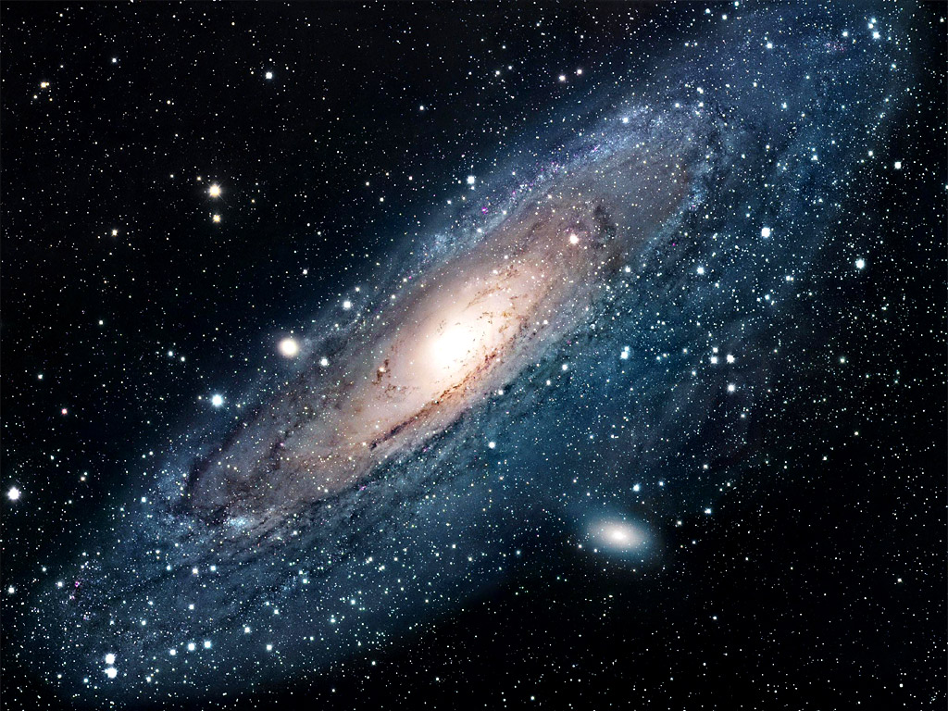
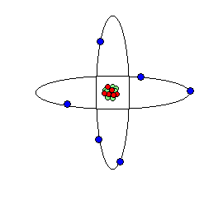
MATTHEW 1:17-21
Mustard seed ~ small, infinitesimal amount
Mountain ~ large, insurmountable obstacle

Slide 13
MATTHEW 1:17-21

Slide 14
MATTHEW 1:17-21
Thomas à Kempis ~ “Look, it all consists in the cross, and it all lies in dying; and there is no other way to life and true peace within.”

Slide 15
MATTHEW 1:17-21

Slide 16
MATTHEW 1:17-21
NASB put this verse in brackets with footnote: “Many MSS do not contain this verse”
NIV and NLT omit it altogether with footnote: “Some MSS: ²¹ But this kind does not go out …”
The majority of all Greek manuscripts do contain this verse
Prayer takes us near to God
Fasting takes us away from ourselves

Slide 17
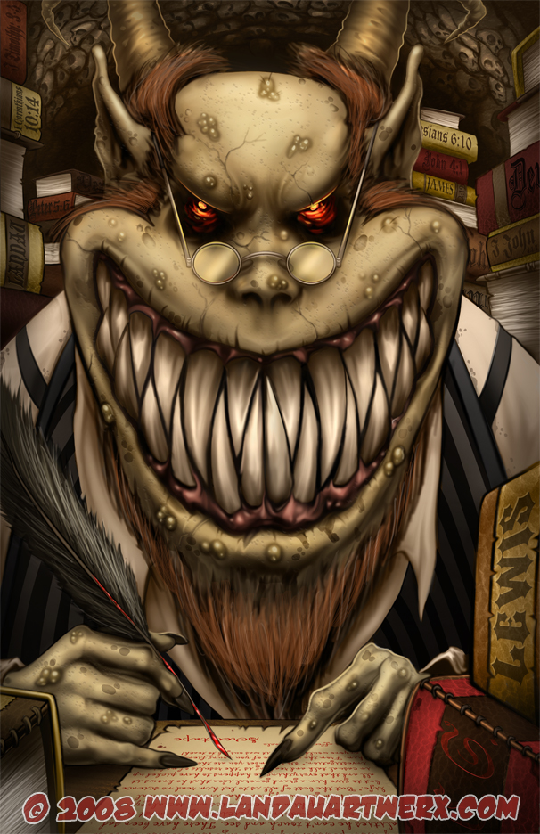
MATTHEW 1:17-21
Kind ~ genos – race, nation, ethnicity
In this case, it's referring to a particular class of demons

Slide 18
MATTHEW 1:17-21

Slide 19
MATTHEW 1:17-21
A.W. Tozer ~ “Among the plastic saints of our times Jesus has to do all the dying and all we want is to hear another sermon about His dying.”
Thomas à Kempis ~ “If thou bear the cross cheerfully, it will bear thee.”

Slide 20
MATTHEW 1:17-21
Rev. 4:10-11 ~ ¹⁰ the twenty-four elders fall down before Him who sits on the throne and worship Him who lives forever and ever, and cast their crowns before the throne, saying:
¹¹ “You are worthy, O Lord,
To receive glory and honor and power;
For You created all things,
And by Your will they exist and were created.”

Slide 21
MATTHEW 1:17-21

