Slide 1


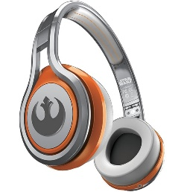
MATTHEW 17:1-9
A free CD of this message will be available following the service
IT WILL ALSO be available LATER THIS WEEK
VIA cALVARYOKC.COM

Slide 2


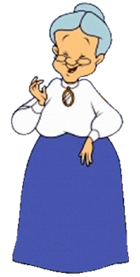

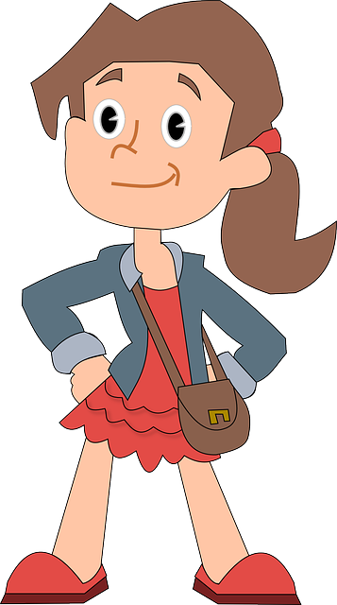


MATTHEW 17:1-9
Mwhh!
Slap!

Slide 3

MATTHEW 17:1-9

Slide 4
MATTHEW 17:1-9
Matt. 16:28 ~ Assuredly, I say to you, there are some standing here who shall not taste death till they see the Son of Man coming in His kingdom.

Slide 5
MATTHEW 17:1-9

Slide 6
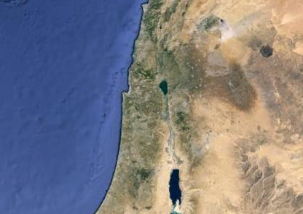
MATTHEW 17:1-9
Mt. Hermon
Caesarea Philippi
Mt. Tabor

Slide 7
MATTHEW 17:1-9

Slide 8
MATTHEW 17:1-9
Transfigured ~ metamorphoō
meta (change) and morphē (form)
Two words for form:
morphē (fundamental essence) and skēma ~ basic shape
Rom. 12:1 ~ And do not be conformed to this world, but be transformed by the renewing of your mind,
Conformed ~ from form of skēma - idea of shape
Transformed ~ metamorphoō – intrinsic nature of Jesus’ body

Slide 9
MATTHEW 17:1-9

Slide 10
MATTHEW 17:1-9
Elijah
Moses

Slide 11
MATTHEW 17:1-9
Luke 9:31 ~ who appeared in glory and spoke of His decease which He was about to accomplish at Jerusalem.
Decease ~ NIV, NASB; departure – exodos

Slide 12
MATTHEW 17:1-9

Slide 13
MATTHEW 17:1-9
Plato ~ “Wise men talk because they have something to say; fools talk because they have to say something.”

Slide 14
MATTHEW 17:1-9

Slide 15
MATTHEW 17:1-9
Albert Schweitzer ~ “Unlike a natural cloud, it was luminous: it simultaneously revealed and concealed the presence of God.”
Literally, Him be hearing! (emphatic)

Slide 16
MATTHEW 17:1-9

Slide 17
MATTHEW 17:1-9
Mark 9:9-10 ~ ⁹ Now as they came down from the mountain, He commanded them that they should tell no one the things they had seen, till the Son of Man had risen from the dead. ¹⁰ So they kept this word to themselves, questioning what the rising from the dead meant.

Slide 18
MATTHEW 17:1-9
John 11:23-24 ~ ²³ Jesus said to her, “Your brother will rise again.”
²⁴ Martha said to Him, “I know that he will rise again in the resurrection at the last day.”
John 11:40 ~ Jesus said to her (Martha), "Did I not say to you that if you would believe you would see the glory of God?"

Slide 19
MATTHEW 17:1-9
1 Pet. 1:16-19a ~ ¹⁶ For we did not follow cunningly devised fables when we made known to you the power and coming of our Lord Jesus Christ, but were eyewitnesses of His majesty. ¹⁷ For He received from God the Father honor and glory when such a voice came to Him from the Excellent Glory: “This is My beloved Son, in whom I am well pleased.” ¹⁸ And we heard this voice which came from heaven when we were with Him on the holy mountain.
^{19a} And so we have the prophetic word confirmed,

Slide 20
MATTHEW 17:1-9
Luke 9:51 ~ Now it came to pass, when the time had come for Him to be received up, that He steadfastly set His face to go to Jerusalem,

Slide 21
MATTHEW 17:1-9

Slide 22
MATTHEW 17:1-9
Matt. 16:24 ~ Then Jesus said to His disciples, “If anyone desires to come after Me, let him deny himself, and take up his cross, and follow Me.”

Slide 23
MATTHEW 17:1-9
Calvin Miller, The Taste of Joy ~ “Many Christians are only ‘Christaholics’ and not disciples at all. Disciples are cross-bearers; they seek Christ. Christaholics seek happiness. Disciples dare to discipline themselves, and the demands they place on themselves leave them enjoying the happiness of their growth. Christaholics are escapists looking for a shortcut to nirvana. Like drug addicts, they are trying to ‘bomb out’ of their depressing world.

Slide 24
MATTHEW 17:1-9
Calvin Miller, The Taste of Joy ~ “There is no automatic joy. Christ is not a happiness capsule; he is the way to the Father. But the way to the Father is not a carnival ride in which we sit and do nothing while we are whisked through various spiritual sensations.”

Slide 25
MATTHEW 17:1-9
Thomas à Kempis ~ “Jesus now has many lovers of his heavenly kingdom, but few bearers of his cross.”
2 Cor. 3:18 ~ But we all, with unveiled face, beholding as in a mirror the glory of the Lord, are being into the same image from glory to glory, just as by the Spirit of the Lord.
transformed
metamorphoō

Slide 26
MATTHEW 17:1-9

