Slide 1


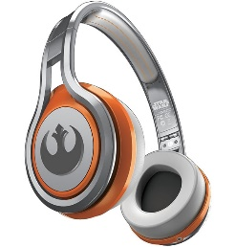
MATTHEW 16:21-28
A free CD of this message will be available following the service
IT WILL ALSO be available LATER THIS WEEK
VIA cALVARYOKC.COM

Slide 2

MATTHEW 16:21-28
Oxymoron ~ a figure of speech in which apparently contradictory terms appear in conjunction
Click the “Start” button
to shut down
Canadian
bacon
Absolutely
unsure
Clogged
drain
A fine
mess
Tech
support
Accurate
horoscope
Marijuana
initiative
Male
compassion

Slide 3

MATTHEW 16:21-28

Slide 4
MATTHEW 16:21-28
Rebuke ~ same word used in casting out demons and calming the sea
Far be it ~ only here and …
Heb. 8:12 ~ For I will be merciful to their unrighteousness, and their sins and their lawless deeds I will remember no more.
Wuest ~ And having taken Him to himself apart privately, Peter began to be rebuking Him, saying, May mercy be shown to you, Lord. This shall positively not be to you.

Slide 5
MATTHEW 16:21-28
Oxymoron ~ a figure of speech in which apparently contradictory terms appear in conjunction
Tame
cat
Female
logic
Turkey
burger
Minor
surgery
Business
ethics
Country
music
NIV
Study Bible
“Far be it from You,
LORD”

Slide 6
MATTHEW 16:21-28

Slide 7
MATTHEW 16:21-28
Offense ~ skandalon – a stumbling-block
2 Cor. 5:21 ~ For He made Him who knew no sin to be sin for us, that we might become the righteousness of God in Him.
KJV ~ for thou savorest not the things that be of God, but those that be of men.

Slide 8
MATTHEW 16:21-28

Slide 9

MATTHEW 16:21-28

Slide 10
MATTHEW 16:21-28

Slide 11
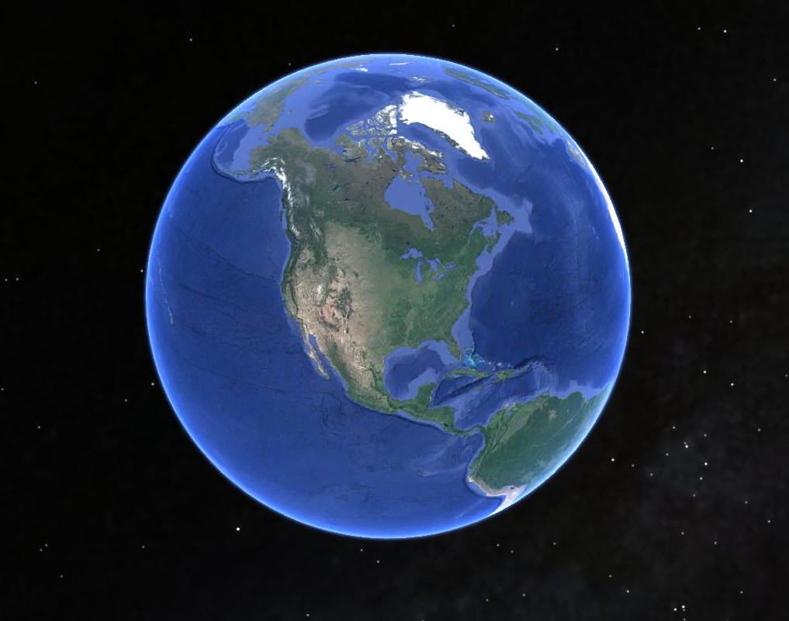
MATTHEW 16:21-28
Not
“bad”
Not
“good”

Slide 12
MATTHEW 16:21-28

Slide 13
MATTHEW 16:21-28
Rom. 12:1 ~ I beseech you therefore, brethren, by the mercies of God, that you present your bodies a living sacrifice, holy, acceptable to God, which is your reasonable service.
I
I
L V NG SACR F CE
I
I

Slide 14
MATTHEW 16:21-28

Slide 15
MATTHEW 16:21-28
George MacDonald (1824-1905) ~ “Christ died to save us, not from suffering, but from ourselves; not from injustice, far less from justice, but from being unjust. He died that we might live—but live as he lives, by dying as he died who died to himself that he might live unto God. If we do not die to ourselves, we cannot live to God, and he that does not live to God, is dead.”

Slide 16
MATTHEW 16:21-28

Slide 17
MATTHEW 16:21-28
Count Nicolaus von Zinzendorf (1700-1760) ~ “I have one passion. It is He, only He.”

Slide 18
MATTHEW 16:21-28

Slide 19
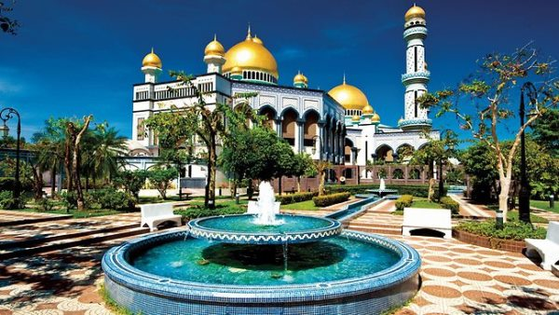
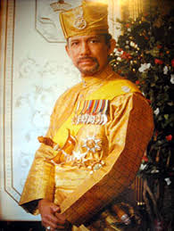
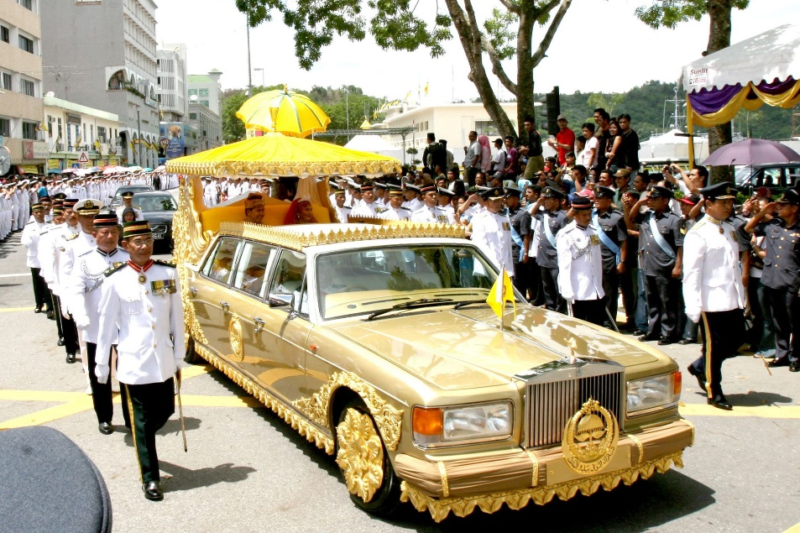
MATTHEW 16:21-28
Over 2,000,000 sq. ft.
Sultan of Brunei
24k gold Rolls Royce

Slide 20
MATTHEW 16:21-28

