Slide 1


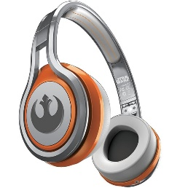
MATTHEW 16:1-20
A free CD of this message will be available following the service
IT WILL ALSO be available LATER THIS WEEK
VIA cALVARYOKC.COM

Slide 2



MATTHEW 16:1-20
What Would Jesus Do?
W. W. J. D.
Only
$17.95

Slide 3

MATTHEW 16:1-20

Slide 4
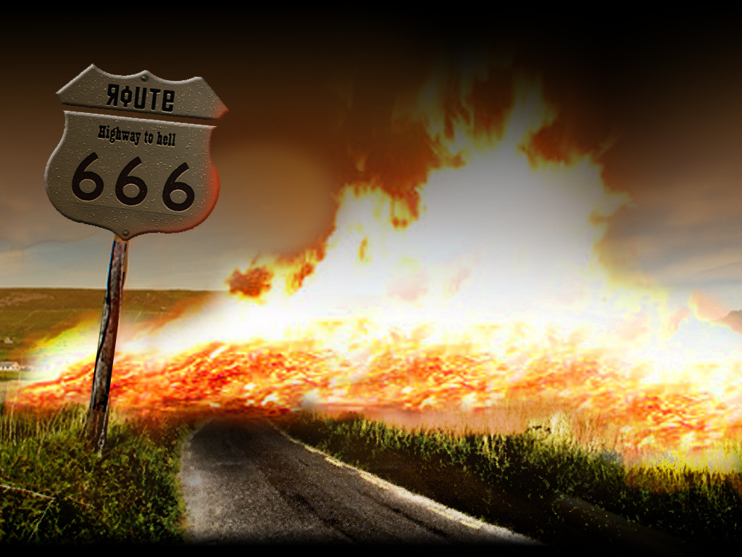

MATTHEW 16:1-20
Sign ~ sēmeion – occurs 77x in New Testament
50 ~ sign, 23 ~ miracle, 3 ~ wonder, 1 ~ token
Heaven
Next Exit
Hell

Slide 5
MATTHEW 16:1-20
Luke 16:27-31 ~ ²⁷ Then he said, “I beg you therefore, father, that you would send him to my father’s house, ²⁸ for I have five brothers, that he may testify to them, lest they also come to this place of torment.' ²⁹ Abraham said to him, ‘They have Moses and the prophets; let them hear them.' ³⁰ And he said, 'No, father Abraham; but if one goes to them from the dead, they will repent.’ ³¹ But he said to him, ‘If they do not hear Moses and the prophets, neither will they be persuaded though one rise from the dead.’”

Slide 6
MATTHEW 16:1-20
Blaise Pascal (1623-1662) ~ “It is impossible on reasonable grounds to disbelieve miracles.”
“Miracles serve not to convert, but to condemn.”
St. Augustine ~ “I should not be a Christian but for the miracles.”

Slide 7
MATTHEW 16:1-20

Slide 8
MATTHEW 16:1-20
Voltaire ~ “Even if a miracle should be wrought in the open market place before a thousand witnesses, I would rather mistrust my senses than admit a miracle.”

Slide 9
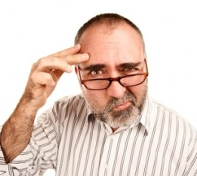

MATTHEW 16:1-20
Two kinds of unbelief
… and those who don't believe because they don't want to
Those who don't believe because they don't know …

Slide 10
MATTHEW 16:1-20
James 4:4 ~ Adulterers and adulteresses! Do you not know that friendship with the world is enmity with God? Whoever therefore wants to be a friend of the world makes himself an enemy of God.

Slide 11
MATTHEW 16:1-20

Slide 12
MATTHEW 16:1-20
Luke 12:1b ~ … Beware of the leaven of the Pharisees, which is hypocrisy.
Thomas Aquinas (1225-1274) ~ “Give me, O Lord, a steadfast heart, which no unworthy affection may drag downwards; give me an unconquered heart, which no tribulation can wear out; give me an upright heart, which no unworthy purpose may tempt aside.”

Slide 13
MATTHEW 16:1-20

Slide 14
MATTHEW 16:1-20
John 8:57-58 ~ ⁵⁸ Jesus said to them, “Most assuredly, I say to you, before Abraham was, I AM.”
⁵⁹ Then they took up stones to throw at Him; but Jesus hid Himself and went out of the temple, going through the midst of them, and so passed by.
John 14:8-9 ~ ⁸ Philip said to Him, “Lord, show us the Father, and it is sufficient for us.”
⁹ Jesus said to him, “Have I been with you so long, and yet you have not known Me, Philip? He who has seen Me has seen the Father; so how can you say, ‘Show us the Father’?

Slide 15
MATTHEW 16:1-20
Matt. 9:4-6 ~ ⁴ But Jesus, knowing their thoughts, said, “Why do you think evil in your hearts? ⁵ For which is easier, to say, ‘Your sins are forgiven you,’ or to say, ‘Arise and walk’? ⁶ But that you may know that the Son of Man has power on earth to forgive sins”—then He said to the paralytic, “Arise, take up your bed, and go to your house.”
Rev. 1:8 ~ I am the Alpha and the Omega, the Beginning and the End … who is and who was and who is to come, the Almighty.

Slide 16
MATTHEW 16:1-20

Slide 17
MATTHEW 16:1-20
Tri
ple
lemma
di
Jesus said, “I am God”
False
True
Jesus is
sincere
insincere
(1 Tim. 3:16)
Lunatic
Liar
Lord

Slide 18
MATTHEW 16:1-20

Slide 19
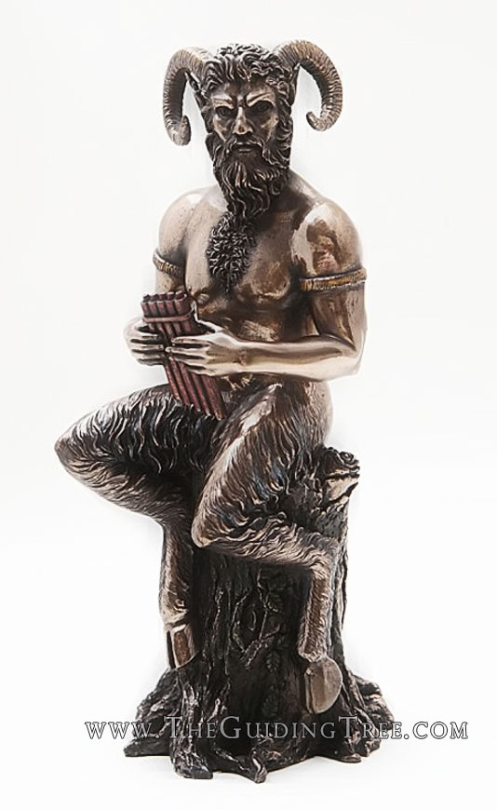
MATTHEW 16:1-20
Pan ~ god of the wild

Slide 20
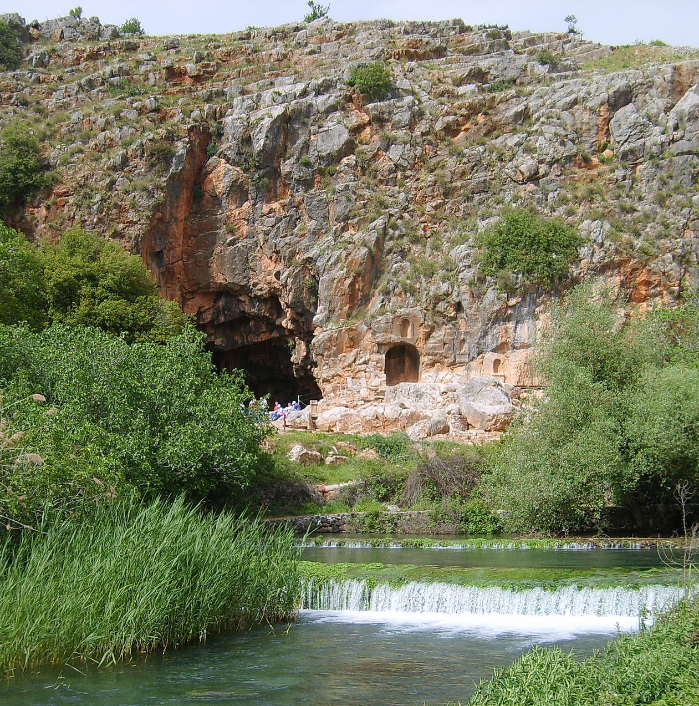
MATTHEW 16:1-20
Church ~ ekklēsia – a called out assembly
Peter ~ Petros (masc.)
Rock ~ petra (fem.)
1 Cor. 3:11 ~ For no other foundation can anyone lay than that which is laid, which is Jesus Christ.

Slide 21
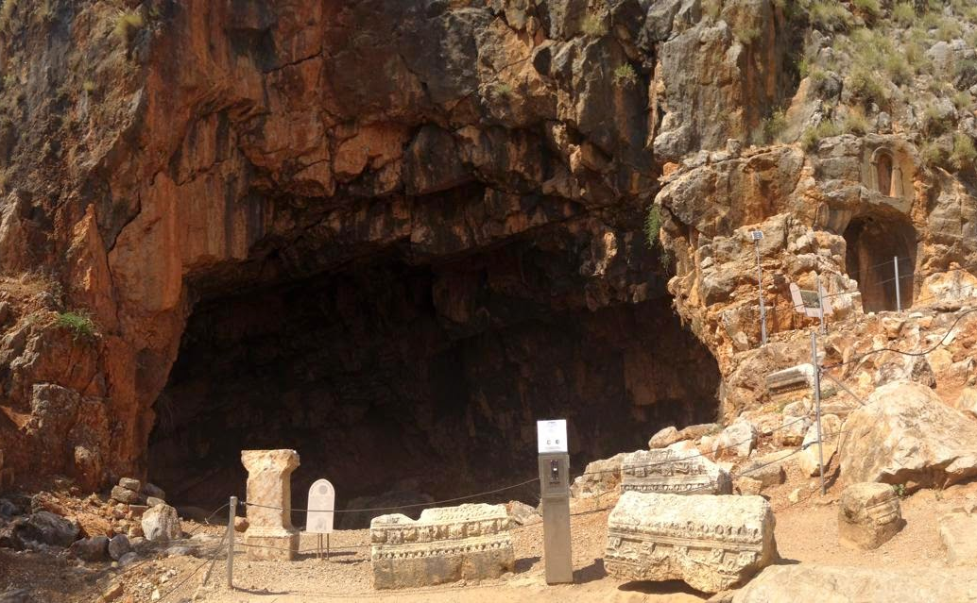
MATTHEW 16:1-20
Hadēs ~ the realm of the dead
The Gates of Hadēs

Slide 22
MATTHEW 16:1-20

Slide 23
MATTHEW 16:1-20
Literally, “shall already have been bound … shall already have been loosed”
Wuest ~ I shall give to you the keys of the kingdom of heaven; and whatever you bind on earth [forbid to be done], shall have been already bound [forbidden to be done] in heaven; and whatever you loose on earth [permit to be done], shall have already been loosed in heaven [permitted to be done].

Slide 24
MATTHEW 16:1-20

