Slide 1


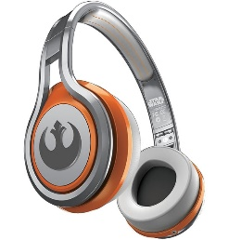
MATTHEW 15:21-39
A free CD of this message will be available following the service
IT WILL ALSO be available LATER THIS WEEK
VIA cALVARYOKC.COM

Slide 2




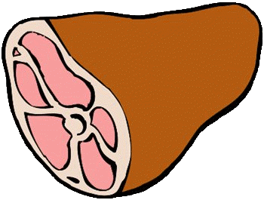
MATTHEW 15:21-39

Slide 3

MATTHEW 15:21-39

Slide 4
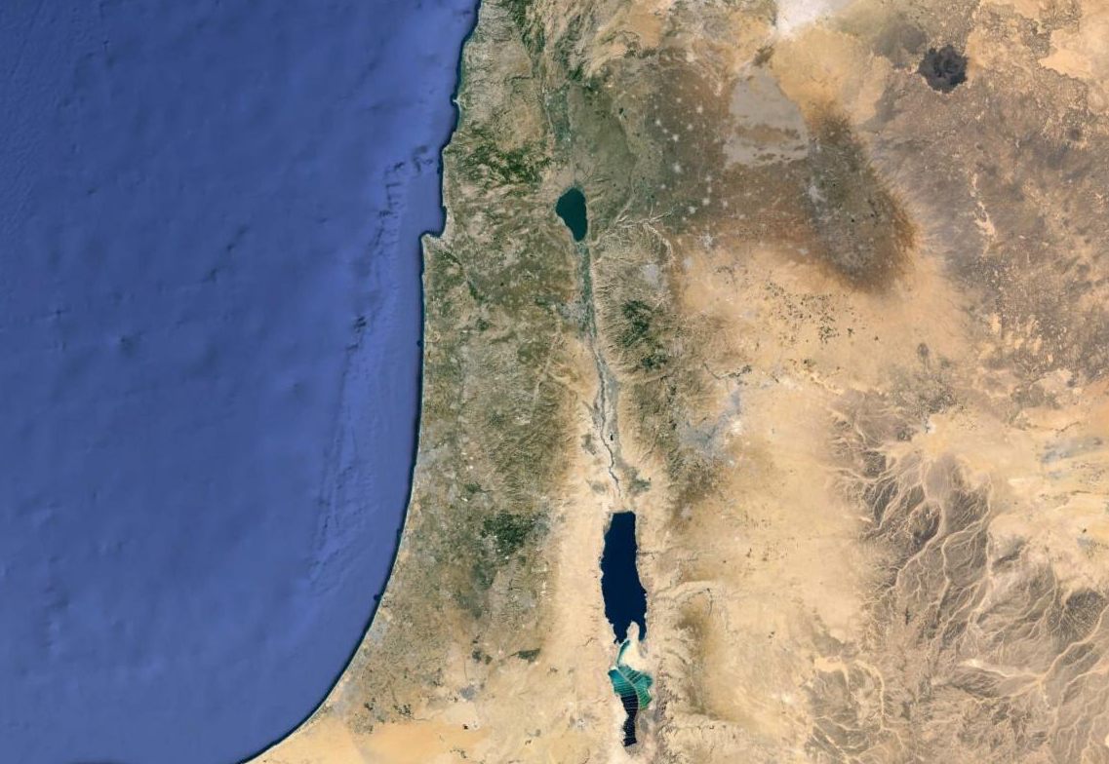
MATTHEW 15:21-39
Sidon
Tyre
Land of Gennesaret
Jordan R.

Slide 5
MATTHEW 15:21-39

Slide 6
MATTHEW 15:21-39
NLT ~ … She is bothering us with all her begging.

Slide 7
MATTHEW 15:21-39

Slide 8
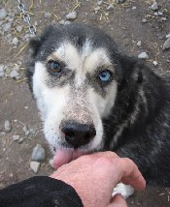
MATTHEW 15:21-39
Worshipped ~ proskuneō
Pros ~ before and kuōn ~ dog

Slide 9
MATTHEW 15:21-39

Slide 10
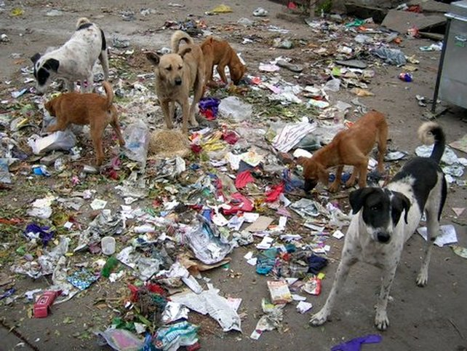
MATTHEW 15:21-39
Little dogs ~ not kuōn – dog
But kunarion – little dogs, or puppies

Slide 11
MATTHEW 15:21-39

Slide 12
MATTHEW 15:21-39
NLT ~ And from the time John the Baptist began preaching and baptizing until now, the Kingdom of Heaven has been forcefully advancing, and violent people attack it.
James Denney ~ “The Kingdom of Heaven is not for the well-meaning but for the desperate.”
William Barclay ~ “Endurance is not just the ability to bear a hard thing, but to turn it into glory.”

Slide 13
MATTHEW 15:21-39
Alan Redpath ~ “A faith that isn’t worth testing is not worth having.”
“Don’t let the treatment you have received at the hands of Christian people keep you back from Christ.”
“The greatest thing that any of us can be is a stepping stone to Jesus.”
“And stepping stones are designed to be walked on.”

Slide 14
MATTHEW 15:21-39

Slide 15
MATTHEW 15:21-39
Sidon
Tyre
Jordan R.
Decapolis
(10 cities)

Slide 16
MATTHEW 15:21-39

Slide 17
MATTHEW 15:21-39
Laid ~ KJV, cast – to fling

Slide 18
MATTHEW 15:21-39

Slide 19
MATTHEW 15:21-39
Matt. 5:16 ~ Let your light so shine before men, that they may see your good works and glorify your Father in heaven.

Slide 20
MATTHEW 15:21-39

Slide 21
MATTHEW 15:21-39
Large baskets ~ spuris ~ large reed basket, a hamper
Not kophinos ~ small wicker basket

Slide 22
MATTHEW 15:21-39
Same miracle?
14:14-21
15:32-38
5000 people
4000 people
5 loaves, 2 fish
7 loaves, a few fish
Green grass
Ground
Galilee
Decapolis
12 kophinos
7 spuris

Slide 23
MATTHEW 15:21-39

