Slide 1



MATTHEW 13:24-58
A free CD of this message will be available following the service
IT WILL ALSO be available LATER THIS WEEK
VIA cALVARYOKC.COM

Slide 2

MATTHEW 13:24-58
Rom. 3:10-12 ~ ¹⁰ As it is written:
“There is none righteous, no, not one;
¹¹ There is none who understands;
There is none who seeks after God.
¹² They have all turned aside;
They have together become unprofitable;
There is none who does good, no, not one.”

Slide 3

MATTHEW 13:24-58

Slide 4
MATTHEW 13:24-58
Treasure ~ thēsauros – a thesaurus is a “treasury” of words
Ex. 19:4-5 ~ ⁴ ‘You have seen what I did to the Egyptians, and how I bore you on eagles’ wings and brought you to Myself. ⁵ Now therefore, if you will indeed obey My voice and keep My covenant, then you shall be a special treasure to Me above all people; for all the earth is Mine.

Slide 5
MATTHEW 13:24-58

Slide 6
MATTHEW 13:24-58
Warren Wiersbe ~ “Unlike most other gems, the pearl is a unity—it cannot be carved like a diamond or emerald. The church is a unity (Eph. 4:4–6), even though the professing church on earth is divided. Like a pearl, the church is the product of suffering. Christ died for the church (Eph. 5:25) and His suffering on the cross made possible her birth.”

Slide 7
MATTHEW 13:24-58

Slide 8
MATTHEW 13:24-58
Matt. 25:31-34 ~ ³¹ When the Son of Man comes in His glory, and all the holy angels with Him, then He will sit on the throne of His glory. ³² All the nations will be gathered before Him, and He will separate them one from another, as a shepherd divides his sheep from the goats. ³³ And He will set the sheep on His right hand, but the goats on the left. ³⁴ Then the King will say to those on His right hand, ‘Come, you blessed of My Father, inherit the kingdom prepared for you from the foundation of the world…

Slide 9
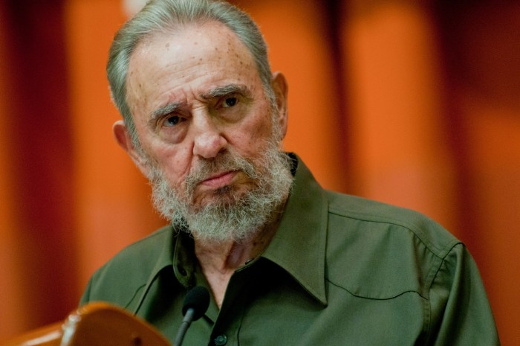
MATTHEW 13:24-58
Parable of the Hidden Treasure ~ Israel
Parable of the Pearl of Great Price ~ Church
Parable of the Dragnet ~ Tribulation Saints
“I never saw a contradiction between the ideas that sustain me and the ideas of that symbol, of that extraordinary figure, Jesus Christ.”
– Fidel Castro

Slide 10
MATTHEW 13:24-58

Slide 11
MATTHEW 13:24-58
Old and New:
Old Testament and New Testament?
Contemporary and Traditional?

Slide 12
MATTHEW 13:24-58
Old and New:
G. C. Morgan ~ “‘Things new and old’ – old in their unseen and eternal principles; new in their seen and temporal practice. The interrelation is for evermore a test. The new thing which contradicts the old is always false. The thing that has no fresh and new production is dead, and the sooner we are rid of it the better … ‘You are my householders, and you are to do your work by bringing out of your treasure-house, out of this infinite wealth of that is Mine, and which I make yours, ‘new things and old.’”

Slide 13
MATTHEW 13:24-58

Slide 14
MATTHEW 13:24-58
Offended ~ skandalizō

Slide 15
MATTHEW 1:1-17

