Slide 1



MATTHEW 12:14-32
A free CD of this message will be available following the service
IT WILL ALSO be available LATER THIS WEEK
VIA cALVARYOKC.COM

Slide 2

MATTHEW 12:14-32
Beelzebub ~ from Baal-Zebub, Canaanite god of Ekron (2 Kings 1:2)
“Lord of the flies”
NASB, ESV ~ Beelzebul, "Lord of the dung"

Slide 3

MATTHEW 12:14-32

Slide 4
MATTHEW 12:14-32
Blasphemy ~ blasphēmia
blaptō; to hurt, harm or injure + phēmē; reputation or fame
Slander

Slide 5
MATTHEW 12:14-32

Slide 6
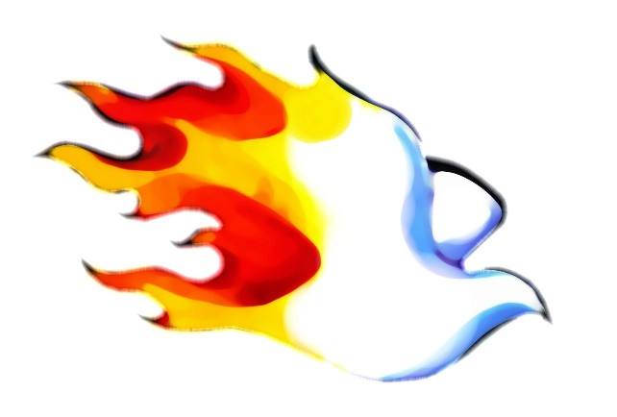
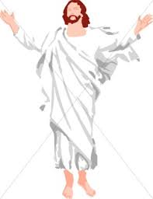
MATTHEW 12:14-32
Church Age
Ministry of Jesus
Jesus Christ
Holy Spirit
Miracles
Word of God
John 16:8 ~ He will convict
the world of sin, and of righteousness, and of judgment:

Slide 7
MATTHEW 12:14-32

Slide 8
MATTHEW 12:14-32
Ex. 7: 14 ~ So the Lord said to Moses: “Pharaoh's heart is hard; he refuses to let the people go.”
kabed – to make heavy
Ex. 11:10 ~ … and the Lord hardened Pharaoh's heart, and he did not let the children of Israel go out of his land.
chazaq ~ to strengthen

Slide 9
MATTHEW 12:14-32
Plague
English
Hebrew
Exo.
1
2
3
4
5
6
7
8
9
10
Blood
Strengthened
Chazaq
7:22
Frogs
Make heavy
Kabed
8:15
Lice
Strengthened
Chazaq
8:19
Flies
Make heavy
Kabed
8:32
Livestock
Make heavy
Kabed
9:7
Boils
LORD strengthened
Chazaq
9:12
Hail
Make heavy/strengthen
Kabed/chazaq
9:34,35
Locusts
LORD strengthened
Chazaq
10:20
Darkness
LORD strengthened
Chazaq
10:27
Firstborn
LORD strengthened
Chazaq
11:10

Slide 10
MATTHEW 12:14-32

Slide 11
MATTHEW 12:14-32
1 Tim.4:1-2 ~ ¹ Now the Spirit expressly says that in latter times some will depart from the faith…² having their conscience seared with a hot iron,
Seared with a hot iron ~ kaustēriazō – cauterize
Perfect tense ~ describes an action completed in the past yet occurs in the present

Slide 12
MATTHEW 12:14-32

Slide 13


MATTHEW 12:14-32
Dude
Holy Spirit
“come to Jesus”

Slide 14
MATTHEW 12:14-32

