Slide 1



MATTHEW 12:1-13
A free CD of this message will be available following the service
IT WILL ALSO be available LATER THIS WEEK
VIA cALVARYOKC.COM

Slide 2

MATTHEW 12:1-13
Deut. 23:24-25 ~ ²⁴ When you come into your neighbor’s vineyard, you may eat your fill of grapes at your pleasure, but you shall not put any in your container. ²⁵ When you come into your neighbor’s standing grain, you may pluck the heads with your hand, but you shall not use a sickle on your neighbor’s standing grain.

Slide 3

MATTHEW 12:1-13

Slide 4
MATTHEW 12:1-13
Ex. 20:10 ~ but the seventh day is the Sabbath of the Lord your God. In it you shall do no work: you, nor your son, nor your daughter, nor your male servant, nor your female servant, nor your cattle, nor your stranger who is within your gates.
Repeated 5 more times in the Pentateuch

Slide 5
MATTHEW 12:1-13

Slide 6
MATTHEW 12:1-13
WorldNetDaily, Oct. 13, 2005, Joe Kovacs: One of the longest running disputes in the history of Christianity – Saturday vs. Sunday – is having new life breathed into it with a cash reward of up to $1 million toward a resolution.
A. Jan Marcussen, a Seventh-day Adventist pastor in Illinois, is starting with $50,000 of his own money if someone can produce “a verse from the Holy Bible showing that God commands us to keep holy the first day of the week” – Sunday – “instead of the seventh

Slide 7
MATTHEW 12:1-13
WorldNetDaily, Oct. 13, 2005, Joe Kovacs: day” – Saturday – “as is commanded in the Bible.”
He says the reward will increase in $25,000 increments each week for 40 consecutive weeks if no one sends him such a verse, with a final cap at $1 million.
“Millions of people believe and have confidence in their clergy that what they're being taught is true,” says Marcussen. “They'll find out that the clergy is not teaching from the Bible.”

Slide 8
MATTHEW 12:1-13

Slide 9
MATTHEW 12:1-13
Ex. 31:15-17 ~ ¹⁵ Work shall be done for six days, but the seventh is the Sabbath of rest, holy to the Lord. Whoever does any work on the Sabbath day, he shall surely be put to death. ¹⁶ Therefore the children of Israel shall keep the Sabbath, to observe the Sabbath throughout their generations as a perpetual covenant. ¹⁷ It is a sign between Me and the children of Israel forever; for in six days the Lord made the heavens and the earth, and on the seventh day He rested and was refreshed.

Slide 10
MATTHEW 12:1-13

Slide 11
MATTHEW 12:1-13
Ex. 16:29 ~ See! For the Lord has given you the Sabbath; therefore He gives you on the sixth day bread for two days. Let every man remain in his place; let no man go out of his place on the seventh day.

Slide 12
MATTHEW 12:1-13
Num. 35:5 ~ And you shall measure outside the city on the east side two thousand cubits, on the south side two thousand cubits, on the west side two thousand cubits, and on the north side two thousand cubits. The city shall be in the middle. This shall belong to them as common-land for the cities.
A Sabbath day’s journey (Acts 1:12)

Slide 13
MATTHEW 12:1-13

Slide 14
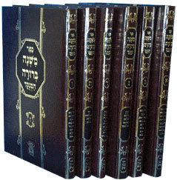
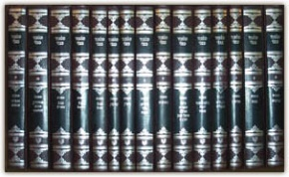
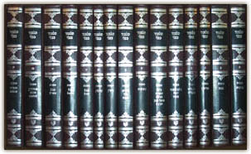
MATTHEW 12:1-13
613 Precepts ~ 365 negative/248 positive
Mishnah (c. AD 200)
Talmud
Gemara (AD 350-400)
48 volumes

Slide 15
MATTHEW 12:1-13

Slide 16
MATTHEW 12:1-13
Baptist General Statement of Faith ~ “We believe that the 1st of the week is the Lord's Day or Christian Sabbath; and is to be kept sacred to religious purposes, by abstaining from all secular labor and sinful recreations.”
Sinful recreations are OK Monday-
Saturday????
Sabbath ~ (Dictionary of Biblical Languages with Semantic Domains) ~ “The seventh day of the Jewish week, ceremonial day of rest; known in our culture as Saturday.”
1 Cor. 10:31b ~ whatever you do, do all to the glory of God

Slide 17
MATTHEW 12:1-13

Slide 18
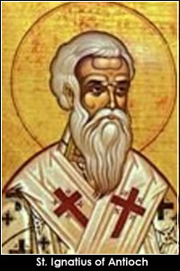
MATTHEW 12:1-13
Ignatius of Antioch (c. AD 35 – c. AD 107), Epistle to the Magnesians 8:1; 9:1-2 ~ “Be not
seduced by strange doctrines nor by
antiquated fables, which are profitless.
For if even unto this day we live after the
manner of Judaism, we avow that we have
not received grace ... If then those who
had walked in ancient practices attained unto newness of hope, no longer observing Sabbaths but fashioning their lives after the Lord's day, on which our life also arose through Him and through His death …”

Slide 19
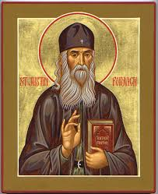
MATTHEW 12:1-13
Justin Martyr, Dialogues 12:3 ~ “The new law requires you to keep perpetual Sabbath, and you, because you are idle for one day,
suppose you are pious…The Lord God
does not take pleasure in such
observances, if there is any perjured
person or thief among you, let him cease
to be so; if any adulterer, let him repent; then he has kept the sweet and true Sabbath of God.”

Slide 20
MATTHEW 12:1-13

Slide 21
MATTHEW 12:1-13
One is in italics
Literally, I say to you that of the Temple greater is here.
NASB, ESV ~ … something greater than the Temple is here.
Message ~ There is more at stake here than religion.

Slide 22
MATTHEW 12:1-13

Slide 23
MATTHEW 12:1-13
African prayer: “Lord Jesus, make my heart sit down.”

Slide 24
MATTHEW 12:1-13

