Slide 1


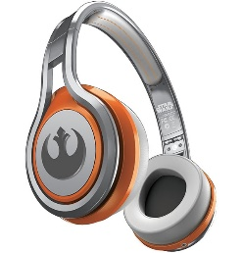
MATTHEW 11:20-30
A free CD of this message will be available following the service
IT WILL ALSO be available LATER THIS WEEK
VIA cALVARYOKC.COM

Slide 2







MATTHEW 11:20-30
Water in Wine
Opening Graves Raising Dead Feeding 5,000
Killing Fig Trees
Teaching w/o Certificate
Medicine w/o License
Walking on Water

Slide 3






MATTHEW 11:20-30
No Women Apostles
Herd of Swine into Sea
Only One Way to Heaven
Israel Building Commission
Promising Mansions w/o Permit
Guilt-free living

Slide 4

MATTHEW 11:20-30

Slide 5
MATTHEW 11:20-30
Message ~ ²¹ Doom to you, Chorazin! Doom, Bethsaida! If Tyre and Sidon had seen half of the powerful miracles you have seen, they would have been on their knees in a minute. ²² At Judgment Day they’ll get off easy compared to you. ²³ And Capernaum! With all your peacock strutting, you are going to end up in the abyss. If the people of Sodom had had your chances, the city would still be around.

Slide 6
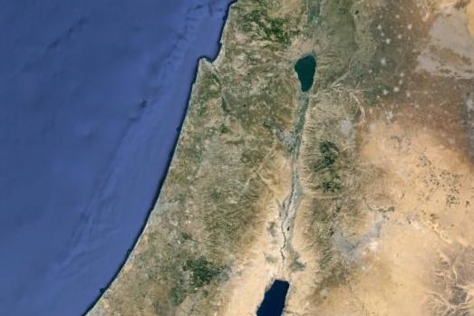
MATTHEW 11:20-30
Chorazin
Capernaum
Bethsaida

Slide 7
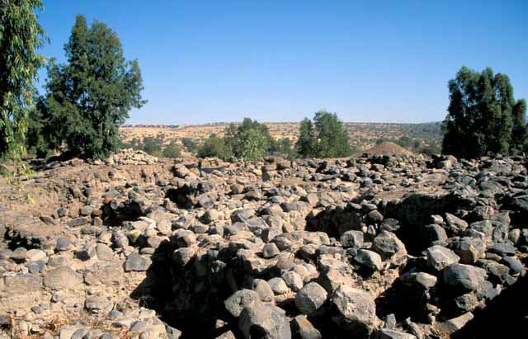
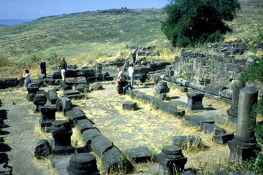
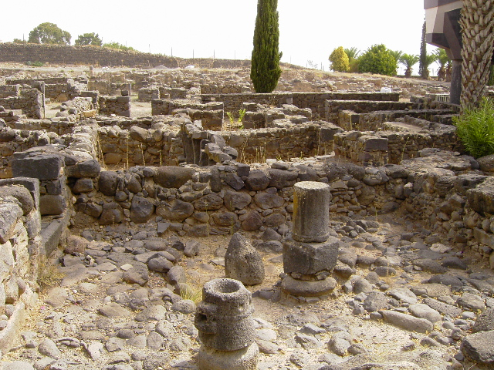
MATTHEW 11:20-30
Bethsaida
Chorazin
Capernaum

Slide 8
MATTHEW 11:20-30
Merrihew Standard Version ~ Woe to you, USA, for I have shed My grace upon you and given you unprecedented freedoms for which to spread My Gospel only to have you selfishly squander these freedoms on “your rights.”
Woe to you, OKC, for I have revealed Myself to you in the midst of manmade catastrophes and natural disasters that you might shake off your own indifference and draw near to Me, but it was short lived.

Slide 9
MATTHEW 11:20-30

Slide 10
MATTHEW 11:20-30
Babes ~ nēpios – without speech
NIV, little children

Slide 11
MATTHEW 11:20-30

Slide 12
MATTHEW 11:20-30
Three steps (all imperative)
Come
Take
Learn

Slide 13
MATTHEW 11:20-30

Slide 14
MATTHEW 11:20-30
Labor ~ kopiaō – labor to the point of exhaustion

Slide 15
MATTHEW 11:20-30

Slide 16
MATTHEW 11:20-30
Deut. 22:10 ~ You shall not plow with an ox and a donkey together.
Easy ~ chrēstos – fit, useful

Slide 17


MATTHEW 11:20-30
Our
Yokes
Fit
Zugoi Mou Crhstoi

Slide 18
MATTHEW 11:20-30

