Slide 1


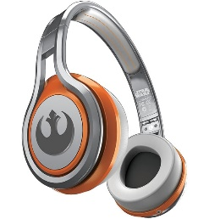
MATTHEW 9:27-10:4
A free CD of this message will be available following the service
IT WILL ALSO be available LATER THIS WEEK
VIA cALVARYOKC.COM

Slide 2


MATTHEW 9:27-10:4
MEMO
Jordan Management Consultants
10 Hillel St
Jerusalem, Judea
TO: Jesus bar Joseph
Woodcrafter's Carpenter Shop
Nazareth, Galilee
Thank you for submitting the resumes of the twelve men you have picked for managerial positions in your new organization. All of them have now taken our battery of tests, and we have not only run the results through our computers, but also arranged personal interviews for each of them with our psychologist and vocation aptitude consultant. It is the opinion of the staff that most of your nominees are lacking in background, education and vocational aptitude for the type of enterprise you are undertaking. They do not have the team concept. We would recommend that you

Slide 3
MATTHEW 9:27-10:4
MEMO
Jordan Management Consultants
10 Hillel St
Jerusalem, Judea
TO: Jesus bar Joseph
Woodcrafter's Carpenter Shop
Nazareth, Galilee
continue your search for persons of experience in managerial ability and proven capacity. We have summarized the findings of our study below:
Simon Peter is emotional, unstable and given to fits of temper. Andrew has absolutely no quality of leadership. The two brothers, James and John, the sons of Zebedee, place personal interests above Company loyalty. Thomas demonstrates a questioning attitude that would tend to undermine morale. We believe it is our duty to tell you that Matthew has been black-listed by the Greater Jerusalem Better Business Bureau. James,

Slide 4
MATTHEW 9:27-10:4
MEMO
Jordan Management Consultants
10 Hillel St
Jerusalem, Judea
TO: Jesus bar Joseph
Woodcrafter's Carpenter Shop
Nazareth, Galilee
the son of Alphaeus, and Thaddeus definitely have radical leanings. Additionally, they both registered high scores on the manic depressive scale. However, one of the candidates shows great potential. He's a man of ability and resourcefulness; he is a great networker; has a keen business mind; and has strong contacts in influential circles. He's highly motivated, very ambitious and adept with financial matters. We recommend Judas Iscariot as your Controller and Chief Operating Officer. All the other profiles are self-explanatory. We wish you the utmost success in your new venture.

Slide 5

MATTHEW 9:27-10:4

Slide 6



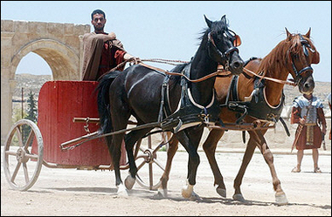


MATTHEW 9:27-10:4
Move with compassion ~ splagchnizomai
Literally, He was boweled
“I Left My Bowels in San Francisco”

Slide 7
MATTHEW 9:27-10:4

Slide 8
MATTHEW 9:27-10:4
Martin Luther ~ “Faith is a living, busy, active powerful thing; it is impossible for it not to do us good continually. It never asks whether good works are to be done, but has done them before there is time to ask the question – and it is always doing.”

Slide 9
MATTHEW 9:27-10:4

Slide 10
MATTHEW 9:27-10:4
Disciples ~ mathētēs, a learner
Apostles ~ apostolos, one who is sent out
He gave them power ~ NIV, NASB authority
Not dunamis, but exousia
John 19:10-11 ~ ¹⁰ Then Pilate said to Him, “Are You not speaking to me? Do You not know that I have power to crucify You, and power to release You?”
¹¹ Jesus answered, “You could have no power at all against Me unless it had been given you from above. Therefore the one who delivered Me to you has the greater sin.”

Slide 11
MATTHEW 9:27-10:4
Oswald Chambers (1874-1917) ~ “If you want to remain a full-orbed grape, you must keep out of God's hands for he will crush you. Wine cannot be had in any other way.”
“The great stumbling block in the way of some people being disciples is that they are gifted, so gifted that they won't trust God.”

Slide 12
MATTHEW 9:27-10:4
“Our Lord's conception of discipleship is not that we work for God, but that God works through us; he uses us as he likes; he allots our work where he chooses.”
“It never cost a disciple anything to follow Jesus: to talk about cost when you are in love with someone is an insult.”

Slide 13
MATTHEW 9:27-10:4

Slide 14
MATTHEW 9:27-10:4
Bartholomew ~ Nathanael (in John’s gospel)
Thaddeus ~ the other Judas (John 14:22), the son of James, the son of Alphaeus (Luke 6:15)
Simon the Cananite ~ from Cana (Luke calls him the Zealot)
1. Peter (always first)
7.
2.
8.
3.
9.
4.
10.
5.
11.
6.
12. Judas (always last)

Slide 15
MATTHEW 9:27-10:4

