Slide 1


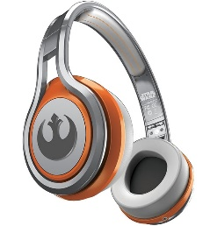
MATTHEW 9:9-26
A free CD of this message will be available following the service
IT WILL ALSO be available LATER THIS WEEK
VIA cALVARYOKC.COM

Slide 2

MATTHEW 9:9-26
Matthew ~ gift of Yahweh

Slide 3

MATTHEW 9:9-26

Slide 4

MATTHEW 9:9-26
KJV ~ Why eateth your Master with publicans and sinners?

Slide 5
MATTHEW 9:9-26

Slide 6
MATTHEW 9:9-26
John 3:17-18 ~ ¹⁷ For God did not send His Son into the world to condemn the world, but that the world through Him might be saved. ¹⁸ He who believes in Him is not condemned; but he who does not believe is condemned already, because he has not believed in the name of the only begotten Son of God.
Eph. 5:8 ~ For you were once darkness, but now you are light in the Lord. Walk as children of light …

Slide 7
MATTHEW 9:9-26

Slide 8
MATTHEW 9:9-26
Hos. 6:1-6 (NLT) ~ ¹ “Come, let us return to the Lord.
He has torn us to pieces;
now he will heal us.
He has injured us;
now he will bandage our wounds.
² In just a short time he will restore us,
so that we may live in his presence.
³ Oh, that we might know the Lord!
Let us press on to know him.
He will respond to us as surely as the arrival of dawn or the coming of rains in early spring.”

Slide 9
MATTHEW 9:9-26
⁴ “O Israel and Judah,
what should I do with you?” asks the Lord.
“For your love vanishes like the morning mist
and disappears like dew in the sunlight.
⁵ I sent my prophets to cut you to pieces—
to slaughter you with my words,
with judgments as inescapable as light.
⁶ I want you to show love,
not offer sacrifices.
I want you to know me
more than I want burnt offerings.”

Slide 10
MATTHEW 9:9-26

Slide 11
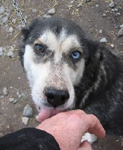
MATTHEW 9:9-26
Worshipped ~ proskuneō
Pros ~ before and kuōn ~ dog
Mark: My little daughter lies at the point of death.
Luke: for he had an only daughter about 12 years of age, and she was dying.

Slide 12
MATTHEW 9:9-26

Slide 13
MATTHEW 9:9-26
Luke 8:43 ~ Now a woman, having a flow of blood for twelve years, who had spent all her livelihood on physicians and could not be healed by any,

Slide 14
MATTHEW 9:9-26

Slide 15
MATTHEW 9:9-26
Num. 15:38-40 ~ ³⁸ Speak to the children of Israel: Tell them to make tassels on the corners of their garments throughout their generations, and to put a blue thread in the tassels of the corners. ³⁹ And you shall have the tassel, that you may look upon it and remember all the commandments of the Lord and do them, and that you may not follow the harlotry to which your own heart and your own eyes are inclined, ⁴⁰ and that you may remember and do all My commandments, and be holy for your God.

Slide 16
MATTHEW 9:9-26

Slide 17
MATTHEW 9:9-26
Made…well ~ sōzō – usually translated save

Slide 18
MATTHEW 9:9-26

Slide 19
MATTHEW 9:9-26
What a contrast!
Little girl was 12 years old
Woman had been sick 12 years
Wealthy family
Spent all she had
Joy of her father
Social outcast
Jesus met them both!

Slide 20
MATTHEW 9:9-26

