Slide 1
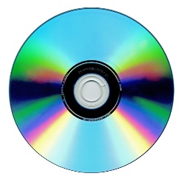
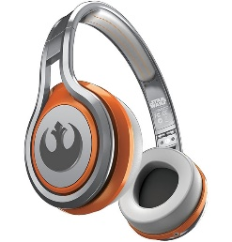
MATTHEW 8:14-27
A free CD of this message will be available following the service
IT WILL ALSO be available LATER THIS WEEK
VIA cALVARYOKC.COM

Slide 2
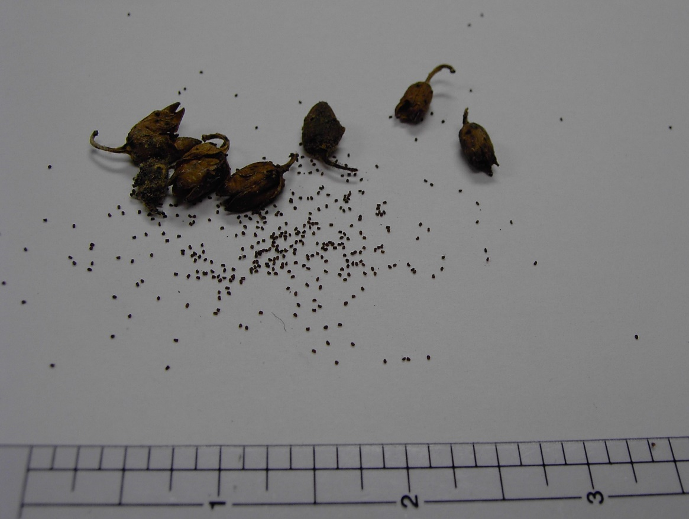
MATTHEW 8:14-27
Matt. 17:20b ~ I say to you, if you have faith as a mustard seed, you will say to this mountain, “Move from here to there,” and it will move;
Mustard seed

Slide 3
MATTHEW 8:14-27

Slide 4
MATTHEW 8:14-27
Is healing in the atonement?
1 Pet. 2:24 ~ who Himself bore our sins in His own body on the tree, that we, having died to sins, might live for righteousness—by whose stripes you were healed.

Slide 5
MATTHEW 8:14-27
Is healing in the atonement?
Rom. 5:18-19 ~ ¹⁸ Therefore, as through one man's offense judgment came to all men, resulting in condemnation, even so through one Man's righteous act the free gift came to all men, resulting in justification of life. ¹⁹ For as by one man's disobedience many were made sinners, so also by one Man's obedience many will be made righteous.
Saved from the Penalty of Sin ~ Justification

Slide 6
MATTHEW 8:14-27
Is healing in the atonement?
Rom. 6:8-11 ~ ⁸ Now if we died with Christ, we believe that we shall also live with Him, ⁹ knowing that Christ, having been raised from the dead, dies no more. Death no longer has dominion over Him. ¹⁰ For the death that He died, He died to sin once for all; but the life that He lives, He lives to God. ¹¹ Likewise you also, reckon yourselves to be dead indeed to sin, but alive to God in Christ Jesus our Lord.
Saved from the Power of Sin ~ Sanctification

Slide 7
MATTHEW 8:14-27
Is healing in the atonement?
1 John 3:2-3 ~ ² Beloved, now we are children of God; and it has not yet been revealed what we shall be, but we know that when He is revealed, we shall be like Him, for we shall see Him as He is. ³ And everyone who has this hope in Him purifies himself, just as He is pure.
Saved from the Presence of Sin ~ Glorification

Slide 8
MATTHEW 8:14-27
Is healing in the atonement?
Rom. 5:18-19
Saved from the Penalty of Sin ~ Justification
Rom. 6:8-11
Saved from the Power of Sin ~ Sanctification
1 John 3:2-3
Saved from the Presence of Sin ~ Glorification

Slide 9
MATTHEW 8:14-27

Slide 10
MATTHEW 8:14-27
F
A
I
T
H
orsaking
ll
rust
im

Slide 11
MATTHEW 8:14-27

Slide 12
MATTHEW 8:14-27
Mt. Hermon
Valley of Megiddo
700’ below sea level

Slide 13
MATTHEW 8:14-27
27’
Tempest ~ seismos – every other occurrence it's translated earthquake

Slide 14
MATTHEW 8:14-27

Slide 15
MATTHEW 8:14-27
1 John. 3:20 ~ For if our heart condemns us, God is greater than our heart, and knows all things.

Slide 16
MATTHEW 8:14-27

Slide 17
MATTHEW 8:14-27
w. Tozer ~ “The Bible recognizes no faith that does not lead to obedience, nor does it recognize any obedience that
does not spring from faith.
The two are at opposite
sides of the same coin.”
OBEDIENCE SPRINGS FROM FAITH
FAITH LEADS TO OBEDIENCE

Slide 18
MATTHEW 8:14-27

