Slide 1
MATTHEW 8:1-13
A free CD of this message will be available following the service
IT WILL ALSO be available LATER THIS WEEK
VIA cALVARYOKC.COM

Slide 2
MATTHEW 8:1-13
The Sermon on the Mount is the standard … not the solution
Sermon on the Mount
Better than most
Pretty darn good
Better than average
Not too bad
Average
So-so
Could be better
Nah, nice try

Slide 3
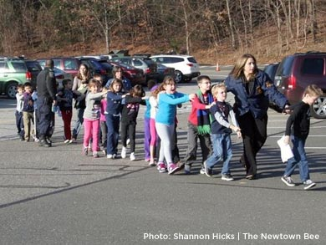
MATTHEW 8:1-13
We usually address the symptoms of the problem by applying the standard rather than addressing the solution
Gun Control
School Violence
Same Sex Marriage

Slide 4
MATTHEW 8:1-13

Slide 5
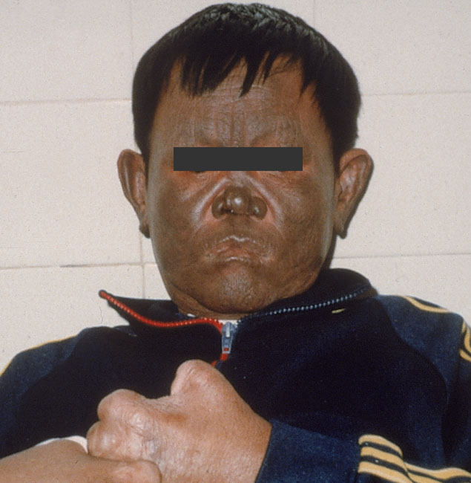
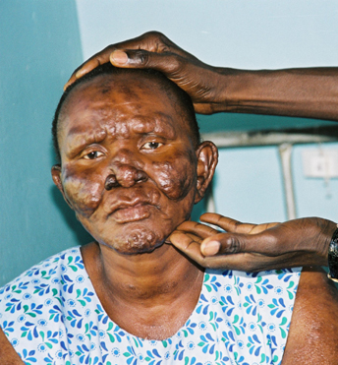
MATTHEW 8:1-13
Elephantiasis Graecorum (Hansen's disease)
Leper ~ lepros – from a root meaning to smite
Strong’s Dictionary ~ “A most offensive, annoying, dangerous cutaneous disease”

Slide 6
MATTHEW 8:1-13

Slide 7
MATTHEW 8:1-13
Num. 5:2-3 ~ ² Command the children of Israel that they put out of the camp every leper, everyone who has a discharge, and whoever becomes defiled by a corpse. ³ You shall put out both male and female; you shall put them outside the camp, that they may not defile their camps in the midst of which I dwell.
Cleansed ~ katharizō, heal ~ therapuō

Slide 8
MATTHEW 8:1-13

Slide 9
MATTHEW 8:1-13
Mark 1:45 (KJV) ~ But he went out, and began to publish it much, and to blaze abroad the matter, insomuch that Jesus could no more openly enter into the city, but was without in desert places: and they came to him from every quarter.
Lev. 14:1-7

Slide 10
MATTHEW 8:1-13
1st bird ~ death of Jesus
Earthen vessel ~ humanity of Jesus
Running water ~ work of the Holy Spirit
Cedar wood ~ incorruption of Jesus' life
Scarlet ~ the blood of Jesus
Hyssop ~ faith in action
2nd bird ~ Jesus’ resurrection

Slide 11
MATTHEW 8:1-13

Slide 12
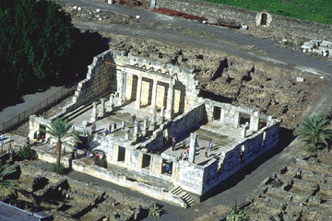
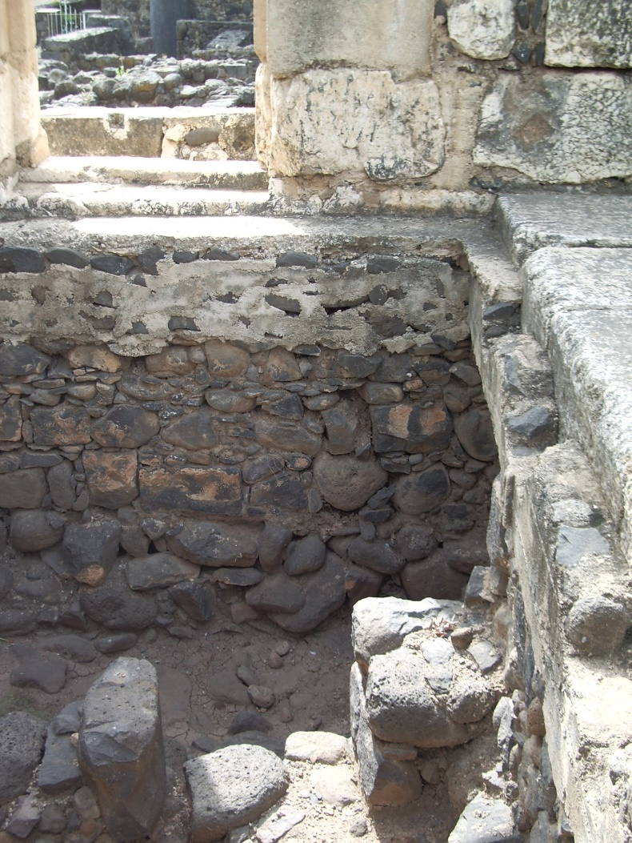
MATTHEW 8:1-13

Slide 13
MATTHEW 8:1-13

Slide 14
MATTHEW 8:1-13
Marveled ~ thaumazō – used 2x to describe Jesus
Mark 6:6 ~ And He marveled because of their unbelief. Then He went about the villages in a circuit, teaching.

Slide 15
MATTHEW 8:1-13

Slide 16
MATTHEW 8:1-13
C. H. Spurgeon ~ “This is a strange thing, yet it is continually happening still, despite its strangeness, that the persons, who are placed in such positions of privilege, that you naturally expect that they would become believers, remain unbelievers, while others, who are placed at a terrible disadvantage, nevertheless often come right out from sin, and right away from ignorance, and become believers in Christ. Oh, that none of us, who sit under the sound of the

Slide 17
MATTHEW 8:1-13
gospel from Sabbath to Sabbath, might be sad illustrations of this truth, while others, unaccustomed to listen to the Word, may be happy instances of the way in which the Lord still takes strangers, and adopts them into his family.”

Slide 18
MATTHEW 8:1-13

