Slide 1


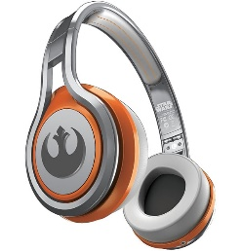
MATTHEW 7:21-29
A free CD of this message will be available following the service
IT WILL ALSO be available LATER THIS WEEK
VIA cALVARYOKC.COM

Slide 2

MATTHEW 7:21-29
truth
Lie

Slide 3

MATTHEW 7:21-29

Slide 4
MATTHEW 7:21-29
How could they do miracles?
Lying
Self-deceived
True miracles

Slide 5
MATTHEW 7:21-29

Slide 6
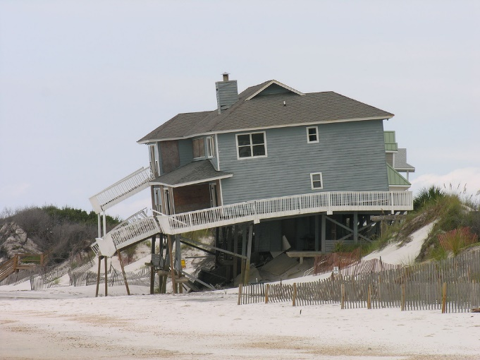
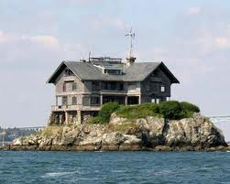
MATTHEW 7:21-29
Sand
Rock
.
Works
Experience
Jesus
My way
Performance
1 Cor. 3:11 ~ For no other foundation can anyone lay than that which is laid, which is Jesus Christ.
Meliorism
The Church
kosmos
Image

Slide 7
MATTHEW 7:21-29
1 Cor. 13:4-8a (NLT) ~ ⁴ Love is patient and kind. Love is not jealous or boastful or proud ⁵ or rude. Love does not demand its own way. Love is not irritable, and it keeps no record of when it has been wronged. ⁶ It is never glad about injustice but rejoices whenever the truth wins out. ⁷ Love never gives up, never loses faith, is always hopeful, and endures through every circumstance.
⁸ … love will last forever.

Slide 8
MATTHEW 7:21-29

Slide 9
MATTHEW 7:21-29
What about those who have never heard the gospel?
1st view:
They are lost
2nd view:
Some are saved

Slide 10
MATTHEW 7:21-29
1st view (They are lost):
In His omniscience, God will provide a witness for the diligent
or …
In His predetermination, God will provide a witness for the Elect

Slide 11
MATTHEW 7:21-29
2nd view (Some are saved):
The Old Testament saints were by faith looking “forward to the Cross”
Doesn’t mean that they understood that Jesus would die on the Cross
It merely states that they understood God would provide a way
Job 19:25 ~ For I know that my Redeemer lives,
And He shall stand at last on the earth;

Slide 12
MATTHEW 7:21-29
What we know:
1. All people are accountable to God
Rom. 14:12 ~ So then each of us shall give account of himself to God.
2. God has revealed Himself to all peoples
In their hearts
Eccl. 3:11b ~ And He has put eternity in their hearts,

Slide 13
MATTHEW 7:21-29
What we know:
2. (cont.) God has revealed Himself to all peoples
In creation
Rom. 1:20 ~ For since the creation of the world His invisible attributes are clearly seen, being understood by the things that are made, even His eternal power and Godhead, so that they are without excuse,
Rom. 2:15 ~ who show the work of the law written in their hearts, their conscience also bearing witness, and between themselves their thoughts accusing or else excusing them.

Slide 14
MATTHEW 7:21-29
What we know:
3. Jesus is the only way to salvation
Acts 4:12 ~ Nor is there salvation in any other, for there is no other name under heaven given among men by which we must be saved.
4. God is love
1 John 4:16 ~ And we have known and believed the love that God has for us. God is love, and he who abides in love abides in God, and God in him.

Slide 15
MATTHEW 7:21-29
What we know:
5. God is just
Ps. 7:11a ~ God is a just judge,

Slide 16
MATTHEW 7:21-29
What we know:
It is through His virgin-born Son’s substitionary death
He is the God/Man
He has made a way for reconciliation
It is by grace alone, through faith alone
We are sinners and separated from Him
He is holy and just
He is personal
There is a God
He is returning

Slide 17
MATTHEW 7:21-29

Slide 18
MATTHEW 7:21-29
Ancient Karen hymn:
Y’wa formed the world originally.
He appointed food and drink.
He appointed the ‘fruit of trial.’
He gave detailed orders.
Mu-kaw-lee deceived two persons.
He caused them to eat the fruit of the tree of trial.
They obeyed not; they believed not Y’wa …
When they ate the ‘fruit of trial,’
They became subject to sickness, aging, and death
– Eternity in Their Hearts, Don Richardson, pg. 78

Slide 19
MATTHEW 7:21-29
Billy Graham ~ “You're born. You suffer. You die.
Fortunately, there’s a loophole.”

Slide 20
MATTHEW 7:21-29
The Solid Rock – Edward Mote
My hope is built on nothing less that Jesus' blood and righteousness;
I dare not trust the sweetest frame, but wholly lean on Jesus' name.
When darkness veils His lovely face, I rest on His unchanging grace;
In ev'ry high and stormy gale, my anchor holds within the veil.

Slide 21
MATTHEW 7:21-29
The Solid Rock – Edward Mote
His oath, His covenant, His blood support me in the whelming flood;
When all around my soul gives way, He then is all my hope and stay.
When He shall come with trumpet sound, O may I then in Him be found;
Dressed in His righteousness alone, faultless to stand before the Throne.

Slide 22
MATTHEW 7:21-29
The Solid Rock – Edward Mote
Chorus:
On Christ the solid Rock, I stand – all other ground is sinking sand;
All other ground is sinking sand.

Slide 23
MATTHEW 7:21-29

