Slide 1



MATTHEW 7:13-20
A free CD of this message will be available following the service
IT WILL ALSO be available LATER THIS WEEK
VIA cALVARYOKC.COM

Slide 2


MATTHEW 7:13-20
Here! Pick me!
Over Here!
I am the way!
Follow me!
I’ll fulfill you!

Slide 3

MATTHEW 7:13-20

Slide 4

MATTHEW 7:13-20
Oprah Winfrey ~ “There are many paths to what you call God … there couldn’t be just one way.”
Hogwashizomai

Slide 5

MATTHEW 7:13-20
Perdition
Paradise

Slide 6
MATTHEW 7:13-20
The
Broad
Road
The
Narrow
Road

Slide 7
MATTHEW 7:13-20

Slide 8
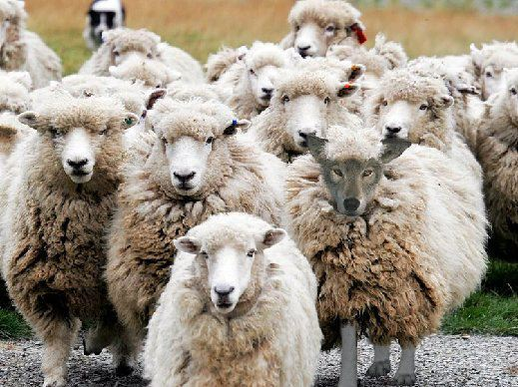
MATTHEW 7:13-20

Slide 9
MATTHEW 7:13-20
Truth
Lie

Slide 10
MATTHEW 7:13-20
Person & Work of Christ
Bodily Resurrection of Christ
Thermostat Control
Inerrancy
Verse by Verse Teaching
We Believe…
Non-negotiable
Negotiable
Continuation and Balance of Spiritual Gifts
Balance between Calvinism & Arminianism
Pre-tribulation Rapture

Slide 11
MATTHEW 7:13-20

Slide 12
MATTHEW 7:13-20
Matt. 12:30 ~ He who is not with Me is against Me, and he who does not gather with Me scatters abroad.
Mark 9:40 ~ For he who is not against us is on our side.
Ravenous ~ harpax – used 4 other times in New Testament
KJV, NKJV ~ extortioners
NASB, NIV ~ swindlers

Slide 13

MATTHEW 7:13-20
Chapter 11. Concerning Teachers, Apostles, and Prophets. Whosoever, therefore, comes and teaches you all these things that have been said before, receive him. But if the teacher himself turns and teaches another doctrine to the destruction of this, hear him not. But if he teaches so as to increase righteousness and the knowledge of the Lord, receive him as the Lord. But
concerning the apostles and prophets, act according to the decree of the Gospel. Let every apostle who comes to you be received as the Lord. But he shall not remain more than one day; or two days, if there's a need. But if he remains three days, he is a false prophet. And when the apostle goes away, let him take nothing but bread until he lodges. If he asks for money, he is a false prophet.
c. AD 100
The Teaching

Slide 14
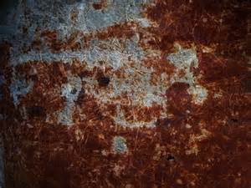

MATTHEW 7:13-20
Heresy Hunters
Gullible Christians

Slide 15
MATTHEW 7:13-20
How can I identify false doctrine (teaching)?
1) Does the doctrine adhere to the cardinal points of Christianity?
2) Does the doctrine lead to Christ-likeness?
3) Does the doctrine lead to a true worship of the true God?

Slide 16
MATTHEW 7:13-20

Slide 17
MATTHEW 7:13-20
J. C. Ryle (1816-1900) ~ “One plague of our age is the widespread dislike to what men are pleased to call dogmatic theology. In the place of it, the idol of the day is a kind of jellyfish Christianity – a Christianity without bone, or muscle, or sinew, – without any distinct teaching about the atonement or the work of the Spirit, or justification, or the way of peace with God – a vague, foggy, misty Christianity, of which the only watchwords seem to be, ‘You must be…liberal and kind. You must condemn no man’s doctrinal views. You must consider everybody is right and nobody is wrong.’”

Slide 18
MATTHEW 7:13-20

Slide 19
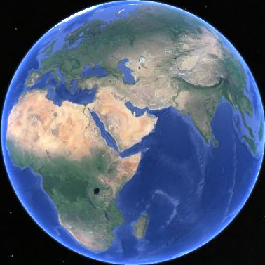
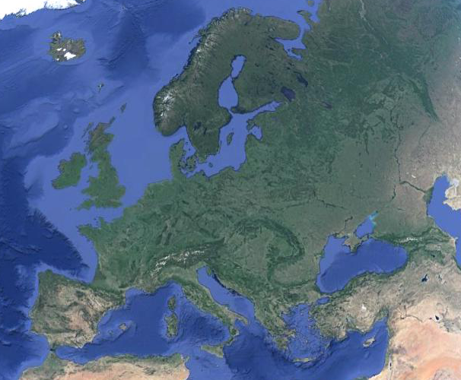
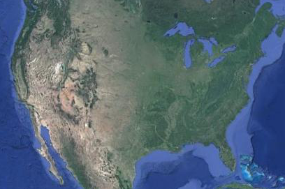
MATTHEW 7:13-20
What is the fastest growing religion in the world today?
Islam
What is the fastest growing religion in Europe today?
Islam
What is the fastest growing religion in the USA today?
Islam

Slide 20
MATTHEW 7:13-20
Gal. 5:22-23 ~ ²² But the fruit of the Spirit is love, joy, peace, longsuffering, kindness, goodness, faithfulness, ²³ gentleness, self-control. Against such there is no law.

Slide 21
MATTHEW 7:13-20

