Slide 1


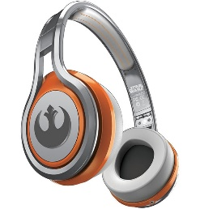
MATTHEW 6:22-34
A free CD of this message will be available following the service
IT WILL ALSO be available LATER THIS WEEK
VIA cALVARYOKC.COM

Slide 2

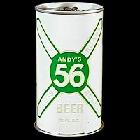
MATTHEW 6:22-34
Bubba
Bubba

Slide 3

MATTHEW 6:22-34

Slide 4
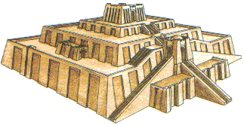
MATTHEW 6:22-34
Noah
Ham
Shem
Japheth
Cush
Monotheistic Yahweh worshippers
Nimrod
Polytheistic Idol worshippers

Slide 5

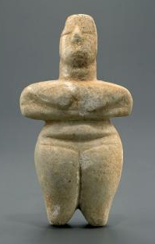
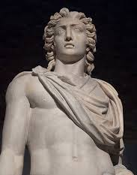
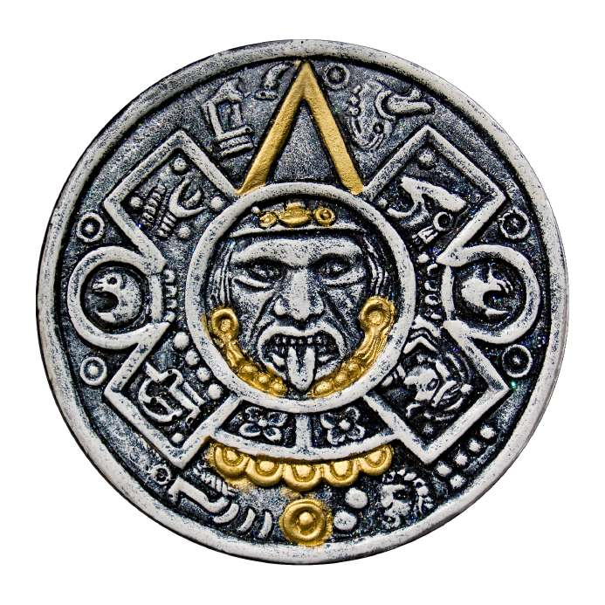
MATTHEW 6:22-34
Sun god
Ra (Egypt)
The Sun
Helios (Greece)

Slide 6
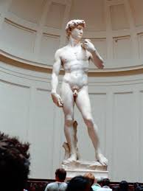
MATTHEW 6:22-34

Slide 7
MATTHEW 6:22-34

Slide 8
MATTHEW 6:22-34
Serve ~ douleuō – verb form of doulos (bond-servant)
Mammon ~ mammōnas – worldly wealth personified
1 Tim. 6:10 ~ For the love of money is a root of all kinds of evil, for which some have strayed from the faith in their greediness, and pierced themselves through with many sorrows.

Slide 9
MATTHEW 6:22-34
1 Tim. 6:17 ~
Command those who are rich in this present age not to be haughty, nor to trust in uncertain riches but in the living God,
who gives us richly all things to enjoy.

Slide 10
MATTHEW 6:22-34

Slide 11
MATTHEW 6:22-34
Worry ~ merimnaō – from compound word meaning to divide the mind

Slide 12
MATTHEW 6:22-34

Slide 13
MATTHEW 6:22-34
Prov. 13:22 ~ A good man leaves an inheritance to his children’s children,
But the wealth of the sinner is stored up for the righteous.

Slide 14
MATTHEW 6:22-34
The Robin to the Sparrow (Elizabeth Cheney)
Said the robin to the sparrow:
“There is one thing I would really like to know,
Why these anxious human beings
Rush about and worry so.”
Said the sparrow to the robin:
“Friend, I think that it must be
That they have no heavenly Father
Such as cares for you and me.”

Slide 15
MATTHEW 6:22-34

Slide 16
MATTHEW 6:22-34
Oswald Chambers ~ “Worry is unconscious blasphemy.”
Corrie ten Boom ~ “Worry does not empty tomorrow of its troubles …
it empties today of its strength.”

Slide 17
MATTHEW 6:22-34

Slide 18

MATTHEW 6:22-34
The 3 Branches of Gub-mint
Is. 33:22 ~ (For the Lord is our Judge,
The Lord is our Lawgiver,
The Lord is our King;
He will save us);
Legislative
Judicial
Executive

Slide 19
MATTHEW 6:22-34
Acts 4:19-20 ~ ¹⁹ But Peter and John answered and said to them, “Whether it is right in the sight of God to listen to you more than to God, you judge. ²⁰ For we cannot but speak the things which we have seen and heard.”

Slide 20
MATTHEW 6:22-34

