Slide 1



MATTHEW 6:11-21
A free CD of this message will be available following the service
IT WILL ALSO be available LATER THIS WEEK
VIA cALVARYOKC.COM

Slide 2

MATTHEW 6:11-21
Ps. 106:13-15 ~ ¹³ They soon forgot His works; they did not wait for His counsel, ¹⁴ but lusted exceedingly in the wilderness, and tested God in the desert. ¹⁵ And He gave them their request, but sent leanness into their soul.

Slide 3

MATTHEW 6:11-21

Slide 4
MATTHEW 6:11-21
Is. 55:1-2 ~ ¹ Ho! Everyone who thirsts, come to the waters; and you who have no money, come, buy and eat. Yes, come, buy wine and milk without money and without price. ² Why do you spend money for what is not bread, and your wages for what does not satisfy? Listen carefully to Me, and eat what is good, and let your soul delight itself in abundance.

Slide 5

MATTHEW 6:11-21

Slide 6
MATTHEW 6:11-21
Eph. 4:30-5:2 ~ ³⁰ And do not grieve the Holy Spirit of God, by whom you were sealed for the day of redemption. ³¹ Let all bitterness, wrath, anger, clamor, and evil speaking be put away from you, with all malice. ³² And be kind to one another, tenderhearted, forgiving one another, even as God in Christ forgave you.
¹ Therefore be imitators of God as dear children. ² And walk in love, as Christ also has loved us and given Himself for us, an offering and a sacrifice to God for a sweet-smelling aroma.

Slide 7
MATTHEW 6:11-21

Slide 8
MATTHEW 6:11-21
Our
Father in heaven,
Hallowed be Your name.
Your kingdom come.
Your will be done
On earth as it is in heaven.
Give us this day our daily bread.
And forgive us our debts,
As we forgive our debtors.
And do not lead us into temptation,
But deliver us from the evil one.
For Yours is the kingdom
and the power
and the glory
forever.
Amen.

Slide 9
MATTHEW 6:11-21

Slide 10
MATTHEW 6:11-21
John R. W. Stott (“The Message of the Sermon on the Mount”) ~ “Once our eyes have been opened to see the enormity of our offence against God, the injuries which others have done to us appear by comparison extremely trifling. If, on the other hand, we have an exaggerated view of the offences of others, it proves that we have minimized our own.”

Slide 11
MATTHEW 6:11-21

Slide 12
MATTHEW 6:11-21
Nathaniel Hawthorne ~ “No man, for any considerable period, can wear a face to himself and another to the multitude, without finally getting bewildered as to which may be true.”

Slide 13
MATTHEW 6:11-21

Slide 14
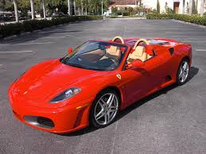
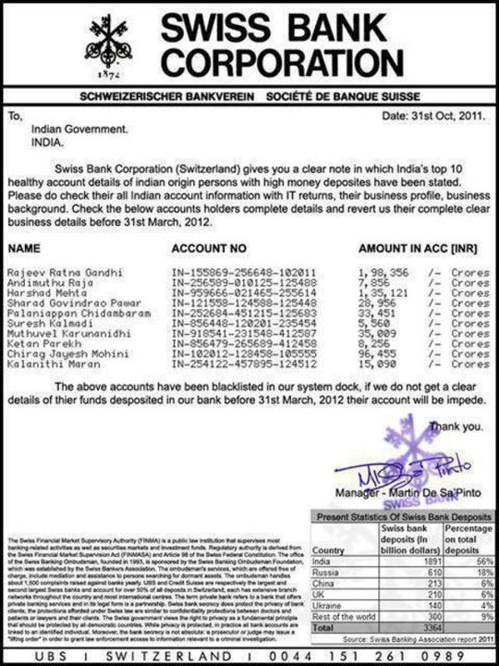
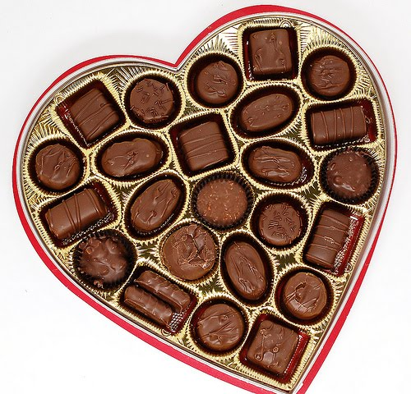
MATTHEW 6:11-21
$1,000,000,000

Slide 15
MATTHEW 6:11-21

Slide 16
MATTHEW 6:11-21
Lay up ~ verb form of treasure (thēsauros) – literally, do not treasure up for yourselves treasures

Slide 17
MATTHEW 6:11-21

Slide 18
MATTHEW 6:11-21
Francois Fenelon (1651-1715) ~ “Tell God all that is in your heart, as one unloads one’s heart, its pleasures and its pains, to a dear friend. Tell God your troubles, that God may comfort you; tell God your joys, that God may sober them; tell God your longings, that God may purify them; tell God your dislikes, that God may help you conquer them; talk to God of your temptations, that God may shield you from them: show God the wounds of your heart, that God

Slide 19
MATTHEW 6:11-21
may heal them. If you thus pour out all your weaknesses, needs, troubles, there will be no lack of what to say. Talk out of the abundance of the heart, without consideration say just what you think. Blessed are they who attain to such familiar, unreserved intercourse with God.”

Slide 20
MATTHEW 6:11-21

