Slide 1


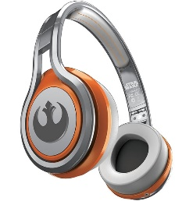
MATTHEW 5:17-30
A free CD of this message will be available following the service
IT WILL ALSO be available LATER THIS WEEK
VIA cALVARYOKC.COM

Slide 2

MATTHEW 5:17-30
“What must I forsake?” the young man asked.
“Get rid of everything in your wardrobe that is not white.”
“Colored clothes for one thing.”
“Stop sleeping on a soft pillow.”
“Sell your musical instruments.”
“And don’t eat any more white bread.”
“Don’t take any more warm baths or shave your beard.”

Slide 3

MATTHEW 5:17-30

Slide 4
MATTHEW 5:17-30
Fulfill ~ plēroō – to fill up, complete
The striking of a tent
A. T. Robertson ~ “Fulfil is to fill full. This Jesus did to the ceremonial law which pointed to him and the moral law he kept.”

Slide 5
MATTHEW 5:17-30

Slide 6
MATTHEW 5:17-30
Jot ~ Hebrew, yod
י
Greek, iota
ι
O
Q
Tittle ~ keraia
Phillips ~ … while Heaven and earth last, the Law will not lose a single dot or comma until its purpose is complete.

Slide 7
MATTHEW 5:17-30

Slide 8
MATTHEW 5:17-30

Slide 9
MATTHEW 5:17-30

Slide 10
MATTHEW 5:17-30
Warren Wiersbe ~ “The Pharisees thought they were conserving God’s Word, when in reality they were preserving God’s Word: embalming it so that it no longer had life!”

Slide 11
MATTHEW 5:17-30

Slide 12
MATTHEW 5:17-30
Matt. 7:29 ~ for He taught them as one having authority, and not as the scribes.
Angry ~ orgizō – from a word meaning to be controlled by violent passion
Hell ~ gehenna – Valley of Hinnom
Not hadēs ~ the place of departed spirits (sheol)

Slide 13
MATTHEW 5:17-30

Slide 14
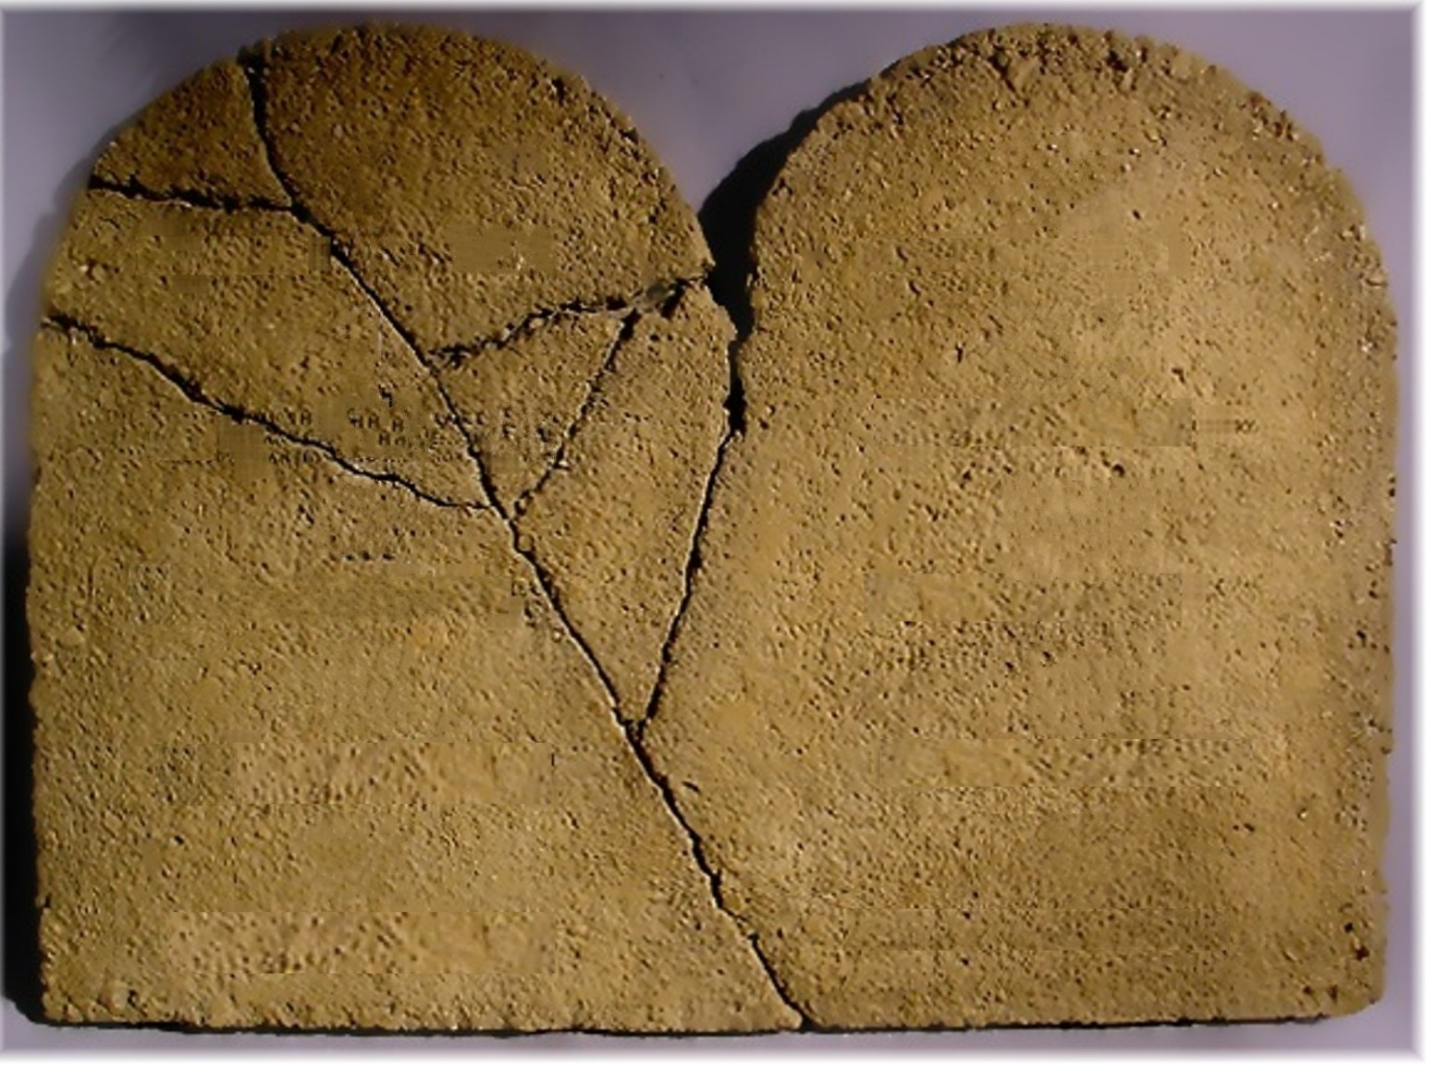
MATTHEW 5:17-30
VI
I
VII
II
VIII
III
IX
IV
X
V
XI GET THEE OVER IT

Slide 15
MATTHEW 5:17-30

Slide 16
MATTHEW 5:17-30
What about the other 8 commmandments?
What about the other 611 commmandments?
Do not commit adultery
Do not commit murder
I.
II.
III.
IV.
V.
VI.
VII.
VIII.
XI.
X.

Slide 17
MATTHEW 5:17-30

Slide 18
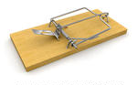
MATTHEW 5:17-30
Causes you to sin ~ skandalizō – the trip-trigger in a snare or trap

Slide 19
MATTHEW 5:17-30

Slide 20

MATTHEW 5:17-30

Slide 21
MATTHEW 5:17-30

