Slide 1


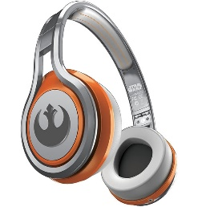
MATTHEW 4:12-25
A free CD of this message will be available following the service
IT WILL ALSO be available LATER THIS WEEK
VIA cALVARYOKC.COM

Slide 2

MATTHEW 4:12-25
G. K. Chesterton ~ “Christianity has not been tried and found wanting; it has been found difficult and not tried.”
''Robert gave Richard a rap in the ribs for roasting the rabbit so rare.''
''Bob gave Dick a poke in the side because the bunny wasn't cooked enough.''

Slide 3

MATTHEW 4:12-25

Slide 4
MATTHEW 4:12-25
1. Buying a stronger whip.
2. Changing riders.
3. Appointing a committee to study the horse.
4. Arranging to visit other countries to see how other cultures ride dead horses.
5. Lowering the standards so that dead horses can be included.
6. Reclassifying the dead horse as living-impaired.

Slide 5
MATTHEW 4:12-25
7. Hiring outside contractors to ride the dead horse.
8. Harnessing several dead horses together to increase speed.
9. Providing additional funding and/or training to increase dead horse's performance.
10. Doing a productivity study to see if lighter riders would improve the dead horse's performance.

Slide 6
MATTHEW 4:12-25
11. Declaring that as the dead horse does not have to be fed, it is less costly, carries lower overhead and therefore contributes substantially more to the bottom line of the economy than do some other horses.
12. Promoting the dead horse to a supervisory position.

Slide 7
MATTHEW 4:12-25

Slide 8
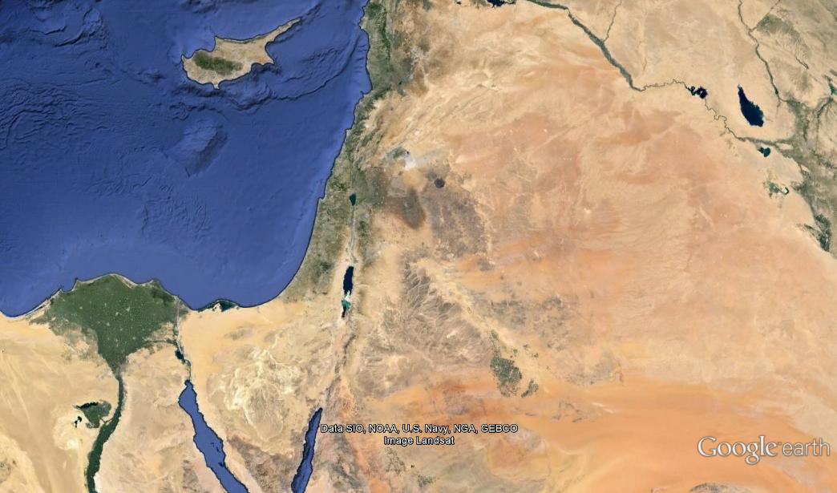
MATTHEW 4:12-25
Is. 9:1-2
Naphtali
Capernaum
Zebulun
Nazareth
Is. 61:1-2 ~ 1 The Spirit of the Lord God is upon Me,
Because the Lord has anointed Me
To preach good tidings to the poor;
He has sent Me to heal the brokenhearted,
To proclaim liberty to the captives,
And the opening of the prison to those who are bound;
2 To proclaim the acceptable year of the Lord,
And the day of vengeance of our God;

Slide 9
MATTHEW 4:12-25

Slide 10
MATTHEW 4:12-25
1 John 1:3-5 ~ ³ that which we have seen and heard we declare to you, that you also may have fellowship with us; and truly our fellowship is with the Father and with His Son Jesus Christ. ⁴ And these things we write to you that your joy may be full. ⁵ This is the message which we have heard from Him and declare to you, that God is light and in Him is no darkness at all.

Slide 11
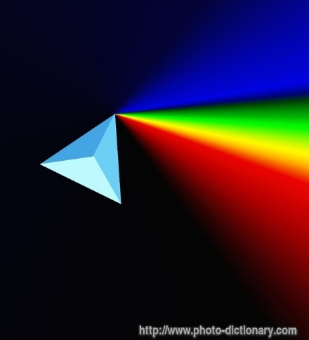
MATTHEW 4:12-25
God
Love
Mercy
Grace
Christ’s humanity
Holiness

Slide 12
MATTHEW 4:12-25

Slide 13
MATTHEW 4:12-25
Matt. 16:21 ~ From that time Jesus began to show to His disciples that He must go to Jerusalem, and suffer many things from the elders and chief priests and scribes, and be killed, and be raised the third day.

Slide 14
MATTHEW 4:12-25

Slide 15
MATTHEW 4:12-25
Luke 6:12-13 ~ ¹² Now it came to pass in those days that He went out to the mountain to pray, and continued all night in prayer to God. ¹³ And when it was day, He called His disciples to Himself; and from them He chose twelve whom He also named apostles:

Slide 16
MATTHEW 4:12-25

Slide 17
MATTHEW 4:12-25
Luke 11:1 ~ Now it came to pass, as He was praying in a certain place, when He ceased, that one of His disciples said to Him, “Lord, teach us to pray, as John also taught his disciples.”

Slide 18
MATTHEW 4:12-25
Luke 11:9-10 ~ ⁹ So I say to you, ask, and it will be given to you; seek, and you will find; knock, and it will be opened to you. ¹⁰ For everyone who asks receives, and he who seeks finds, and to him who knocks it will be opened.
Ask, seek, knock ~ present participles
Literally, ask and keep on asking; seek and keep on seeking; knock and keep on knocking

Slide 19
MATTHEW 4:12-25
Jam. 5:16a ~ The effective, fervent prayer of a righteous man avails much.
Phillips ~ Tremendous power is made available through a good man's earnest prayer.

Slide 20
MATTHEW 4:12-25
Eph. 1:19-20 (Phillips) ~ ¹⁹ and how tremendous is the power available to us who believe in God. ²⁰ That power is the same divine energy which was demonstrated in Christ when he raised him from the dead and gave him the place of highest honour in Heaven …

Slide 21
MATTHEW 4:12-25

Slide 22
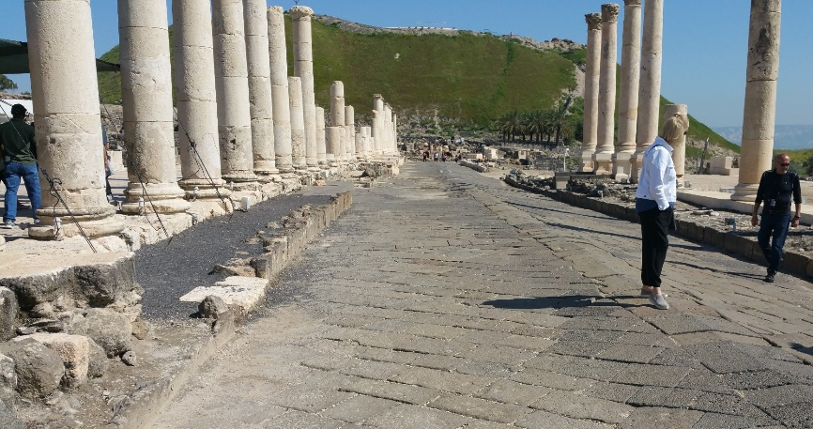
MATTHEW 4:12-25
The 10 Cities of the Decapolis
Damascus
Canatha
Hippus
Dion
Scythopolis
Raphana
Gadara
Pella
Gerasa
Philadelphia

Slide 23
MATTHEW 4:12-25

