Slide 1


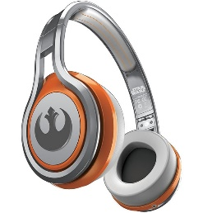
MATTHEW 4:1-11
A free CD of this message will be available following the service
IT WILL ALSO be available LATER THIS WEEK
VIA cALVARYOKC.COM

Slide 2

MATTHEW 4:1-11
Prov. 18:24 ~ A man who has friends must himself be friendly,
But there is a friend who sticks closer than a brother.

Slide 3
MATTHEW 4:1-11
What a Friend we have in Jesus,
All our sins and griefs to bear!
What a privilege to carry
Everything to God in prayer!
O what peace we often forfeit,
O what needless pain we bear,
All because we do not carry
Everything to God in prayer.
Joseph Scriven

Slide 4
MATTHEW 4:1-11
Me and you is friends
You smile …
me smile
You hurt…
me hurt
You cry…
me cry
You jump off a bridge…
me gonna miss you
Cuz Me and You is Friends

Slide 5

MATTHEW 4:1-11

Slide 6
MATTHEW 4:1-11
1 John 2:16 ~ For all that is in the world—the lust of the flesh, the lust of the eyes, and the pride of life—is not of the Father but is of the world.
Lust of the flesh ~ it's all about pleasure
Lust of the eyes ~ it's all about possessions
Pride of life ~ it's all about me personally

Slide 7
MATTHEW 4:1-11
Heb. 4:14-15 ~ ¹⁴ Seeing then that we have a great High Priest who has passed through the heavens, Jesus the Son of God, let us hold fast our confession. ¹⁵ For we do not have a High Priest who cannot sympathize with our weaknesses, but was in all points tempted as we are, yet without sin.

Slide 8
MATTHEW 4:1-11
Mark 1:12 ~ drove – ekballō, to drive out
James 1:13 ~ Let no one say when he is tempted, "I am tempted by God"; for God cannot be tempted by evil, nor does He Himself tempt anyone.
Tempted ~ peirazō – test, put to the test, tempt, try

Slide 9
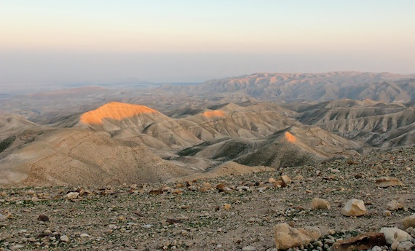
MATTHEW 4:1-11
Judean Wilderness

Slide 10
MATTHEW 4:1-11

Slide 11
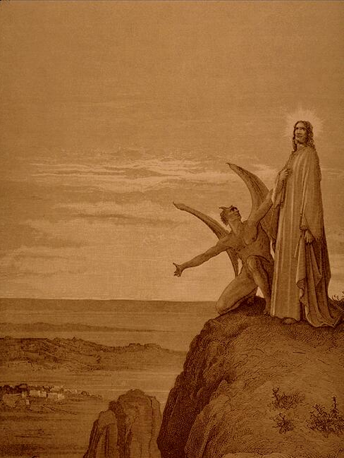
MATTHEW 4:1-11
“The Temptation of Jesus” – Gustave Dore’

Slide 12
MATTHEW 4:1-11

Slide 13
MATTHEW 4:1-11
Luke 4:13 ~ Now when the devil had ended every temptation, he departed from Him until an opportune time.
Message ~ That completed the testing. The Devil retreated temporarily, lying in wait for another opportunity.

Slide 14
MATTHEW 4:1-11
Helen Keller ~ “Walking with a friend in the dark is better than walking alone in the light.”

Slide 15
MATTHEW 4:1-11
Have we trials and temptations?
Is there trouble anywhere?
We should never be discouraged—
Take it to the Lord in prayer.
Can we find a friend so faithful
Who will all our sorrows share?
Jesus knows our every weakness—
Take it to the Lord in prayer.
Joseph Scriven

Slide 16
MATTHEW 4:1-11
Are we weak and heavy laden,
Cumbered with a load of care?
Precious Savior, still our refuge—
Take it to the Lord in prayer.
Do thy friends despise, forsake thee?
Take it to the Lord in prayer;
In His arms He’ll take and shield thee—
Thou wilt find a solace there.
Joseph Scriven

Slide 17
MATTHEW 4:1-11

