Slide 1



MATTHEW 3:10-17
A free CD of this message will be available following the service
IT WILL ALSO be available LATER THIS WEEK
VIA cALVARYOKC.COM

Slide 2

MATTHEW 3:10-17
FL: $900 –
$400 for materials; $400 for crew; $100 for me
TX: $700 –
$300 for materials; $300 for crew; $100 for me
NY: $2700 –
$1000 for you; $1000 for me; we hire the guy from Texas

Slide 3

MATTHEW 3:10-17

Slide 4
MATTHEW 3:10-17
1. What is the significance of water baptism?
2. Is there a difference between having been baptized in the Holy Spirit and having been baptized with the Holy Spirit?

Slide 5
MATTHEW 3:10-17

Slide 6
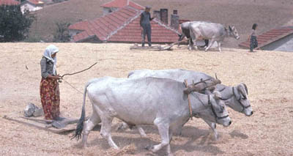
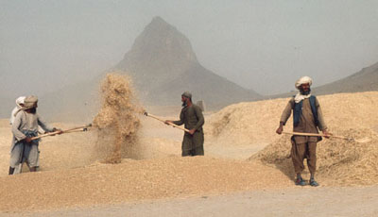
MATTHEW 3:10-17
Threshing sledge
Winnowing fan

Slide 7
MATTHEW 3:10-17

Slide 8
MATTHEW 3:10-17
John 1:32-33 ~ ³² And John bore witness, saying, “I saw the Spirit descending from heaven like a dove, and He remained upon Him. ³³ I did not know Him, but He who sent me to baptize with water said to me, ‘Upon whom you see the Spirit descending, and remaining on Him, this is He who baptizes with the Holy Spirit.’”

Slide 9
MATTHEW 3:10-17

Slide 10
MATTHEW 3:10-17
Two ordinances:
Two greatest doctrines:
Communion
Christ in us
Baptism
Us in Christ

Slide 11
MATTHEW 3:10-17

Slide 12
MATTHEW 3:10-17
Eph. 2:8-9 ~ ⁸ For by grace you have been saved through faith, and that not of yourselves; it is the gift of God, ⁹ not of works, lest anyone should boast.

Slide 13


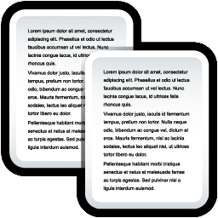

MATTHEW 3:10-17
Clipboard
X
Lust
Cut
Paste All
Clear All
Lust
Copy
Lying
Lust
Lying
Paste
Stealing
Lying
Stealing
Stealing
Voting for the wrong political party
Voting for the wrong politi …
Voting for the wrong political party

Slide 14
MATTHEW 3:10-17

Slide 15
MATTHEW 3:10-17
Romans 6:1-10
1 Pet. 3:20-21 ~ ²⁰ … when God waited patiently in the days of Noah while the ark was being built. In it only a few people, eight in all, were saved through water, ²¹ There is also an antitype which now saves us—baptism (not the removal of the filth of the flesh, but the answer of a good conscience toward God), through the resurrection of Jesus Christ,

Slide 16
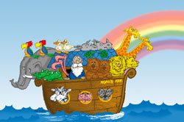
MATTHEW 3:10-17
Noah and the Flood are a type of Baptism
We are a type of Noah
The flood waters are a type of judgment
The ark is a type of Jesus

Slide 17
MATTHEW 3:10-17

Slide 18
MATTHEW 3:10-17
Fitting ~ prepō – from a primary verb meaning to tower up or to be conspicuous
1) Authentication of John's ministry
2) Identification with our own sinfulness
3) Proclamation of His mission
4) Illustration of the Trinity (v. 17)

Slide 19
MATTHEW 3:10-17

Slide 20
MATTHEW 3:10-17
John 14:16-17 ~ ¹⁶ And I will pray the Father, and He will give you another Helper, that He may abide with you forever— ¹⁷ the Spirit of truth, whom the world cannot receive, because it neither sees Him nor knows Him; but you know Him, for He dwells with you and will be in you.
Acts 1:8a ~ But you shall receive power when the Holy Spirit has come upon you;
para ~ with
en ~ in
epi ~ upon

Slide 21
MATTHEW 3:10-17
Acts 11:16 ~ Then I remembered the word of the Lord, how He said, “John indeed baptized with water, but you shall be baptized with (eis) the Holy Spirit.”
1 Cor. 12:13 ~ For by one Spirit we were all baptized into (eis) one body — whether Jews or Greeks, whether slaves or free — and have all been made to drink into (eis) one Spirit.

Slide 22
MATTHEW 3:10-17

Slide 23
MATTHEW 3:10-17
Acts 8:5-8; 14-16

Slide 24
MATTHEW 3:10-17

Slide 25
MATTHEW 3:10-17
Acts 1:8 ~ But you shall receive power when the Holy Spirit has come upon you; and you shall be witnesses to Me in Jerusalem, and in all Judea and Samaria, and to the end of the earth.

Slide 26
MATTHEW 3:10-17

Slide 27
MATTHEW 3:10-17
Gal. 5:22-24 ~ ²² But the fruit of the Spirit is love, joy, peace, longsuffering, kindness, goodness, faithfulness, ²³ gentleness, self- control. Against such there is no law. ²⁴ And those who are Christ's have crucified the flesh with its passions and desires.

Slide 28
MATTHEW 3:10-17

Slide 29
MATTHEW 3:10-17
John's baptism was a statement of repentance
An identification with one's sinfulness
Jesus' baptism is a statement of death, burial and resurrection
An identification with one's union in Christ
The Spirit’s baptism is a statement of His control over our lives
An identification with the power to live victoriously
2 Pet. 1:3 ~ [It’s] His divine power [that] has given to us all things that pertain to life and godliness …

Slide 30
MATTHEW 3:10-17

