Slide 1



MATTHEW 3:1-9
A free CD of this message will be available following the service
IT WILL ALSO be available LATER THIS WEEK
VIA cALVARYOKC.COM

Slide 2

MATTHEW 3:1-9
If College Students Wrote the Bible:
Instead of God creating the world in six days and resting on the seventh, He would have put it off until the night before it was due and then pulled an all-nighter.
The Last Supper would have been eaten the next morning … cold.
The Ten Commandments would actually be only five … double-spaced and written in a large font.

Slide 3
MATTHEW 3:1-9
If College Students Wrote the Bible:
A new edition would be published every two years in order to limit reselling.
Forbidden fruit would have been eaten because it wasn't cafeteria food.
Paul's letter to the Romans would become Paul's email to abuse@romans.gov.
Reason Cain killed Abel: they were roommates.
Reason why Moses and followers walked in the desert for 40 years: they didn't want to ask directions and look like freshmen.

Slide 4

MATTHEW 3:1-9

Slide 5
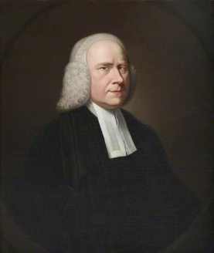
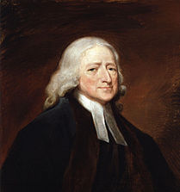
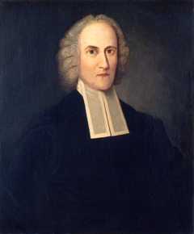

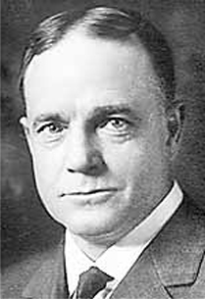
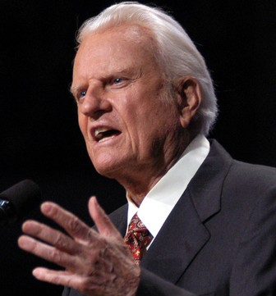
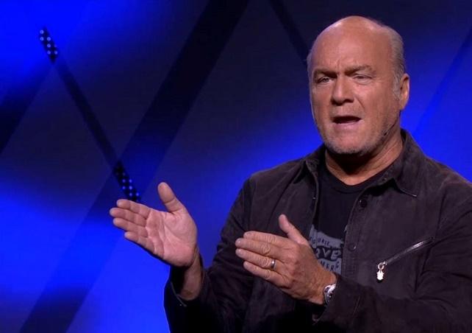
MATTHEW 3:1-9
George Whitefield
John Wesley
Jonathan Edwards
?
Vera Craft
Billy Sunday
Billy Graham
Greg Laurie

Slide 6
MATTHEW 3:1-9

Slide 7
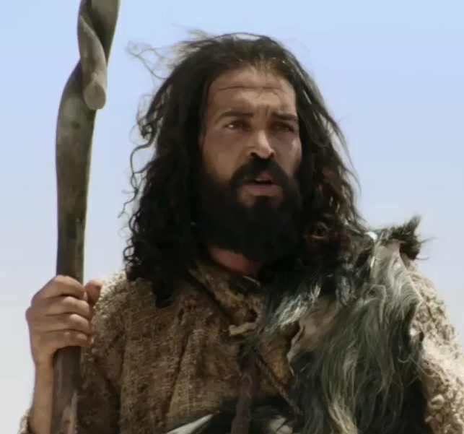
MATTHEW 3:1-9
Prophet
monthly
Vol. 777
Who is Antichrist this month?
(Pg. 13)
The Kingdom of Heaven issue
John the Baptist diet
10 pounds in
10 days … GUARANTEED!

Slide 8
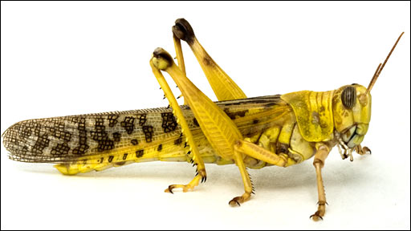
MATTHEW 3:1-9
Lev. 11:21-22 ~ ²¹ Yet these you may eat of every flying insect that creeps on all fours: those which have jointed legs above their feet with which to leap on the earth. ²² These you may eat: the locust after its kind, the destroying locust after its kind, the cricket after its kind, and the grasshopper after its kind.

Slide 9
MATTHEW 3:1-9
Locusts (ISBE) ~ “The Arabs prepare for food the thorax of the locust, which contains the great wing muscles. They pull off the head, which as it comes away brings with it a mass of the viscera, and they remove the abdomen (or ‘tail’), the legs and the wings. The thoraxes, if not at once eaten, are dried and put away as a store of food for a lean season. The idea of feeding upon locusts when prepared in this way should not be so repellent as the thought of

Slide 10
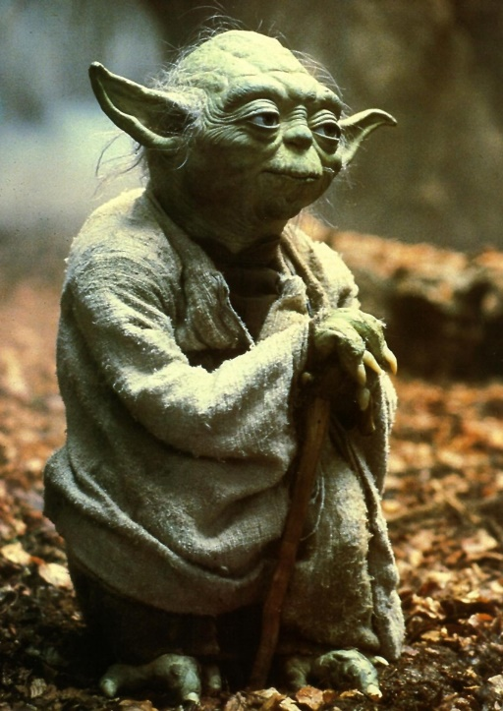
MATTHEW 3:1-9
eating the whole insect. In the light of this it is not incredible that the food of John the Baptist should have been ‘locusts and wild honey.’”
Food ~ KJV, meat
A porterhouse
… it is not.

Slide 11
MATTHEW 3:1-9

Slide 12
MATTHEW 3:1-9
Worthy ~ NIV, NASB – in keeping with; KJV – meet
axios ~ of equal weight
Repentance ~ metanoia – meta (to change) + nous (mind)

Slide 13
MATTHEW 3:1-9
Repent ~ the 1st word of the Gospel:
Mark 1:14b-15 ~ ^{14b} Now after John was put in prison, Jesus came to Galilee, preaching the gospel of the kingdom of God, ¹⁵ and saying, “The time is fulfilled, and the kingdom of God is at hand. Repent, and believe in the gospel.”
Acts 2:38 ~ Then Peter said to them, “Repent, and let every one of you be baptized in the name of Jesus Christ for the remission of sins; and you shall receive the gift of the Holy Spirit.”

Slide 14
MATTHEW 3:1-9
Repent ~ the 1st word of the Gospel:
Acts 25:19-20 ~ ¹⁹ Therefore, King Agrippa, I was not disobedient to the heavenly vision, ²⁰ but declared first to those in Damascus and in Jerusalem, and throughout all the region of Judea, and then to the Gentiles, that they should repent, turn to God, and do works befitting repentance.
J. Edwin Orr ~ “If the Gospel is the sword of the Lord, the word ‘repent’ is the point of that sword.”

Slide 15
MATTHEW 3:1-9

