Slide 1
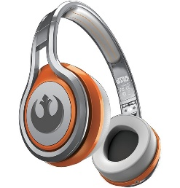
MATTHEW 2:16-23
A free CD of this message will be available following the service
IT WILL ALSO be available LATER THIS WEEK
VIA cALVARYOKC.COM

Slide 2
MATTHEW 2:16-23
Matt. 10:28 ~ And do not fear those who kill the body but cannot kill the soul. But rather fear Him who is able to destroy both soul and body in hell.

Slide 3
MATTHEW 2:16-23
FOUR “CONTRADICTORY” PROPHECIES
v. 6 ~ Mic. 5:2
v. 15 ~ Hos. 11:1
v. 18 ~ Jer. 31:15
Nazareth
v. 23 ~ Is. 53:2-3
Ramah
Egypt
Bethlehem

Slide 4
MATTHEW 2:16-23
2nd Coming
1st Coming
Church Age Valley
Old Testament Valley

Slide 5
MATTHEW 2:16-23

Slide 6
MATTHEW 2:16-23
Was deceived ~ KJV, was mocked

Slide 7
MATTHEW 2:16-23

Slide 8
MATTHEW 2:16-23
hus
Augustus ~ It's better to be Herod's than his
sow
huios
son

Slide 9
MATTHEW 2:16-23

Slide 10
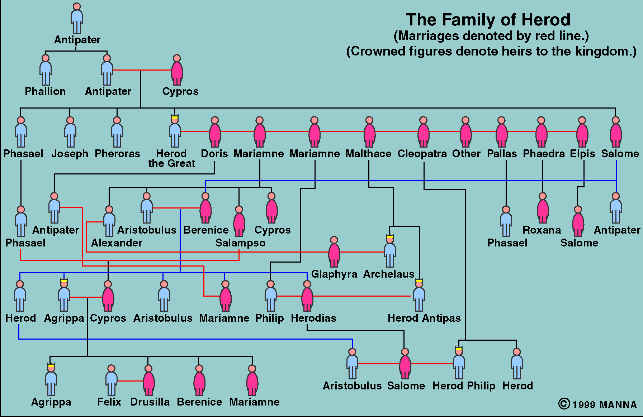
MATTHEW 2:16-23

Slide 11
MATTHEW 2:16-23

Slide 12
MATTHEW 2:16-23
Jer. 31:16 ~ Thus says the Lord:
"Refrain your voice from weeping,
And your eyes from tears;
For your work shall be rewarded, says the Lord,
And they shall come back from the land of the enemy.
Matt. 10:34 ~ Do not think that I came to bring peace on earth. I did not come to bring peace but a sword.

Slide 13
MATTHEW 2:16-23
Herod the Great
Archelaus
Herod Antipas
Herod Philip
Decapolis

Slide 14
MATTHEW 2:16-23

Slide 15
MATTHEW 2:16-23
John 6:66-68 ~ ⁶⁶ From that time many of His disciples went back and walked with Him no more. ⁶⁷ Then Jesus said to the twelve, “Do you also want to go away?”
⁶⁸ But Simon Peter answered Him, “Lord, to whom shall we go? You have the words of eternal life.

Slide 16
MATTHEW 2:16-23
Luke 18:29-30 ~ ²⁹ So He said to them, "Assuredly, I say to you, there is no one who has left house or parents or brothers or wife or children, for the sake of the kingdom of God, ³⁰ who shall not receive many times more in this present time, and in the age to come eternal life."
John 12:24 ~ Most assuredly, I say to you, unless a grain of wheat falls into the ground and dies, it remains alone; but if it dies, it produces much grain.

Slide 17
MATTHEW 2:16-23

Slide 18
MATTHEW 2:16-23
He would be betrayed by a friend
Ps. 41:9
He would be betrayed for 30 pieces of silver
Ps. 41:9
Money would be used to buy a Potters’ Field
Zech. 11:13
He would be crucified
Ps. 22:16
He would be spat upon
Is. 50:6

Slide 19
MATTHEW 2:16-23
He would be mocked
Ps. 22:7-8
He would be pierced
Zech. 12:10
He would died among sinners
Is. 53:12
He would be buried in a rich man’s tomb
Is. 53:9
He would raise after 3 days
Jonah 1:17; Matt. 12:40

Slide 20
MATTHEW 2:16-23
He would ascend to the right hand of the Father
Ps. 110:1

Slide 21
MATTHEW 2:16-23
2 Pet. 1:19-21 ~ ¹⁹ And so we have the prophetic word confirmed, which you do well to heed as a light that shines in a dark place, until the day dawns and the morning star rises in your hearts; ²⁰ knowing this first, that no prophecy of Scripture is of any private interpretation, ²¹ for prophecy never came by the will of man, but holy men of God spoke as they were moved by the Holy Spirit.

Slide 22
MATTHEW 2:16-23
For every passage of Scripture that talks of His 1st Coming, there are 8 that deal with His 2nd Coming
23 of the 27 New Testament books speak of the Lord’s return

Slide 23
MATTHEW 2:16-23
Sanctified walk
1 John 3:2-3 ~ ² Beloved, now we are children of God; and it has not yet been revealed what we shall be, but we know that when He is revealed, we shall be like Him, for we shall see Him as He is. ³ And everyone who has this hope in Him purifies himself, just as He is pure.

Slide 24
MATTHEW 2:16-23
Encourage others
Heb. 10:24-25 ~ ²⁴ And let us consider one another in order to stir up love and good works, ²⁵ not forsaking the assembling of ourselves together, as is the manner of some, but exhorting one another, and so much the more as you see the Day approaching.

Slide 25
MATTHEW 2:16-23
Burden for the lost
2 Pet. 3:9 ~ The Lord is not slack concerning His promise, as some count slackness, but is longsuffering toward us, not willing that any should perish but that all should come to repentance.

Slide 26
MATTHEW 2:16-23

