Slide 1
MATTHEW 1:1-17
A free CD of this message will be available following the service
IT WILL ALSO be available LATER THIS WEEK
VIA cALVARYOKC.COM

Slide 2
MATTHEW 1:1-17
Matthew (AD 55-65) ~ King
Mark (AD 45-55) ~ Servant
“Synoptic Gospels”
Luke (AD 60-65) ~ Man
to view together
John (AD 90-95) ~ God
AD 50
AD 60
AD 70
AD 80
AD 90

Slide 3
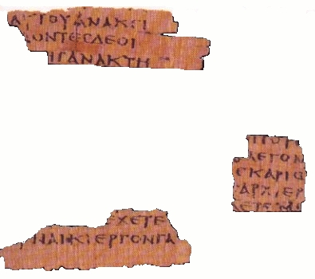
MATTHEW 1:1-17
^{P}64, or “Magdalen Papyrus” dated by some to mid-first century

Slide 4
MATTHEW 1:1-17

Slide 5
MATTHEW 1:1-17
Matthew ~ gift of Yahweh

Slide 6
MATTHEW 1:1-17

Slide 7
MATTHEW 1:1-17
Two Genealogies:
Matt. 1:1-17
Luke 3:23-38
From Abraham to Jesus
From Jesus backwards to Adam
Both are the same from Abraham to David
Follows Solomon's lineage (through Joseph)
Follows Nathan's lineage (through Mary)

Slide 8
MATTHEW 1:1-17

Slide 9
MATTHEW 1:1-17
Notable mentions in Jesus' Genealogy:
v. 3) Tamar, a Canaanite
v. 4) Rahab, a harlot
v. 5) Ruth, a Moabitess
Deut. 23:3 ~ An Ammonite or Moabite shall not enter the assembly of the Lord; even to the tenth generation, none of his descendants shall enter the assembly of the Lord forever,
v. 6) Bathsheba ~ an adulteress

Slide 10
MATTHEW 1:1-17

Slide 11
MATTHEW 1:1-17
2 Tim. 3:16-17 ~ ¹⁶ All Scripture is given by inspiration of God, and is profitable for doctrine, for reproof, for correction, for instruction in righteousness, ¹⁷ that the man of God may be complete, thoroughly equipped for every good work.

Slide 12
MATTHEW 1:1-17

Slide 13
MATTHEW 1:1-17
Of whom ~ feminine form of the reflexive pronoun
In other words … of Mary was born Jesus

Slide 14
MATTHEW 1:1-17

Slide 15
MATTHEW 1:1-17
Rom. 8:1 ~ There is therefore now no condemnation to those who are in Christ Jesus…
2 Cor. 5:17 ~ Therefore, if anyone is in Christ, he is a new creation; old things have passed away; behold, all things have become new.

Slide 16
MATTHEW 1:1-17
Gal 4:4 ~ …when the fullness of time had come, God sent forth His Son, born of a woman, born under the Law.
Pax Romana
System of Roads
Lingua Franca
LXX (Greek translation of the OT)
Political situation
Moral and Religious situation

Slide 17
MATTHEW 1:1-17
Horace – d. 8 BC ~ "Our fathers, worse in their time that our grandsires,
Begot us a still more degenerate race;
And soon will a worse brood
Than we are succeed us."

Slide 18
MATTHEW 1:1-17

