Slide 1


A CD of this message will be available (free of charge) immediately following today's message
15:42-
16:20
This message will be available via podcast later this week at calvaryokc.com

Slide 2

15:42-16:20
Feast of Firstfruits:
1st day following the 1st Sabbath following Passover
Passover
Firstfruits
Friday
Saturday
Sunday
Crucifixion
Resurrection

Slide 3

15:42-16:20

Slide 4
15:42-16:20
Alarmed ~ ekthambeō – KJV, affrighted
John Singleton Copley (3x High Chancellor of England) ~ "I know pretty well what evidence is, and I tell you, such evidence as that for the resurrection has never broken
down yet."

Slide 5
15:42-16:20

Slide 6
15:42-16:20
Job 19:25-27 ~ ²⁵ For I know that my Redeemer lives,
And He shall stand at last on the earth;
²⁶ And after my skin is destroyed, this I know,
That in my flesh I shall see God,
²⁷ Whom I shall see for myself,
And my eyes shall behold, and not another.
How my heart yearns
within me!

Slide 7
15:42-16:20

Slide 8
15:42-16:20
Mark 16:9-20:
NASB ~ "Later mss add vv 9–20"
NIV ~ "The earliest manu-scripts and other ancient witnesses do not have Mark 16:9-20"

Slide 9
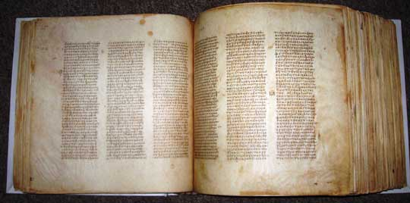
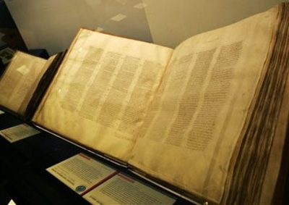
15:42-16:20
Mark 16:9-20:
Both contain spaces of about 12 verses long
Codex Vaticanus
AD 325-350
Codex Sinaticus
AD 330-360

Slide 10
15:42-16:20
Vv. 9-20 quoted by Irenaeus (fl. c. AD 175-195), Tatian (c. AD 120-AD 180), Justin Martyr (AD 100-c. AD 165) and Hippolytus (c. AD 160-AD 236)

Slide 11
15:42-16:20
NASB: A few late mss: "And they promptly reported all these instructions to Peter and his companions. And after that, Jesus Himself sent out through them from east to west the sacred and imperishable proclamation of eternal salvation."

Slide 12
15:42-16:20

Slide 13
15:42-16:20
NASB ~ followed; KJV ~ fol-lowing (present participle)

Slide 14
15:42-16:20

